Slide 1
Culture Shift
Liberal Attitude Change in the Post-Industrial West

Slide 2
Value Change in Modern Society
How has public opinion in major western countries changed over time – especially in the post-industrial period?
Are there major differences between countries?
Is this change cultural and independent of techno-economic shifts?
If opinions changed, when and why did they change
What do changes in public opinion tell us about wider social and political transformations

Slide 3
Survey Techniques
Based on the new techniques of opinion surveys
Surveys go back to 1910s and 30s in USA, But:
Only since late 1960s in US has there been a continuous survey (General Social Survey)
Euro-barometer surveys since 1970s provide cross-country comparisons
In Britain, intermittent surveys since 60s, but BSA since 1983
Need to ask whether questions are the same over time, and across country
Major pre-1970 trends missed in many cases

Slide 4
Changes in Public Opinion in USA
Cultural attitudes become more liberal from the 1960s onward
  Race
  Ethnicity
  Religion
  Sexual mores
  Gender roles
Economic Attitudes became more liberal until the 1970s, then became more conservative

Slide 5
Post-War Attitude Changes
In 1944, 52 percent of whites endorsed the idea that "white people should have the first chance at any kind of job," by 1972, just 3 percent did
White approval for laws against inter-racial marriage fell from 60 percent in 1963 to 38 percent in 1972 to 26 percent in 1984

Slide 6
Attitude Liberalisation, USA

Slide 7
Attitude Liberalisation, USA…

Slide 8
Attitude Change, 1965-73
Jennings & Niemi find that high school seniors more liberal than their parents in both 1965 and 1973, BUT
Difference between parents and children is wider in 1973
Big part of the difference comes from the fact that children in 1973 were more likely to be considering attending university

Slide 10
Changes in Public Opinion: Europe
Similar changes in attitude took place in Europe among the 'baby boom' and subsequent generations
Cultural attitudes more liberal: divorce, gender roles, homosexuality, race, religion
Rise of a 'postmaterialist' orientation among younger and better educated generations (cohorts)

Slide 11
Changing Cultural Attitudes: Europe
& the USA

Slide 12
Social Changes, Europe

Slide 13
The Rise of 'Postmaterialism'
Ronald Inglehart analysed cross-national survey evidence, largely from Eurobarometer post-1970
Claims that answers to questions in the period since 1970 show growth in certain kinds of beliefs, labelled 'postmaterialist'
Found that people who answered certain questions the same way also answered other questions the same way. Clustered into 'materialists' and 'postmaterialists'
Postmaterialists tend to be liberal on cultural issues and of higher status, and are the main support base for green parties
Postmaterialism stronger in Europe than in the United States in the past 2 decades

Slide 14
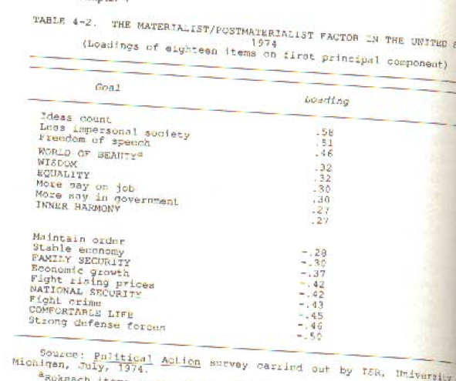
What is Postmaterialism?
Postmaterialism
Materialism

Slide 15
Is 'Postmaterialism' an Accurate Term?
Many of the questions which cluster together (ie. Freedom of speech, equality) are about liberalism and egalitarianism
Religious and nationalistic people could be counted as 'postmaterialist'
So perhaps we're better served by speaking about the rise of post-1960s cultural liberalism

Slide 16
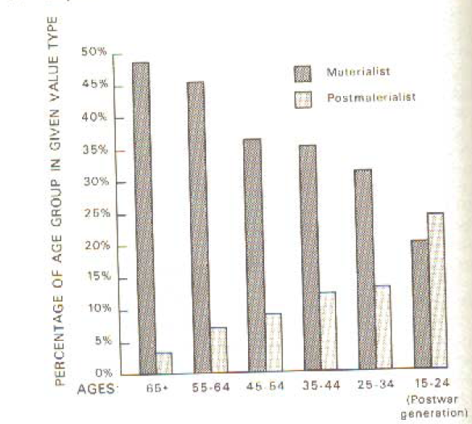
The Rise of Postmaterialist Attitudes?

Slide 17
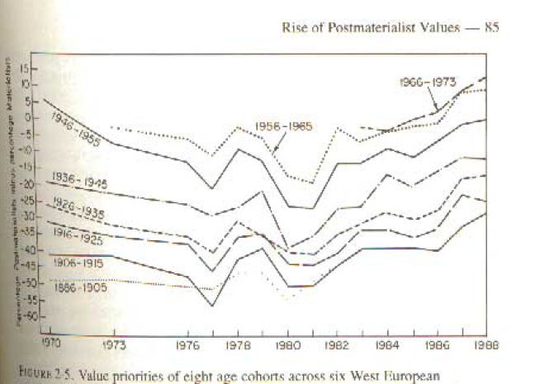
Similar Generational Patterns Across European Nations

Slide 18
Why the Change of Attitudes?
Attitude changes may seem obvious to us today, but there was no obvious reason for things to change
Explanations:
  Rising wealth;
  Rising security through peacetime;
  Education – especially Higher Education;
  Spread of TV media;
  Events

Slide 19
Postwar Affluence
Steady GNP growth, 1945-73
Few wars apart from a few colonial skirmishes. (Vietnam for the US an exception)
Welfare state and prosperity leads to more income equality
TV media growth: in 1960, less than 10% of American homes. By 1970, almost 95% have TV

Slide 20
Postwar Economic Trends

Slide 21
Education Explosion: USA

Slide 22
Growth of Higher Education

Slide 23
The Clinton Generation?: Generational Change, USA

Slide 24
Liberal Institutionalisation
Liberal values may have spread because the most liberal parts of the society expanded
Growth in government professionals (knowledge class) as government spending rises
Growth of universities and professoriate
Growth of mass electronic media

Slide 25
Liberalism in the Mass Media

Slide 26
Liberalism and University Professors

Slide 27
Compositional Nature of Attitude Change
Much attitude change is compositional in nature rather than anybody radically changing their own beliefs
Surveys show that academics were already the most liberal part of American society pre-1960
Growth in the university-educated population, rise in higher-status population, growth of liberal professions
Clear value divide between the elites, higher-status and better-educated population, and the rest

Slide 28
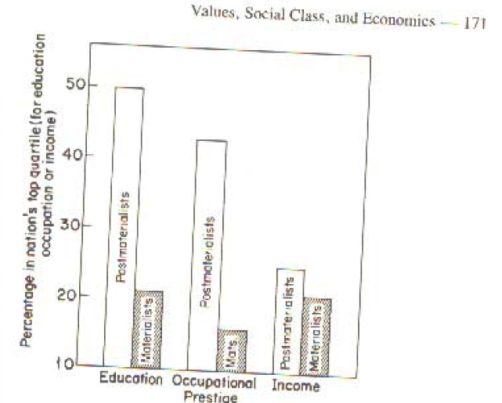
Educated, higher status and wealthier people tend to be postmaterialists

Slide 29
Values: The Education Divide

Slide 30
Values: The Education Divide

Slide 31
Values: The Education Divide

Slide 32
Value Change and Voting
Rise of a ‘postmaterialist strata’ or ‘New Class’ cross-cuts the old left-right division based on class
Liberal-Conservative cultural axis cross-cuts the Left-Right economic axis
In many European countries, the Left no longer gets a majority of the working-class vote and the right no longer can count on the middle class
Rise of Green parties (for middle class postmaterialists) on the one hand, and ethno-nationalist parties on the other
In the US, Shafer & Claggett suggest that the majority of Americans are left-wing economically yet culturally conservative. Two cross-cutting dimensions of opinion

Slide 33
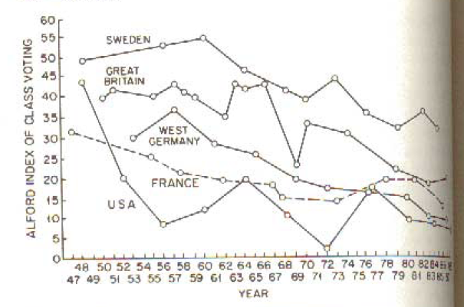
The Decline of Class Voting

Slide 34
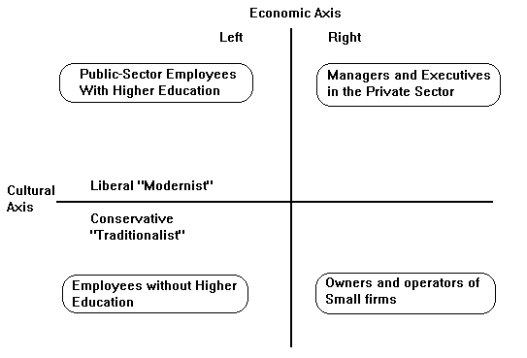
The American Value Structure and the ‘New Class’ (Daniel Bell c. 1980)

Slide 35
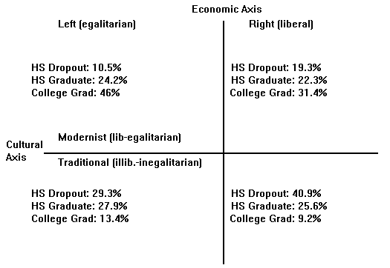
Education and the 4 Value Sectors (US case, c. 1993)

Slide 36
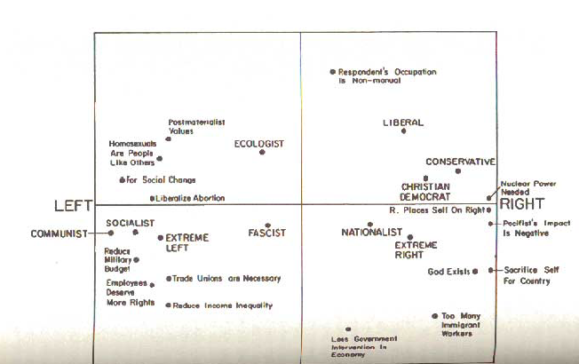
Cross-Cutting Cleavages and the Impact on Attitudes and Party Positions
Economic Left
Economic Right
Postmaterialist
Materialist

Slide 37
Conclusion
There has been substantial liberalisation of cultural attitudes in western countries since the 1960s
Inglehart attributes this to a more affluent and peaceful society which satisfies material needs so people can pursue postmaterial ones
Others suggest that the change has more to do with the transmission of liberal values from liberal cultural elites to upwardly mobile strata through education and TV
The new cultural values have led to a major realignment in voting, resulting in cross-cutting economic and cultural electoral cleavages

