Slide 1
The Politics of Liberalisation
A history of developments in Europe and the Islamic World

Slide 2
Liberalism in Practice
We've looked at the democratic revolutions in America and France (6 & 7). But not the end of the story
Also the political philosophy of liberals like Locke, Rousseau and Mill (8)
BUT - How was liberalism implemented, deepened, extended?
Why liberalism in some societies and not others?
It is easy for autocratic societies to democratise, but how to liberalise?

Slide 3
Varieties of Liberalisation
Individual rights against the State
Checks on executive power of the state
Checks on influence of religion on individuals or the state

Slide 4
Liberalism and Democracy
'Liberal democracy' often used, implying interchangeable nature of liberalism and democracy
Zakaria and Snyder allege that most new democracies are not liberal, and that democratisation can often lead to restrictions on the individual liberties of some people

Slide 5
Democracy
Free, fair, periodic elections
Adult population can vote
Freedom for dissent and opposition
Candidates sometimes lose elections and leave office
Constitutional limits on terms of office
Key is popular power and majority rule

Slide 6
Liberalism
Free Press
Constitutional liberties v. state, church
Freedom from arbitrary arrest, freedom to assemble
Enforced non-discrimination
Other human rights
Political pluralism/Checks on executive branch
Individual liberty can clash with majority rule , i.e. 'tyranny of the majority'

Slide 7
Do Liberalism and Democracy Need Each Other?
Democracy needs to have liberty for opposition parties to assemble, organise and contest an election; Voters need to be at liberty to make their choice; Press at liberty to get messages out
Liberalism does not require democracy, but merely contending power centres

Slide 8
Illiberal Democracy
Most democratising countries do better on political than civil liberty, 1990s
Growing number of illiberal democracies
Many mass plebiscites, few impartial judges
Many developing nations where there is freedom do not necessarily have the most democracy

Slide 9
Illiberal Democracy…
What if the Iraqis elect illiberal Islamists?
Snyder and Zakaria contend that relatively liberal non-democracies like 18th c. Britain, Hong Kong or Antigua are preferable to illiberal democracies like Haiti
They argue that the institutions of liberalism have their own separate trajectory of development from that of mass democracy

Slide 10
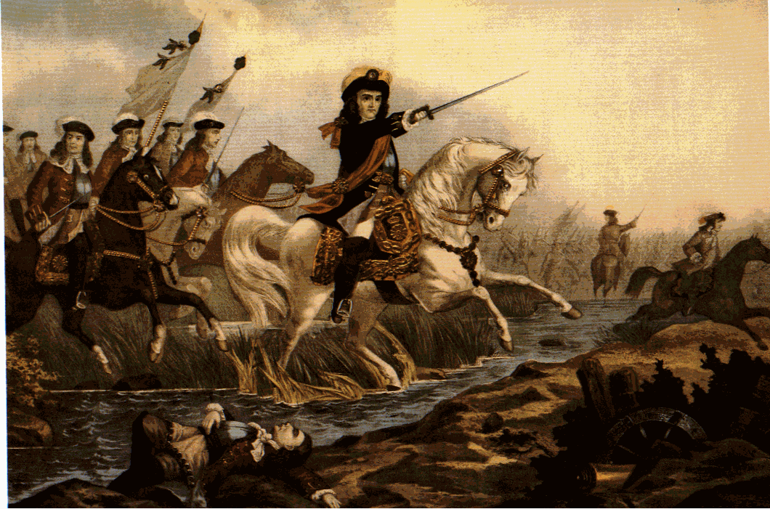
Liberalism in pre-Democratic England
Tradition of Magna Carta 1215, 12th c. Common Law, English Civil War 1642-51
Glorious Revolution and subsequent 'age of oligarchy', 1688
These were liberal, not democratic events
Empowered a tiny Whig elite of 5000 who owned 3/4 of agricultural land
But Whigs had a liberal ideology and advanced free speech and abolished press censorship in 1695
Seen as a heritage of ancient liberties v. Crown

Slide 11
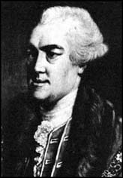
18th c. Reforms in Britain
18th century key for advancement of civil rights
Habeas Corpus and forward to Catholic Emancipation (1829), battle for freedom of press in early 19th c.
Often the work of courts against government
John Wilkes' rights after his newspaper criticised a King's speech (1763) were defended by the Lord Chief Justice who interpreted government actions in the light of common law and parliamentary privilege

Slide 12
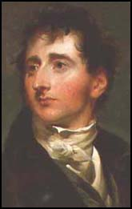
18th c. Reforms in Britain
In parliament led by radicals like Sir Francis Burdett and Jospeph Hume - supported by middle class artisans and shopkeepers in boroughs like Westminster who resented aristocratic privileges
Individual liberties had backing of non-voting middle class, an important popular constituency

Slide 13
18th & 19th c. Reforms in Britain
Still, subject to reversals: Pitt the Elder had extended Habeas Corpus (1758), whereas Pitt the Younger suspends Habeas Corpus during wartime, 1793
Already, appeals to popular sovereignty, even national identity: heritage of individual liberties of 1215-1641-1688
Catholic rights in Ireland (1829) gained through threat of Catholic violence and continual political pressure by O' Connell

Slide 14
English Liberal Exceptionalism?
English liberty becomes part of Whig 'nationalism'. Part of the English national identity and then the American. Gains force from this.
Space for liberty opened up by competition between King and parliament (nobility), as in much of western Europe
But unlike Germany or France, an active bourgeoisie allowed King to finance activities through borrowing rather than coercive rural taxation
Spawns English liberal philosophy of Locke, Mill, etc

Slide 15
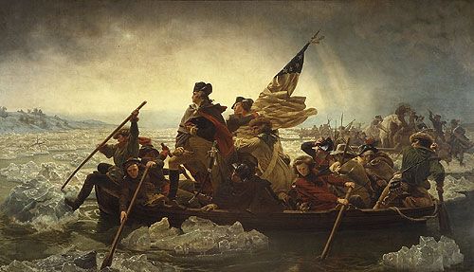
The American Revolution
American Revolution: rights of 'free white persons' to vote, 1790
Already built on the world's most liberal political culture
Separation of church and state
Liberal checks and balances to guard against 'tyranny of the majority' and of the executive
Strong judiciary, constitution, bill of rights

Slide 16
American liberal institutions
US well-served by many associations and institutions like the New England town meeting (Tocqueville)
Sectarian diversity promotes church disestablishment and desire for liberty
Eases congregational-style religion and mitigates conflict with church
Already substrate of smallholders, liberal institutions
Even in Canada, counter-revolutionaries are unthinkingly 'liberal'

Slide 17
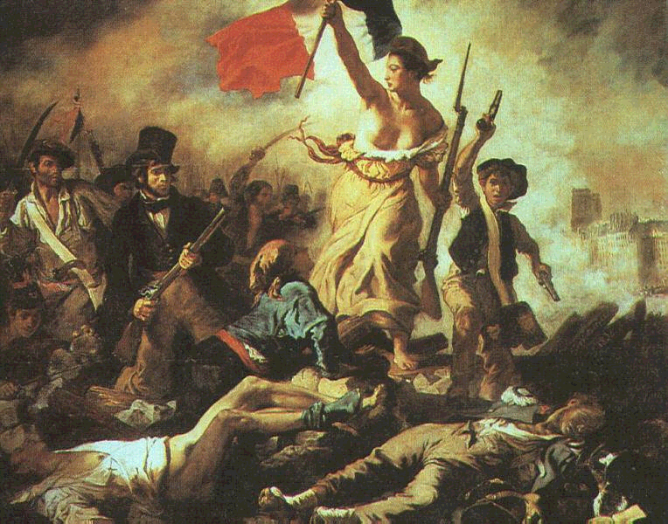
French Revolution
Declaration of the Rights of Man
Against tyranny, but liberal institutions weak due to power of Bourbon absolutism:
  electoral machinery
  courts
  Free press
  Historic parliament
  Bureaucracy not accountable to legislature
  Tradition of taxation of peasants rather than capital markets, as in Britain

Slide 18
Variations in Europe
In France, few checks and balances on the executive, hence relapse into monarchy, 1815, 1849
In Prussia, as in France, absolutist state had crushed older representative parliaments of the gentry and towns
Only in a few places, notably England and Sweden, did the older representative institutions survive
National identity is also affected by survival/non-survival of these traditions

Slide 19
Democratisation: Extension of the Franchise
Proceeds in fits and starts
Franchise narrows during 18th c.
  1715 – 24% of male adults could vote
  1831 – just 14 %
  1832 Reform Act opens it up (but only 18% of males could afford the vote)
  1867, 1884-5
  1919/28: women

Slide 20
Why Extend the Franchise?
Why would privileged segments of society extend the franchise?
Enlightenment ideology, 18th c
Political party competition
Threat of revolution:
  Rioting preceded extension of 1829, 1832, 1867, 1884-5 in Britain; 1848 spawned reform in France and German states
  Extension completed in Germany and Sweden after unrest of WWI

Slide 21
Democratisation is Not Liberalisation
Democracy is favoured by the majority through popular pressure
Who guards against 'tyranny of the majority'?
Sometimes the threat of violence by a minority or their electoral influence (i.e. Irish Catholics)
Also the role of liberal or egalitarian ideology (we shouldn't underestimate this)
Snyder stresses role of established elite: can they adapt to modernity and find a new role in a liberal system?

Slide 22
Religious Toleration
Second aspect of liberalism is in realm of religion
Toleration Act 1689 - tolerates worship of dissenters from the Church of England. Still a long way to go in implementing this - especially in Ireland (both dissenters and Catholics)
Response to challenge to established church is often to accuse dissenters of 'heresy'
The success of the Reformation was aided by kings keen to break from power of Rome

Slide 23
Religious Toleration under Protestantism?
Post-Reformation, there were groups arguing for toleration. But small and despised, like Anabaptists
Only where geography allowed, could liberal sects thrive (i.e. Pennsylvania, Rhode Island)
Bruce's theory of toleration: Catholic establishment more secure because it rests on the church. Less secure in Protestant societies where it is anchored only by the bible and interpretive traditions

Slide 24
Religious Toleration under Protestantism?…
Dissenters are not pluralist liberals, but seek to dominate. No pluralists until 19th c
"Most dissent was not liberal until its conservatism failed" - S Bruce
In societies like Scotland, the failure of the main Presbyterian church to control religion leads to acceptance of dissent. Most dissenters are strongly anti-Catholic and many oppose Catholic emancipation
In England, dissenters grew in number and political power and elites needed their support to maintain united 'Protestant' front against Catholics

Slide 25
The Growth of Toleration in Europe
In Holland, Calvinist elite moderates its stand in the 17th c, partly due to commercial expansion and desire for stability
In Scandinavian countries, toleration of religious dissent was done more for ideological reasons - in late 19th or 20th c
Introduced as part of a major constitutional change from absolutist monarchy to parliamentary democracy
In France, the Enlightenment & Revolution helps spread idea of toleration of Jews and Protestants
Anti-slavery sentiment influenced Latin America and even parts of the Islamic world as part of ‘modernising’ Enlightenment reform ideas

Slide 26
The Islamic World
Tradition of Islamic group tolerance, as in Spanish Caliphates (Jews & Christians) or Ottoman millet system
But no tradition of individual liberty vs Caliph/Sultan
Shari'a - body of texts and practices; Fiqh - juristic precedent
These cover a wider range of daily practices than Christianity

Slide 27
Islamic Religious Restrictions
Usury is not permitted, as in Christianity (where restrictions on usury ended earlier)
Restrictions on alcohol, women
Role of religious Qadi courts
Successive empires from medieval times get around the restrictions by corruption. Rulers do as they please and sell religious-bureaucratic offices
But popular legitimacy rests in religion despite compromised clerics. Tapped into by maverick religious figures

Slide 28
Islam and the Enlightenment
In West, dual inheritance from Greco-Roman (secularism) and Judaic sources legitimates aspects of liberalism
In Islamic societies, Greek learning was prized by some, but successfully kept at bay by Islamic scholars and jurists
Need for laws in areas not stipulated by Islamic Laws leads to interpretations and some compromises with modernity

Slide 29
Liberal Reform in the Islamic World
Great deal of change in nineteenth century with Ottoman Tanzimat reforms (1839-76) under Grand Viziers like Resid Pasha
Individual liberty seen as 'modern' and hence desirable by Tanzimat reformers
But tainted by association with European infidels
Reforms threatened established elites - as in Prussia at the time. Thwarted
Followed by Ataturk - yet still limits on civil liberties
Reforms in 20th c: Shah gives women and minorities the vote in Iran, 1963

Slide 30
Liberal Reform in Islam?
Communist movements in some countries are secular. Secular pan-Arab nationalism of Nasser and authoritarian rulers like the Baathists. A break from tradition but not liberal
Iranian Revolution leads to loss of rights, but economic need for women to work and population explosion brings support for female work and family planning in 1988
External forces can prompt liberalisation (EU membership in Turkey?), but can also taint liberalisation as western

Slide 31
Conclusion
Individual liberty against the state or religion
Liberty for minority groups against majorities or the state
How achieved: mix of ideology, power politics and fear of revolt
Does democracy advance or hinder liberty (Madison) ?

Slide 32
Liberalisation: Main Questions
Is liberalisation - especially for small minorities - driven by liberal ideology, power-politics or the threat of revolt?
What are the factors that stifle liberal social and political changes?
Is liberalism in danger in the West from any present or future trend?

