Slide 1
Immigration and the Rise of the Far Right

Slide 2
The Rise of the Far Right in Europe
Trend
Why
Major theories
Legislative and agenda-setting success
Demographic Aspects

Slide 3
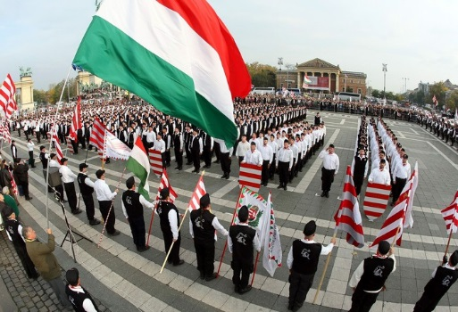
Fascist parties
Earlier era of fascist parties (i.e. Poujadist, NF) seeking return to traditional social structures
Echo in East and S. European far right today
Issues such as role of church, illegitimacy of democracy, wrongs of history/irredentism

Slide 4
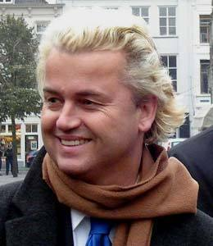
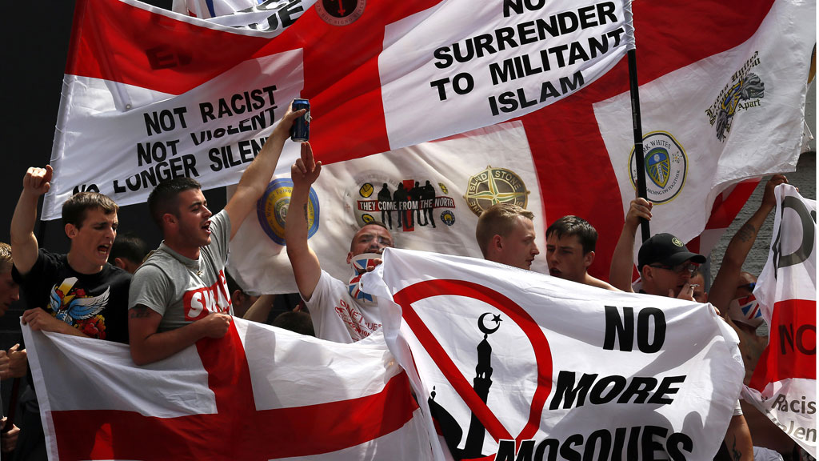
Anti-immigrant Populism
Most W. European parties are populist-democratic not fascist
Animated by immigration and cultural change rather than return to traditional order of authoritarian monarchy and church
May be open to gay leadership (Haider, Fortuyn) and liberal social mores
Liberalism may be symbol of differentiation from immigrants, esp. Muslims (i.e. EDL counter-jihad, Dutch Freedom Party)
May be pro-Israel

Slide 5
Respectability and Fascist roots
Some parties have fascist or street roots (FN, BNP)
Other parties began as low-tax bourgeois parties (UKIP, Swiss People’s Party)
Many voters, especially women, tend not to vote for ‘toxic’ party brands with thuggish or violent baggage
Parties with bourgeois origins more likely to have ‘reputational shield’ (Blinder, Ford 2014) against charges of racism and fascism

Slide 7
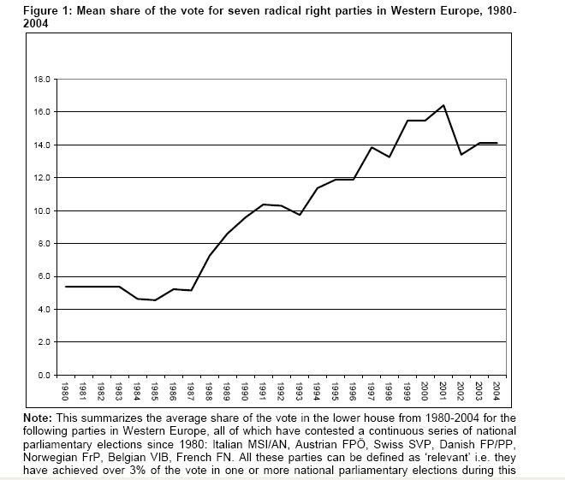

Slide 8
A Rising Force?

Slide 9
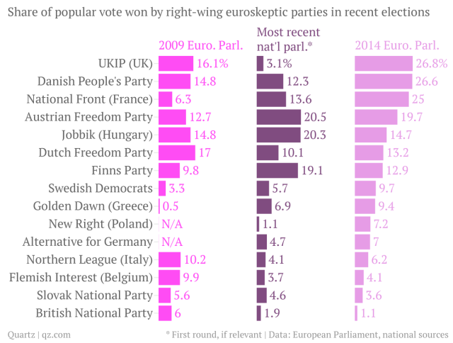

Slide 10
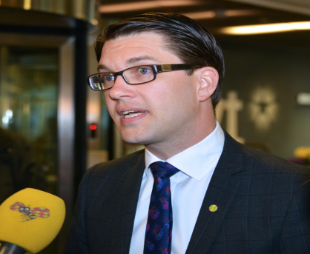
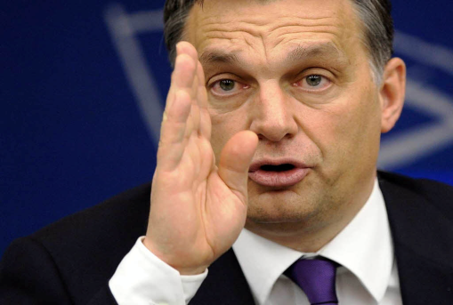
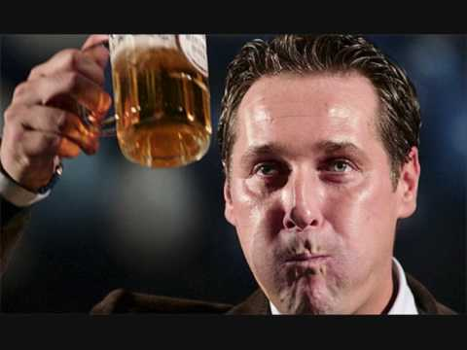
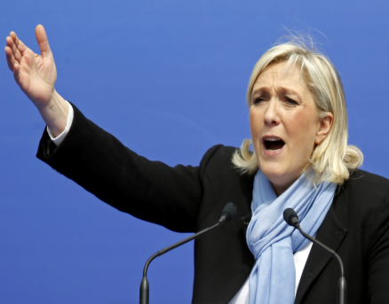
The story so far (Nov 2015)…
 | Last election* | Current average | Change
Austria | 24 | 32 | +8
Finland | 17.6 | 11 | -6.6
France (Le Pen) | 17.9 | 29 | +11.1
Hungary (Orban) | 28 | 43 | +15
Italy | 4.0 | 14 | +10
Netherlands | 10.1 | 35 | +25
Sweden | 12.9 | 23 | +10.1
Switzerland | 26.6 (2011) | 29.4 | +2.8
United Kingdom | 12.7 | 13 | +0.3

Slide 11
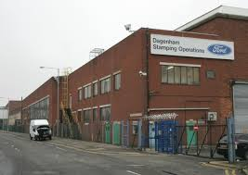
Economic Explanations
Decline of manufacturing and agricultural employment, deskilling, deindustrialisation, globalisation and outsourcing
Rise of tertiary sector:
  Growth of tertiary industries: transport, utilities;
  Quaternary industries: trade, finance and capital exchange;
  Quinary industries: health, education, research, public administration, and leisure

Slide 12
Public Sector Expansion

Slide 13
The Rise of Tertiary Sectors..

Slide 14
Changing Occupations

Slide 15
Support Base
Petit Bourgeoisie – traditionally well-represented in fascist parties
Industrial Working Class – also represented in fascist vote (note Adorno’s ‘working-class authoritarianism’) but not always if anti-clerical
Rural traditionalists – support traditionalist right parties
Rarely the well-educated or modernising strata

Slide 16
Economic Crises
Nazi rise during Depression
Golden Dawn does well during Economic Crisis in Greece
But does economic cycle correlate with rise of far right?

Slide 17
Cultural Explanations
Rise in more liberal attitudes among new generations and the university educated. Bell’s ‘New Class’, Inglehart’s ‘Postmaterialists’
Creates a ‘modern vs traditional’ political cleavage which cuts through Left and Right
‘Traditionalists’ of both left (ie workers) and right (ie petit bourgeois) attracted to extreme right, which fills political void

Slide 18
The Expansion of Education

Slide 19
Mass Attitude Change post-1965

Slide 20
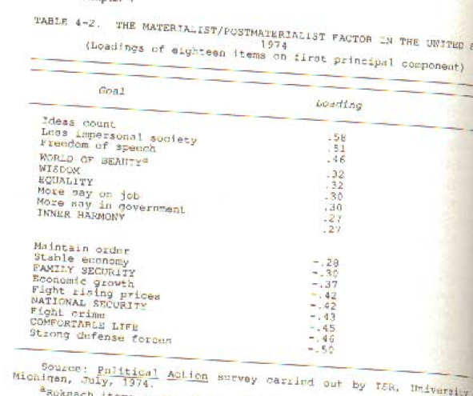
Postmaterialism
Postmaterialism
Materialism

Slide 21
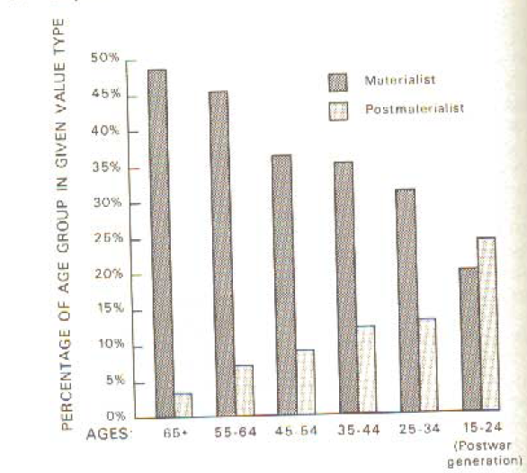
The Rise of Postmaterialist Attitudes?

Slide 22
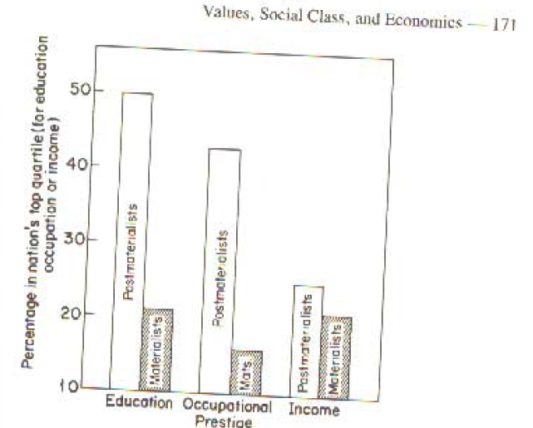
Educated, higher status and wealthier people tend to be postmaterialists

Slide 23
The American Value Structure and the ‘New Class’ (Daniel Bell c. 1980)

Slide 24
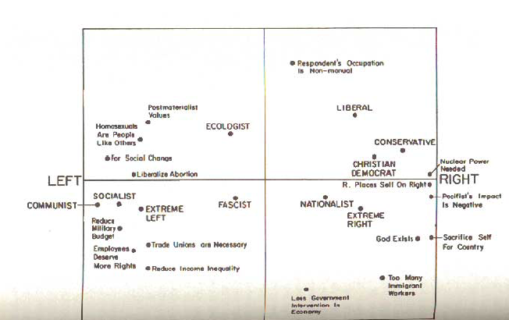
Cross-Cutting Cleavages and the Impact on Attitudes and Party Positions
Economic Left
Economic Right
Postmaterialist
Materialist

Slide 25

The Role of Education - Australia

Slide 26
The Role of Education & Age, Germany

Slide 27
Elite Ideological Changes
Left-wing parties adopt ‘cultural turn’ of the Left
Right-wing parties focus on economic neoliberalism, not cultural traditionalism
New Left: culturally oppressed (ethnic minorities, women, gays) the new object of sympathy/agent of change, not workers
New Right: Thatcher/Reagan neoclassical economic emphasis. Role of business, which tends to be pro-immigration. Neoconservatism in USA, Thatcherism in UK
New moral consensus constrains the Right over immigration (i.e. Powellism)

Slide 28
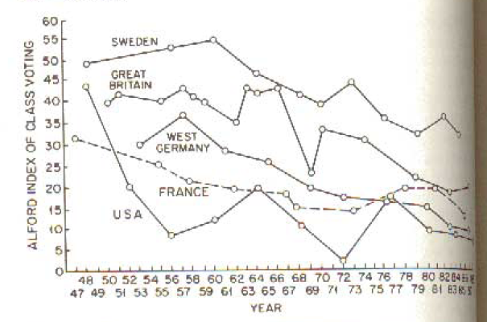
The Decline of Class Voting

Slide 29

The Far Right as a Worker's Party?
Anti-elitist, anti-political class
Claim that elite consensus 'represses' debate on immigration
In virtually no European country does main left-wing party retain majority support among white male workers

Slide 30
Welfare Chauvinism
‘All parties now espouse inegalitarian protectionism of the disenfranchised strata of native populations via outgrouping of ethnic populations and social undesirables condemned under ethnocentric/authoritarian thinking. Welfare chauvinism pace Kitschelt, seems an essential part of the winning formulae.’ (Ivarsflaten, 2002 p4)
If welfare is the issue, why target the white dispossessed?

Slide 31
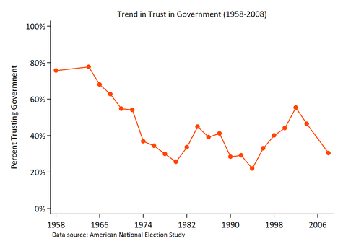
III. Political Explanations

Slide 32
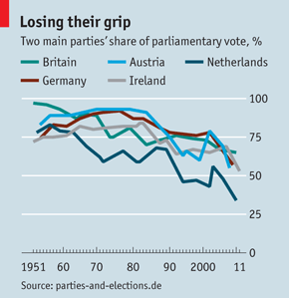
Weaker Parties
Trinity of trade union, religion and party eroding in society
I.e. unravelling of Dutch pillarised party system based on ideology and religion
Less social capital and political participation

Slide 33
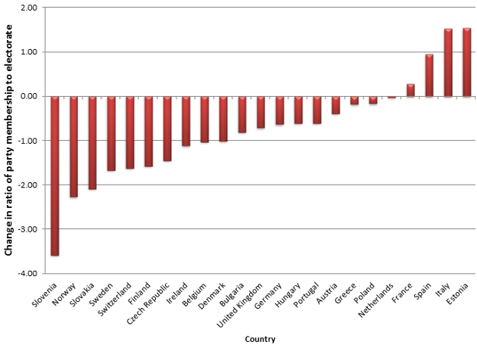
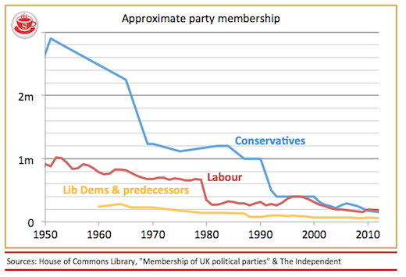
…….
Weaker parties, less connection to society
Younger generations less trusting and participatory?

Slide 34
Political Opportunity Interpretation
‘The New right is the offspring of the post industrialisation of advanced capitalist economies, of changes within the pattern of competition within democratic party systems and of political entrepreneurs finding new electoral niches, they are able to exploit with racist, authoritarian and populist slogans.’ (Kitschelt, 1995 p43)

Slide 35
Consensus View Emerging
Empirical work shows that culture matters more than economics or political alienation in explaining far right support in survey data (Mudde, Lubbers, Ford & Goodwin)
Education often more important than class in correlating with far right support in surveys
Key role of rapid change, dislocation, alienation
Still, one might argue that individuals are displacing concern over economic insecurity, declining social connectedness and political alienation onto immigrants/minorities

Slide 36
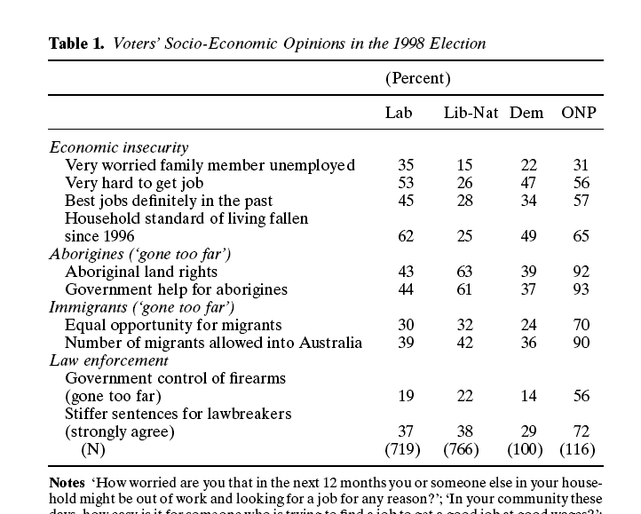

Slide 37
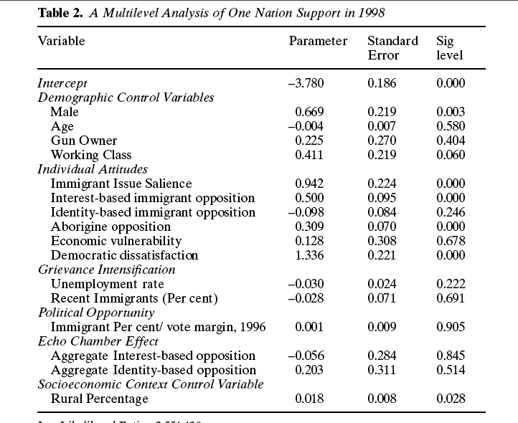

Slide 38

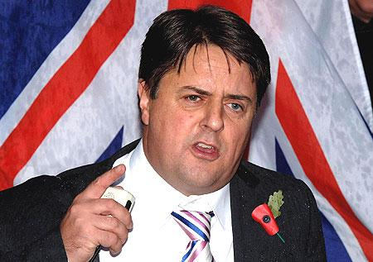
Personality and Fracture
Often formed through splinter/disaffection from a main party
Far Right parties reliant on charismatic leadership
Lack institutional bases at local level
Ideological and personality splits not checked by pragmatism or party discipline
May have allied street movements or splinter groups
Rise and fall pattern in party support over time

Slide 39
Coalition and Absorption
Where accepted into coalition, as in Italy or Austria, has won respectability for far right
Far right aims advanced when in coalition
Decline of multiculturalism, rise of tougher immigration policies (ie Denmark) ascribed to influence of far right (i.e. Brubaker’s work)
Does co-opting the far right strengthen or weaken it?
Far right parties, with narrow issue agenda, at an electoral disadvantage
FPTP hostile to far right parties, with their even vote spreads

Slide 40
Political Demography?
Increase in share of those of ethnic minorities (whether immigrants or natives such as Roma)
Either through immigration, higher birth rates, younger age structures
How strong is the link between ethnic change and perceptions of ethnic change?
Assimilation or war can undercut concerns which give rise to anti-immigration populism (ie Scotland, USA)
Discursive or political culture change can do so as well (ie N America post 1965)
How important is ethnic change versus economic dislocation, political populism, Euroskepticism, traditionalist authoritarianism?

Slide 41
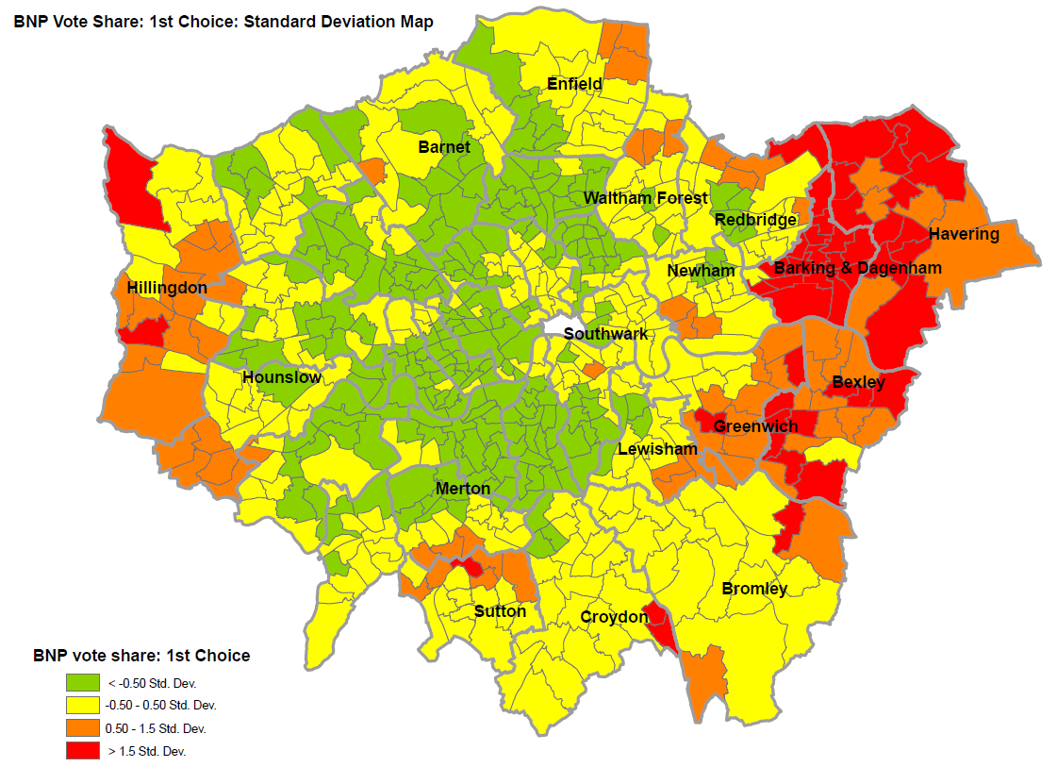
Halo Effect: Ethnic Demography and Geography (2008 BNP vote)

Slide 42
Conclusion
Far Right has trebled since mid-80s in W Europe
Economic, political and cultural explanations
Demography of ethnic change arguably plays an important role
Ethnic geography also important
Far right support falls due to infighting, co-optation, assimilation. Often quite rapid
Far right can shift political cultures and drive policy change in their areas of concern but unlikely to win outright

