Slide 1
Demographic and Democratic Transitions

Slide 2
Democracy
Key question is whether developing countries can become stable liberal democracies
Neoconservative and liberal internationalist views optimistic (i.e. Fukuyama)
Huntington – pessimistic, due to absence of liberal culture in many societies
But might population be part of the equation?

Slide 3
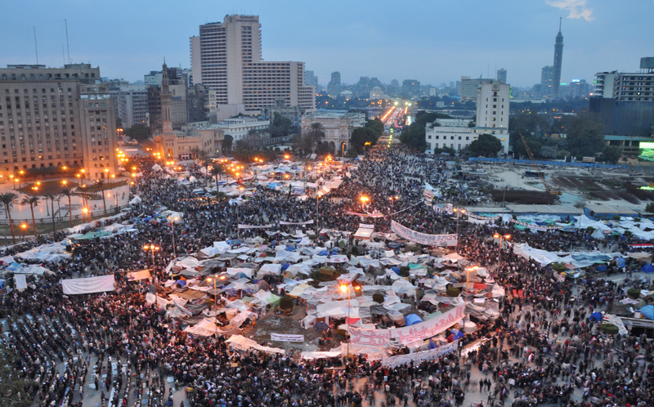
Demography and Democracy: what is the link?

Slide 4
Demographic Transition
Lower death rate, especially among younger people
Reduced population growth
Mature age structure
Less pressure on economy and institutions, at elite and mass levels

Slide 5
Two Aspects
Young men as revolutionary force, can bring democracy
Young men as destabilising force, can prevent liberal democracy

Slide 6

Goldstone on Revolutions
1688, 1789, 1848, 1917
Also pressures in 19th c Ottoman Empire, Japan and China
All preceded by young, growing populations
Peasant uprisings and discontent
Nationalism and democracy initially twinned against the old regime and clerics
But does ‘popular sovereignty’ mean respect for liberalism?

Slide 7
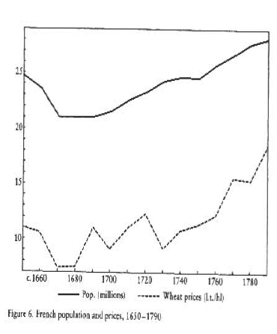
Rising food prices due to population growth
State depends on agricultural taxes
Discontent results

Slide 8
Goldstone on Revolutions
Discontent due to overproduction of elite children for number of elite positions available
Pressure of youth on existing social, economic, political institutions
Some revolutions were democratic (1688, 1789)
Liberal consolidation phase much more difficult, however, ie. France
‘National liberation’ not necessarily liberal

Slide 9
Youth as Revolutionary Force in Europe
‘The explosion of revolutionary, warlike, nationalist, and anti-imperialist (i.e. anti-French) activity toward the end of the eighteenth and in the early nineteenth century received its social fuel from the large youth cohorts of “Europe’s initial population explosion”.’ – Moller on Germany
[T]he emergence of modern nationalism and of imperialistic expansion coincided with– and was indeed a consequence of – the first great increase in population in modern history . . . Now it is Asia, Africa, and South America that are experiencing the population explosion, and it is in these countries that we are witnessing the upsurge of chauvinistic and imperialistic nationalism - Commager
- Also aftermath of baby boom in West: 1960s cultural upheavals

Slide 10
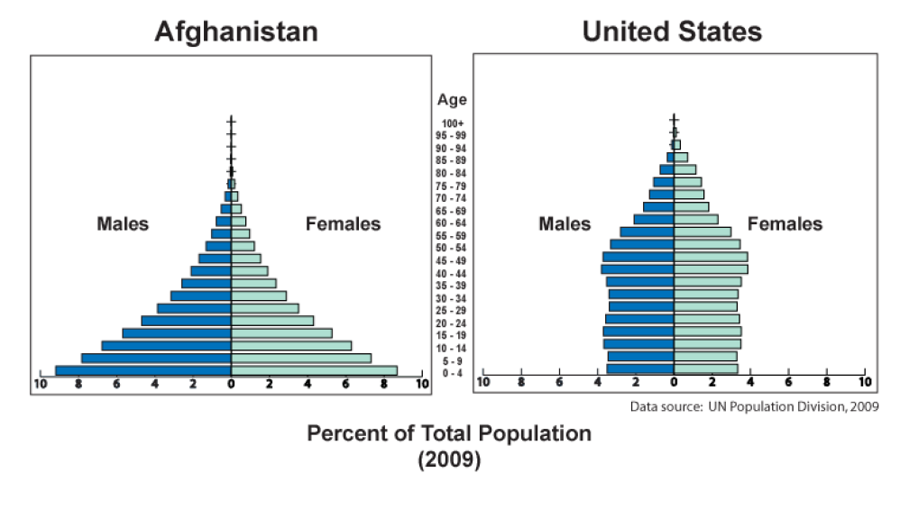
How important is this?

Slide 11
Youth as Destabilising for Democracy
Revolution good for democracy if society is not democratic
But if society is democratic, youth movements may support anti-democratic tendencies
Youth revolts may not support pluralism and messy politics of compromise, i.e. liberalism
May not support judiciary, open society, rights of opponents
Young may be impatient with institutions and procedure
Can limit consolidation of democracy
Can scare established groups into supporting dictatorships or preventing reform

Slide 12
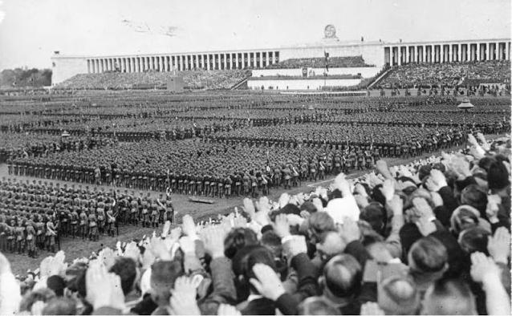
Was Youth a factor in rise of Nazism?
In 1933, the age group from 20–45 was the largest in German history, both in absolute and relative numbers
In 1925, young men between 15 and 29 years of age made up around 20% of the total German adult population (just 14% in France). Shrank to 13.3% in 1973
Millions of recruits to Nazi and Communist street gangs in interwar period

Slide 13
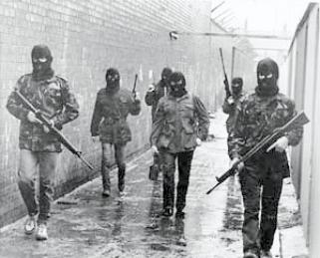

Youth and nationalism?

Slide 14
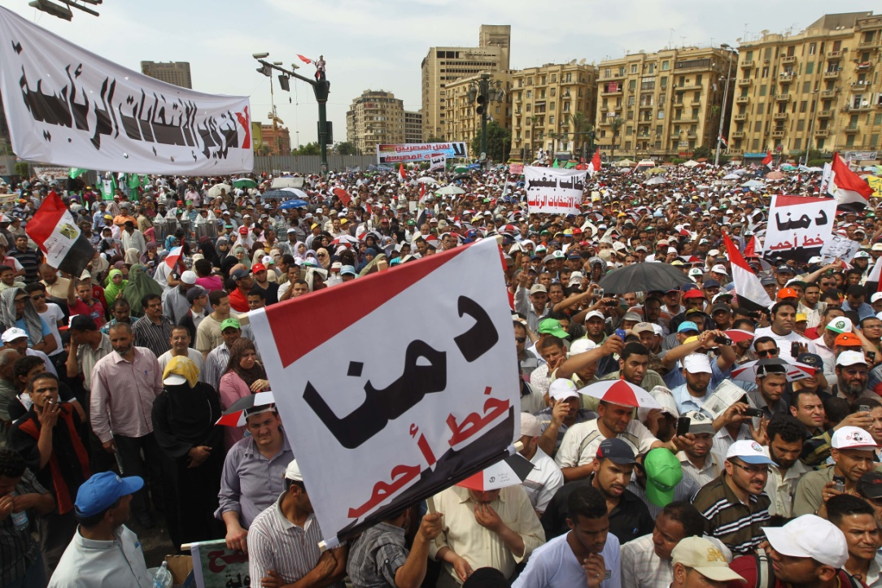
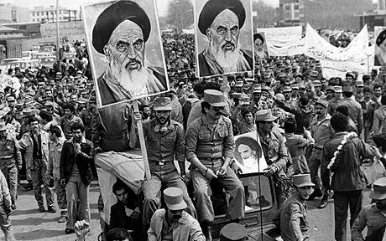
Youth and Islamism?

Slide 15
Demography-Democracy Link
A broad phenomenon encompassing:
Youth and violence
Youth in urban areas, unemployed
Youth and transformative ideologies
Youth and impatience with institutions and procedures
Youth instilling fear into established groups, stalling reforms
2nd and 3rd order effects of demography

Slide 16
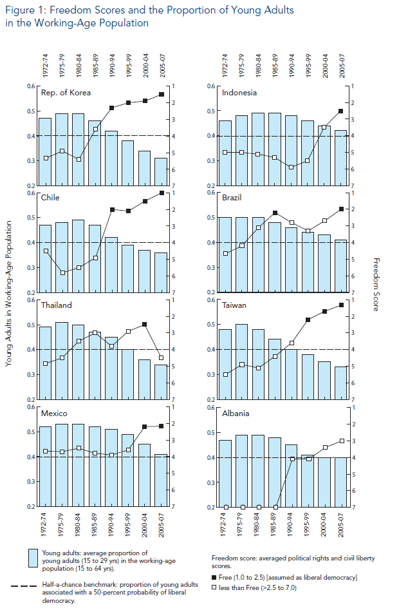

Slide 17
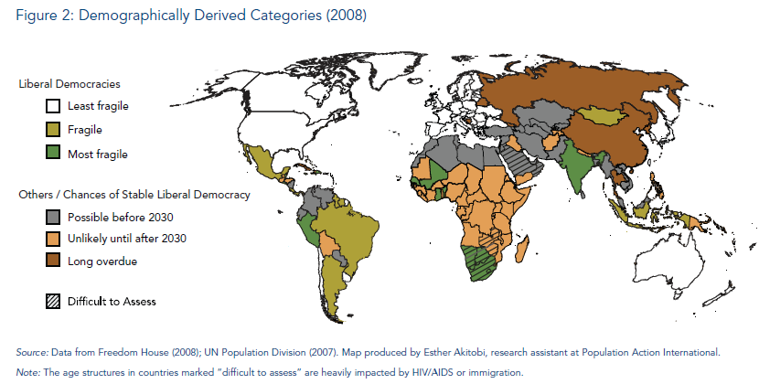

Slide 18
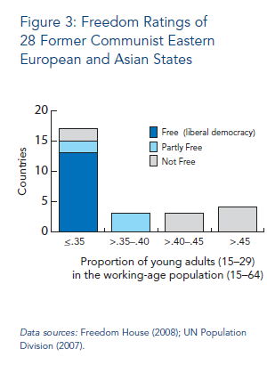

Slide 19
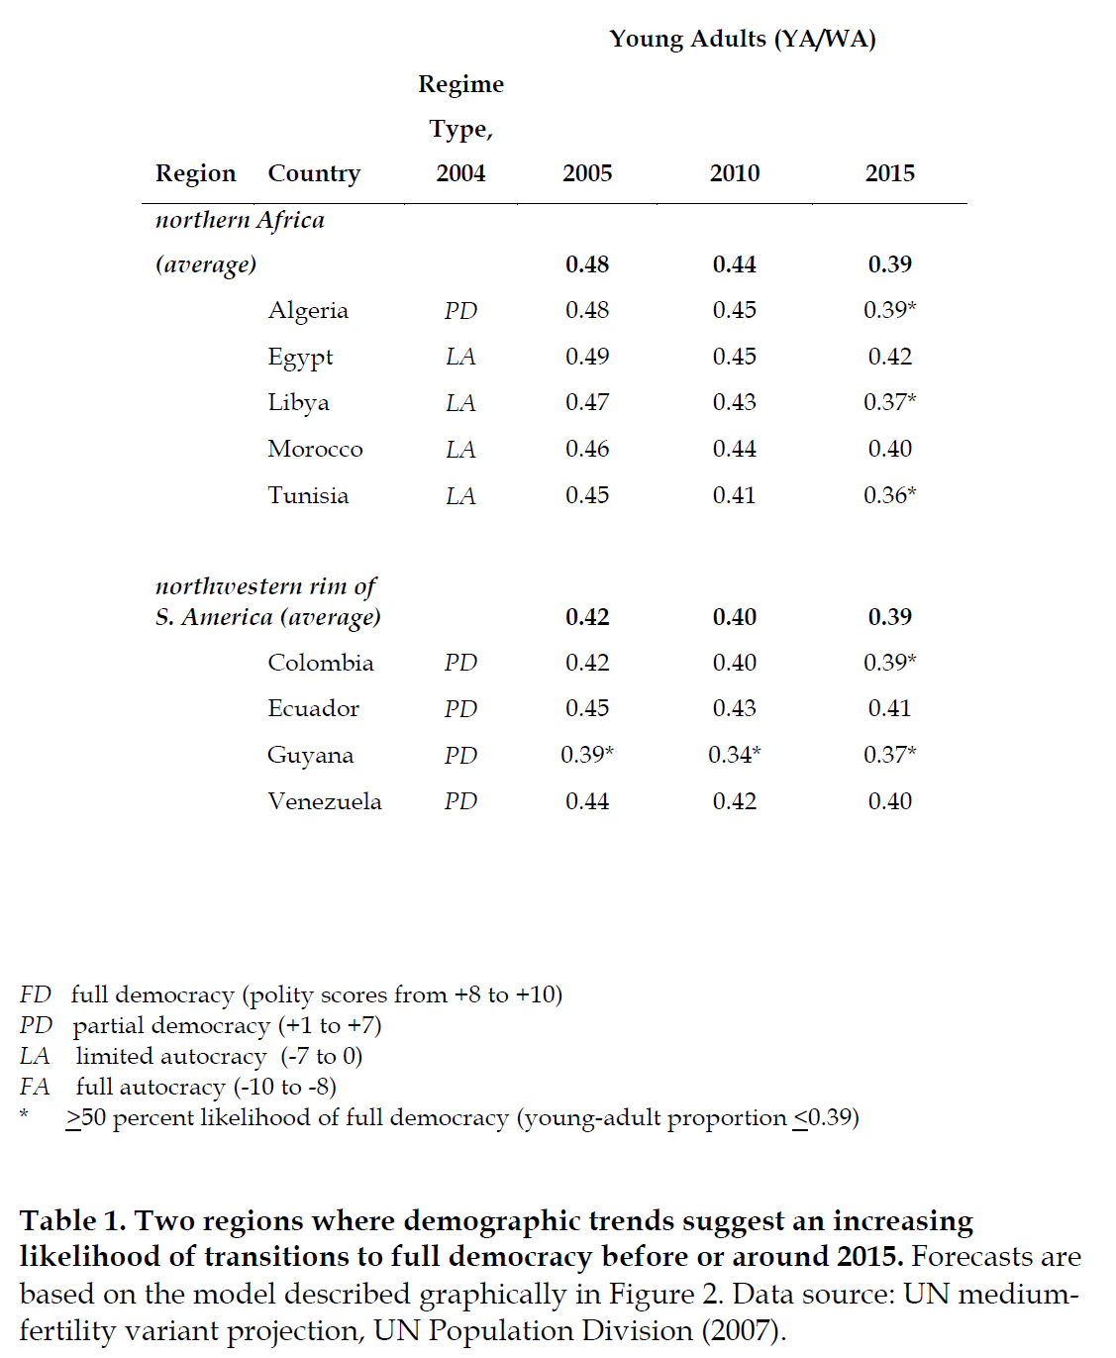
?

Slide 20
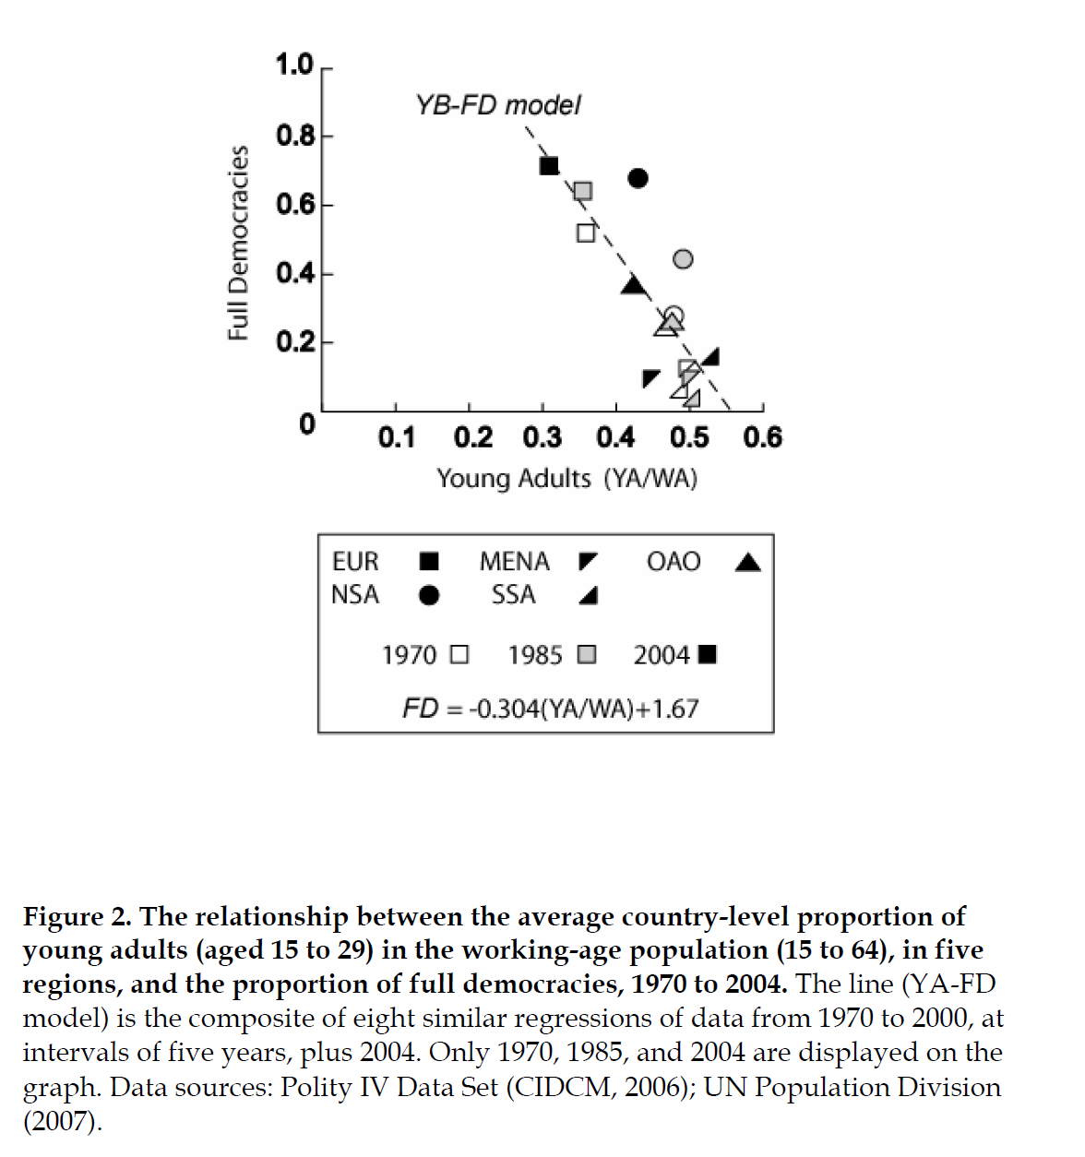

Slide 21
Spurious Link?
Proportion of Youth correlated at over .5 with GDP per capita
Correlated with education, women’s rights, liberalism and economic stability
Does it still matter after we have controlled for all of this?

Slide 22
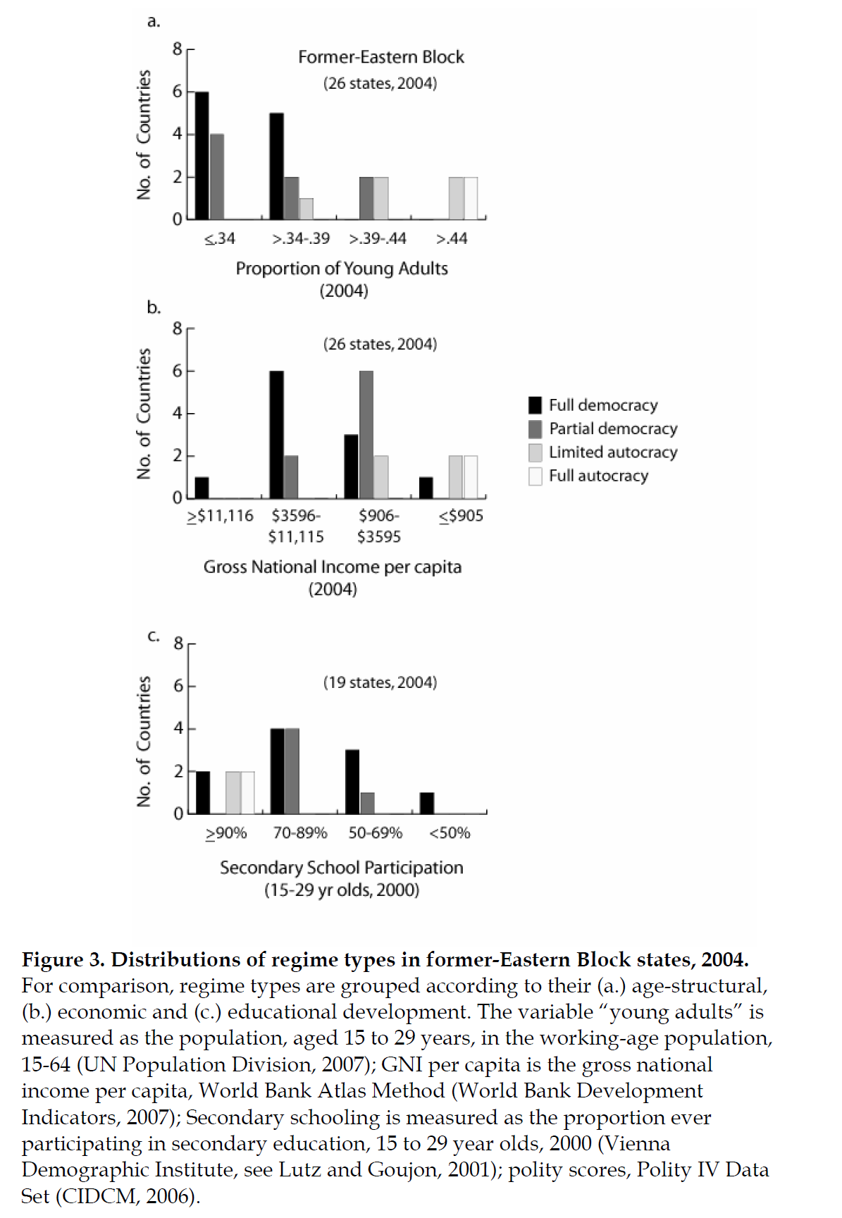

Slide 23
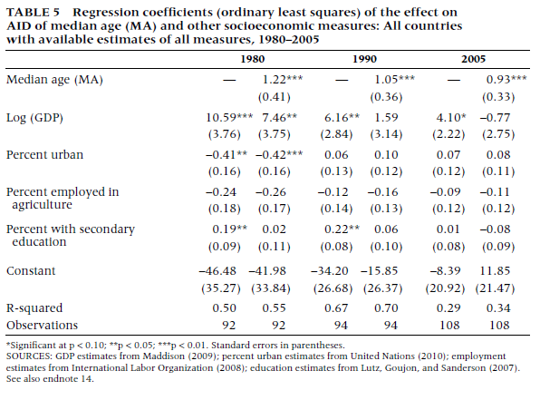

Slide 24
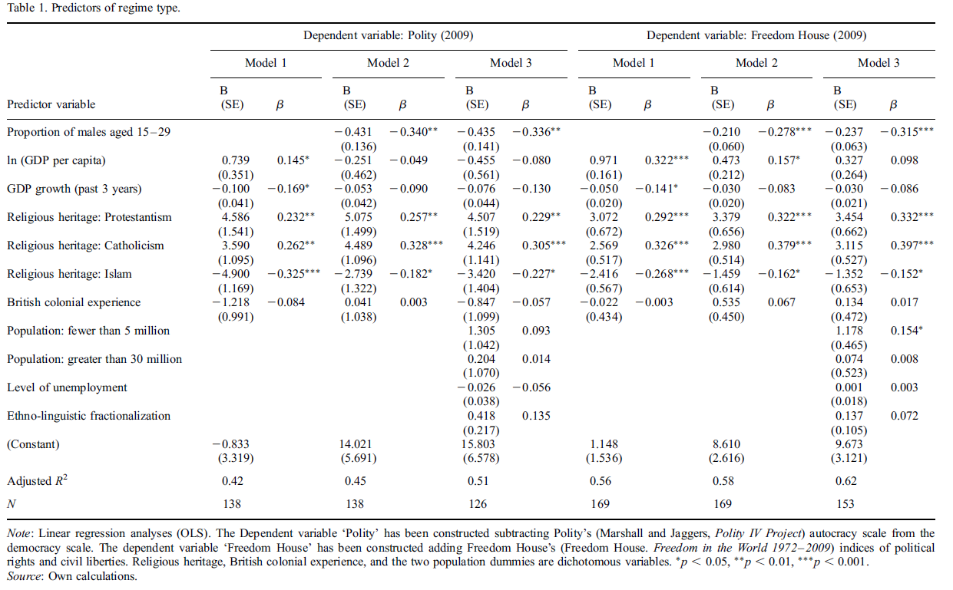

Slide 25
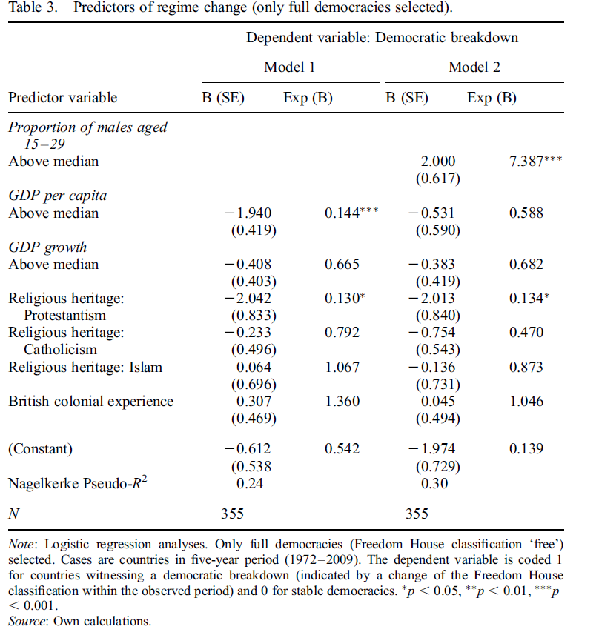
Instability of Democracy in
Youthful Countries
Full or partial democracies with young men exceeding 19.9% of adult population have a probability of 23.1% of becoming a dictatorship within the next five years,
whereas this probability is 4.6% for democracies with less young men.

Slide 26

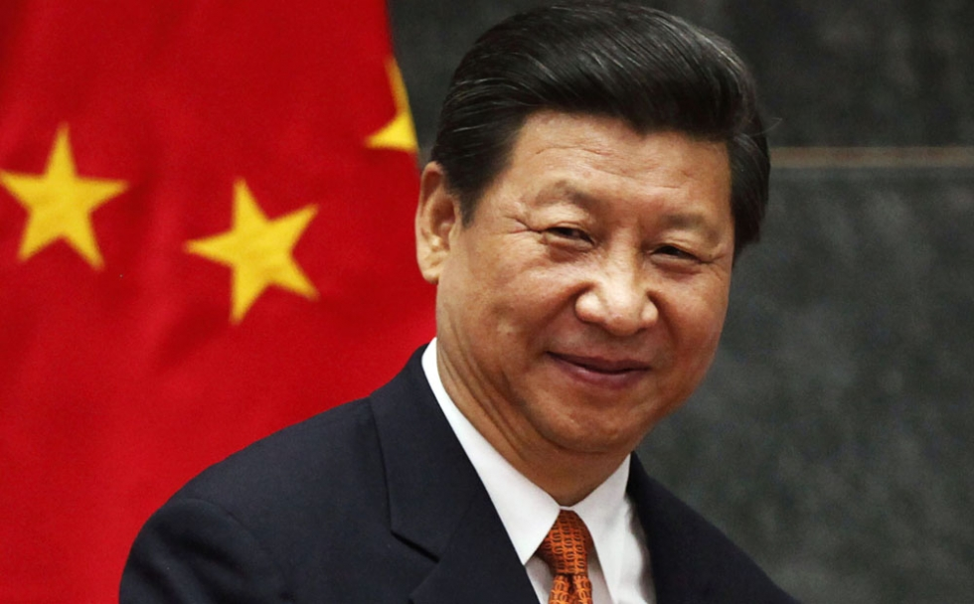
Or do we need the young to shake things up?

Slide 27
Conclusion
Young can:
  spur democratic revolution
  also spur undemocratic revolution
  cause established groups to fear change, preventing democracy
  put pressure on institutions and employment, driving political instability
  cause more violence and short-termism

Slide 28
  Young may:
    be a problem for consolidation of liberal procedures, rules, institutions, practices
    Be unwilling to be tolerant of difference, opposition and pluralism
So demographic transition can lead to democratic transition

