Slide 1
The Political Demography of Inequality
The Piketty Thesis

Slide 2
Political Demography
Recall: Interactions; 2nd or 3rd order effects
Can have 4th order effects:
Demography Economic Growth
Inequality Conflict
Interaction between population stagnation, political calm, and low inflation

Slide 3
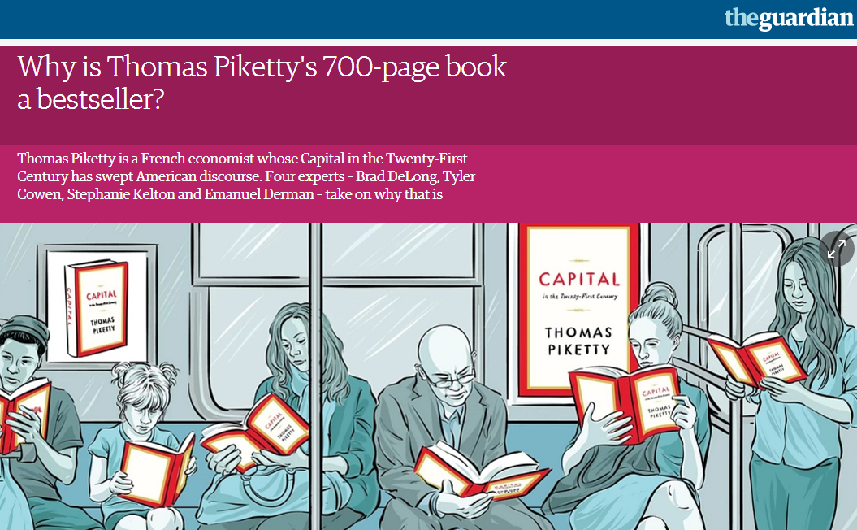
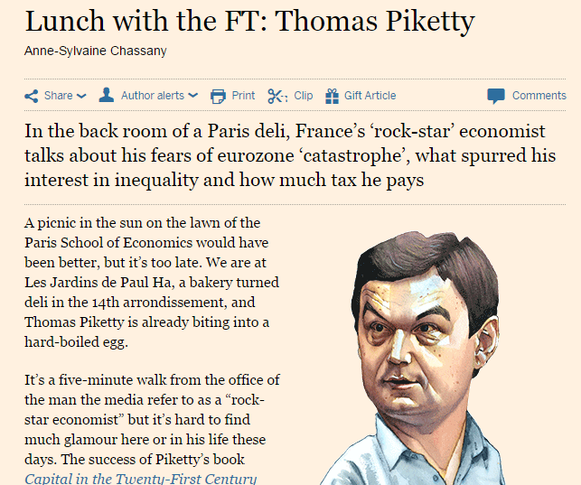

Slide 4
Research Base for the book
Economic history rather than presentist economics
Long time horizon needed, late 18th c until now
Key is drawing on pre-1914 work, which is distinctive
Tax records
Inheritance records
Estate valuation records
Rich lists

Slide 5
What is Capital?
Anything which generates income:
Stocks and bonds
Bank accounts
Physical plant and machinery
Home
Line between income, consumption goods and capital is unclear and socially defined: car? Ipad? education?

Slide 6
Piketty’s Thesis in 3 Minutes
https://www.youtube.com/watch?v=HL-YUTFqtuI

Slide 7

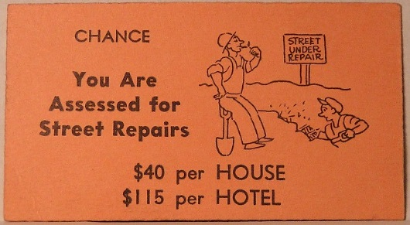

Iron law of r > g
Rate of return on capital (r)
Exceeds growth of income (g)
Capital accumulates
Solution:
=
Income stagnates

Slide 8
What does this have to do with demography?
Population growth = income growth = less inequality
Inequality = rate of return on capital (r) – growth rate of income (g)
Aging population slows growth rate of income (g)
This increases r > g. In other words, rents accrue to houses and hotels while income from labour is stuck at $200 per round! So capital (money, properties, houses and hotels) will be more unevenly distributed between players than wealth
“Rentiers” vs Earners; Rents v Income

Slide 9
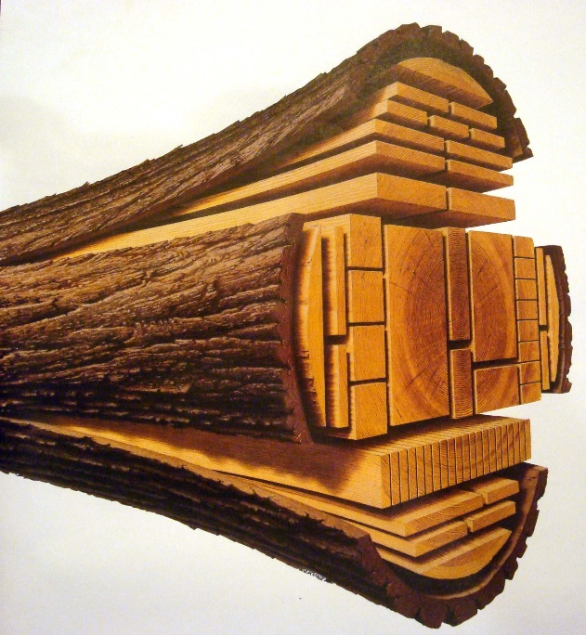



Economic output
Resources
Capital
Labour
+
+
+
+
Technology

Slide 10

Economic (Income) Growth
More Resources
More Capital
More Labour
+
+
+
+
Better Technology

Slide 11
Piketty’s Political Demography of Inequality
Capital is less equally distributed than income. Capital produces returns (r), different from income growth (g)
Stagnant population (ie. labour) growth = lower economic growth (g)
Lower economic growth (g) makes capital more important (r-g)
When capital more important (r-g), more inequality
More inequality = political tension and violence

Slide 12
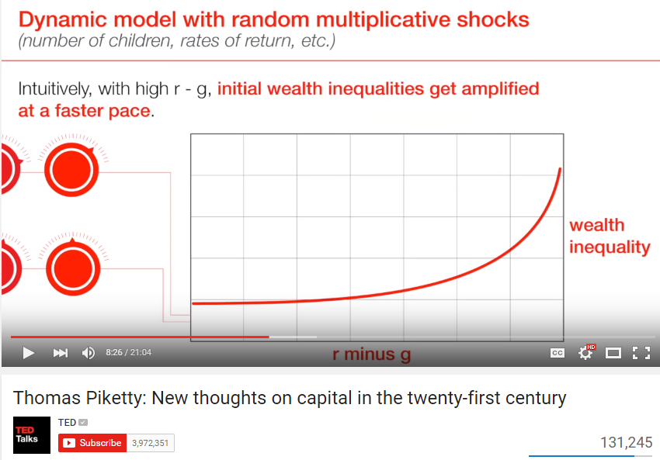

Slide 13

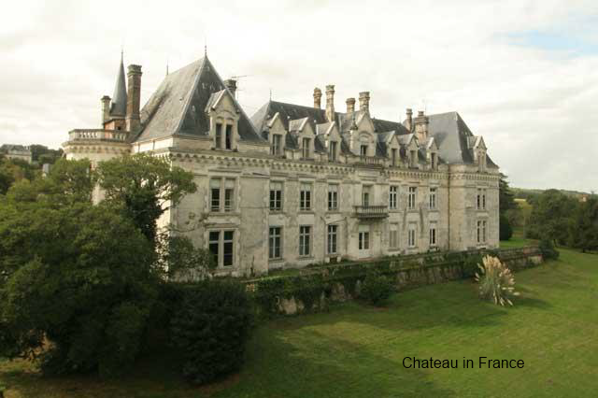
Capital-Dominated Societies
Inheritance not income is what counts
Stable capital income
Low inflation
Few wars
In Sense and Sensibility,
’John has just inherited the vast Norland estate, which brings in £4000 a year (100x average British income)…this is contrasted with the comparative poverty of his half-sisters, Elinor, Marianne, and Margaret (4 x avg income)

Slide 14
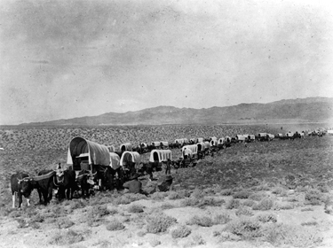
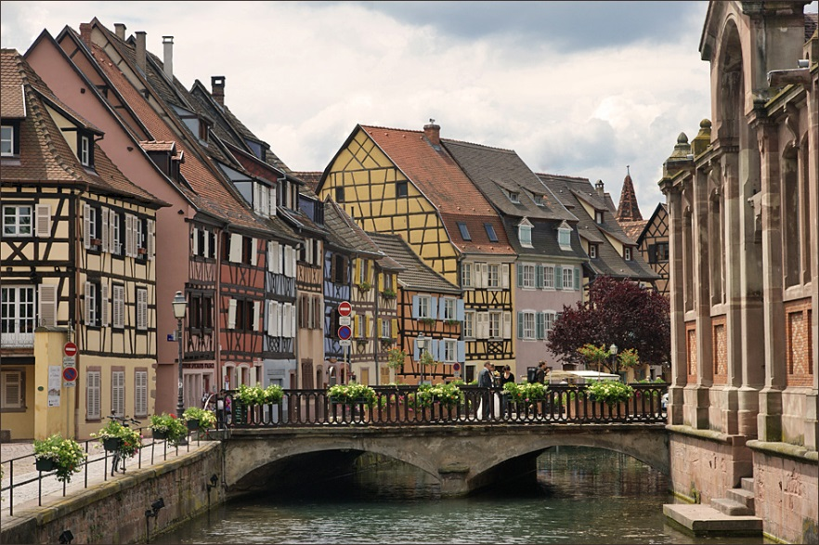
US v Europe
US had immigration and population growth
Income of new people an important share of national econ. growth
Europe a more stagnant population
Capital more important part of national economic growth

Slide 15
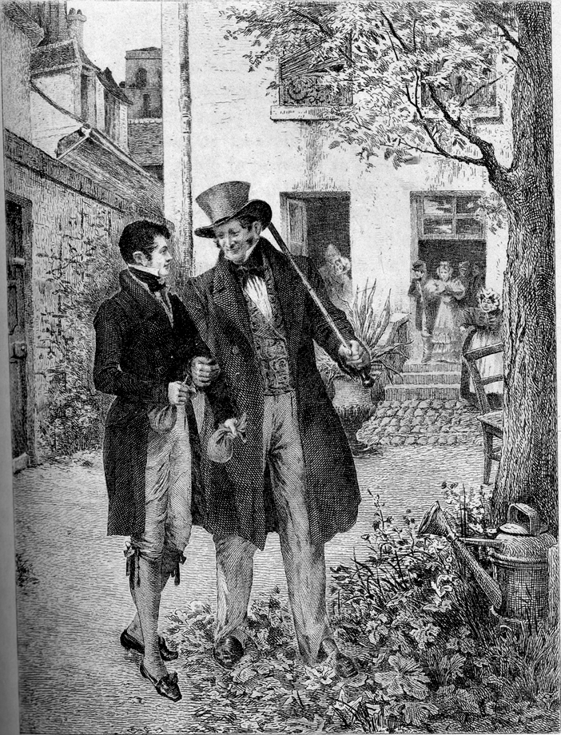
Pre-1914 Inequality
Balzac, Jane Austen, Henry James 19th c novels
Rastingnac: cannot hope to earn as much as a lawyer as if married into wealth. Even if he made it, would have just 10x average wealth
Needed to be in the 1% to be secure: 20x, 50x, 100x richer than average, from late 18th c-early 20th c

Slide 16
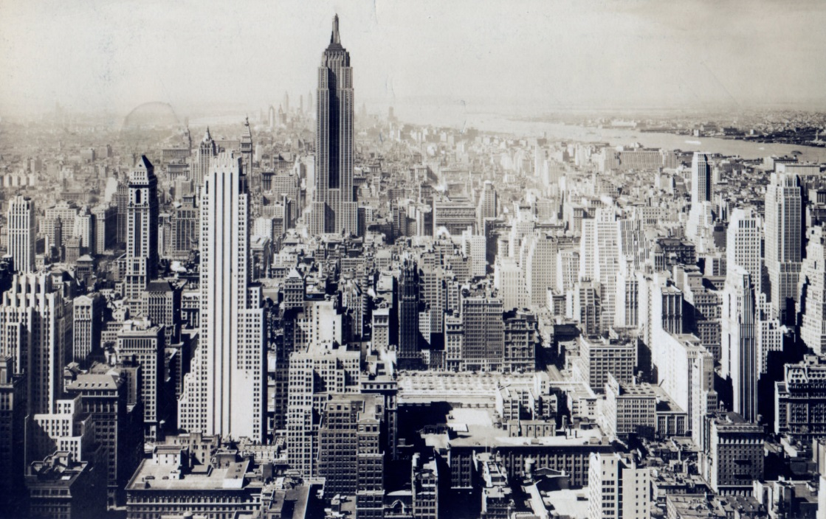
Capital Destroyed, Inequality Reset
‘The suicides by skyscraper leaps began…Einhorn was among the first to be wiped out…he lost his legacy…at the finish he had nothing but vacant lots…of these several went for taxes…when I sometimes took him for a ride he’d say, “We used to have that block of stores….”’ – Saul Bellow, The Adventures of Augie March, p. 106

Slide 17
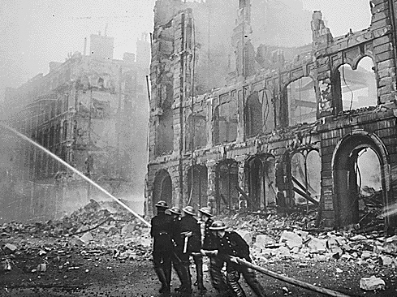
Wars and Depression
War destroys capital
Invaders expropriate
Wealth taxed by state to fund war effort
Depression wipes out value
Inflation devalues capital
Political instability, little trade

Slide 18
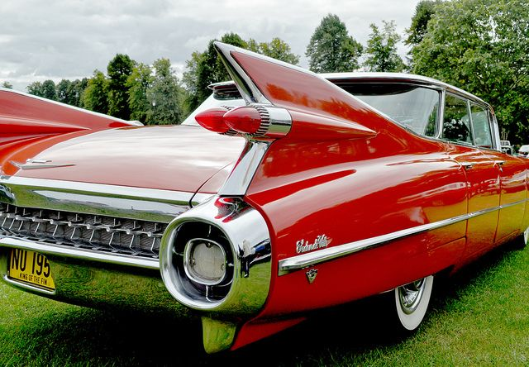
Postwar Economic Boom, 1945-73
Baby boom
Expanding education
End of gold standard
Freer trade
Pent up demand leads to growth
GDP per head (income) rises rapidly
This reduces r – g, lowering inequality

Slide 19
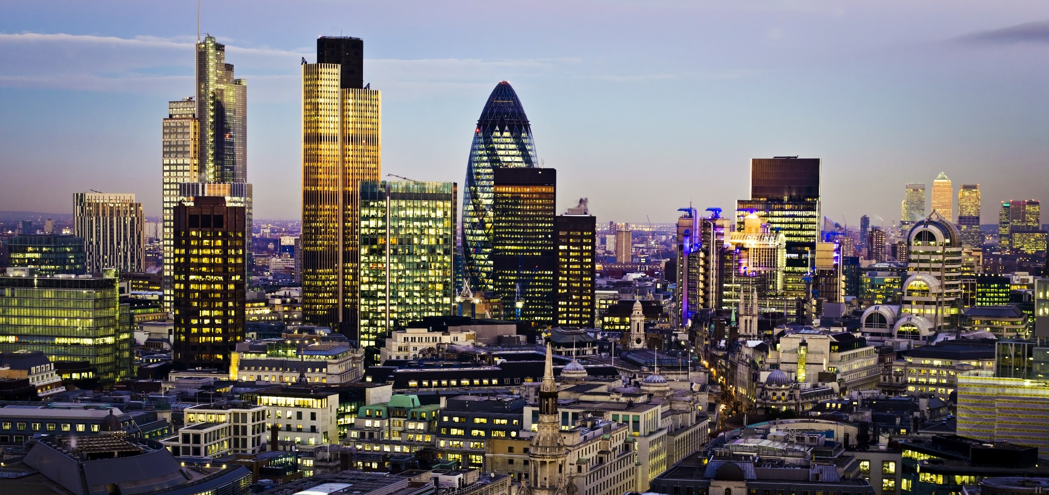
Post-1973: Back to Normal
Income more unequal, BUT, the key is:
Capital accumulates
Capital Share of income rises back to previous levels

Slide 20
US had low inequality, was less affected by war

Slide 21


Inheritance and Fertility Rates

Slide 22
The Return of Inheritance

Slide 24
Endgame
Risk of a spiral (p 572) of capital accumulation generating rents, much of which is saved as capital, fuelling a vicious circle
But unlike Marx, Piketty envisions a floor to the process

Slide 25
Political Risk?
"In France, it's very striking to see that in 1920, the political majorities adopted steeply progressive taxation. Exactly the same people refused the income tax in 1914 with a 2 percent tax rate. And in between, the Bolshevik revolution made them feel, after all, that progressive taxation is not so dangerous as revolution.“ Piketty, 1 May 2014, Huffington Post

Slide 26
Solution
Piketty argues for wealth tax rather than income tax
Global capital tax
Inheritance tax
Property tax
Accepts it is politically difficult
Inflation may be good – especially for Eurozone debtors

Slide 27
Critique I: The role of Labour
Marx believed in the Falling Rate of Profit thesis, that capitalists needed more labour. More capital would chase available labour, driving down rate of return (r)
Piketty: more capital does not drive down rate of return

Slide 28
Economists’ critique
Economists like Larry Summers, like Marx, say more capital means lower rate of return, also higher economic growth (g) drives up rates of return (r)
More capital, more depreciation costs. Ignored by Piketty
Piketty replies that rate of return (r) fairly consistent and independent of growth and capital accumulation
Many economists disagree, suggesting capital and income are connected

Slide 29

Land prices in cities
Rognlie argues that much of what has occurred post-73 is to do with soaring land rents, not corporate capital gains. Cities have seen a big revival (London, San Franciso, New York….)

Slide 30
Goodhart’s Critique
High fertility and globalisation boosted supply of labour, lowering wages and boosting rents and profits. Golden age of capital.
As young workers become scarce, they will be able to command higher wages
Spending on health care will burst budgets, leading to inflation, which weakens capital value
"We are on the cusp of a complete reversal. Labour will be in increasingly short supply. Companies have been making pots of money but life isn't going to be so cosy for them anymore," said Prof Goodhart.

