Slide 1
Tackling Endogeneity in Quantitative Research Designs: the case of anti-immigrant attitudes
Eric Kaufmann and Gareth Harris
Dept of Politics

Slide 2
Community and Closure
'Neighborhoods can be open only if countries are at least potentially closed...The distinctiveness of cultures and groups depends upon closure and without it cannot be conceived as a stable feature of human life' – Michael Walzer Spheres of Justice (1983)

Slide 3

Exit, Voice, Accommodation
Voice = White opposition to immigration and/or Far Right voting (Closure 1)
Exit = ‘White Flight’ or Avoidance (Closure 2)
Accommodation = White acceptance of diversity, immigration,
ESRC project: How are exit, voice, acc. related?

Slide 4

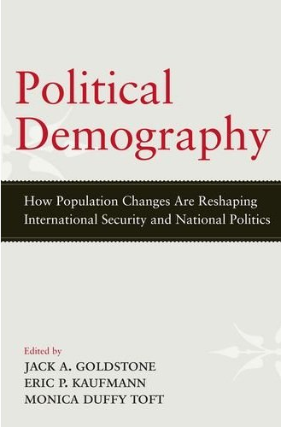

Conceptual Frameworks
Dominant Ethnicity
Political Demography
Ethnic Status

Slide 5
Reduce Immigration (a little or a lot)
80.4% of white UK born respondents wish immigration to be reduced (vs stay same or increase)
Source: Home Office Citizenship Survey,
2010-11, geocoded with Census 2011

Slide 6
Reduce the number of immigrants (a lot and a little) by social class and ward diversity (aggregated dataset) for all white respondents

Slide 7
Source: Understanding Society survey, waves 1-3, 2009-12

Slide 8
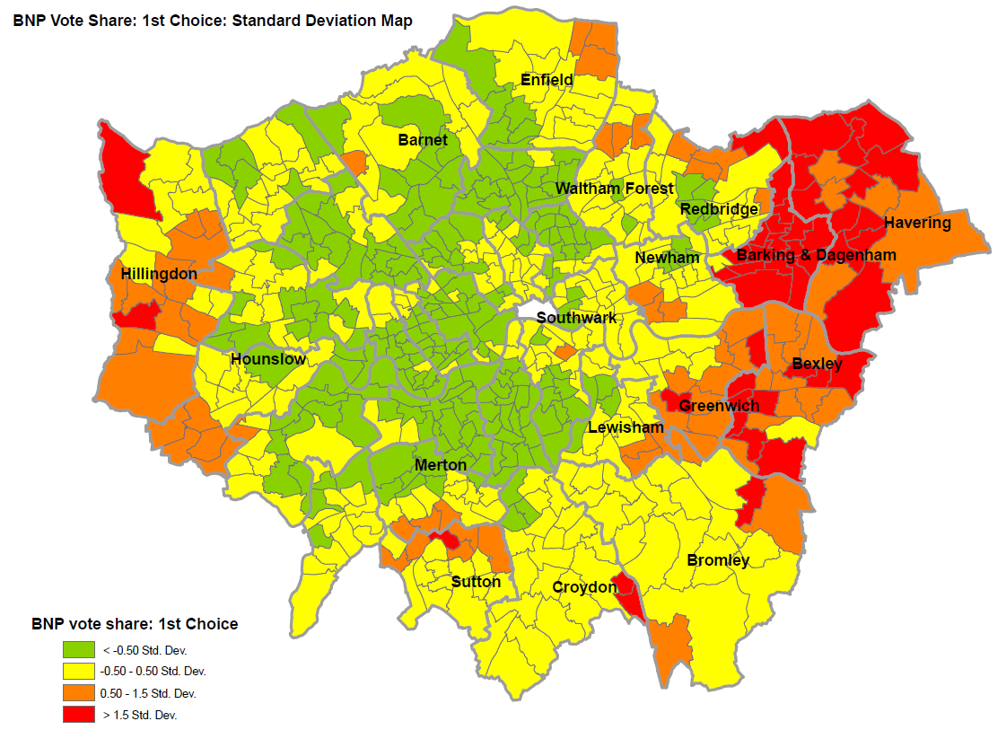

Slide 9
Local Contact, Metro Threat?
22 studies at ward level (population generally 10,000-30,000) : 74 percent link higher diversity to reduced animosity, just 18 percent the reverse
43 studies using units above 100,000 population: a significant increase in out-group hostility in 86 percent of these studies

Slide 10
Feeling of threat at metro level as minorities grow, but positive contact at local level creates accommodation

Slide 11
Selection Bias Problem
Q: Why are whites in diverse areas more tolerant?
A: Selection bias: whites who don’t like diversity leave, a.k.a. ‘white flight’ or white avoidance

Slide 12
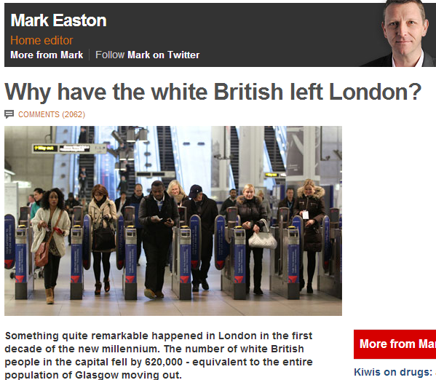
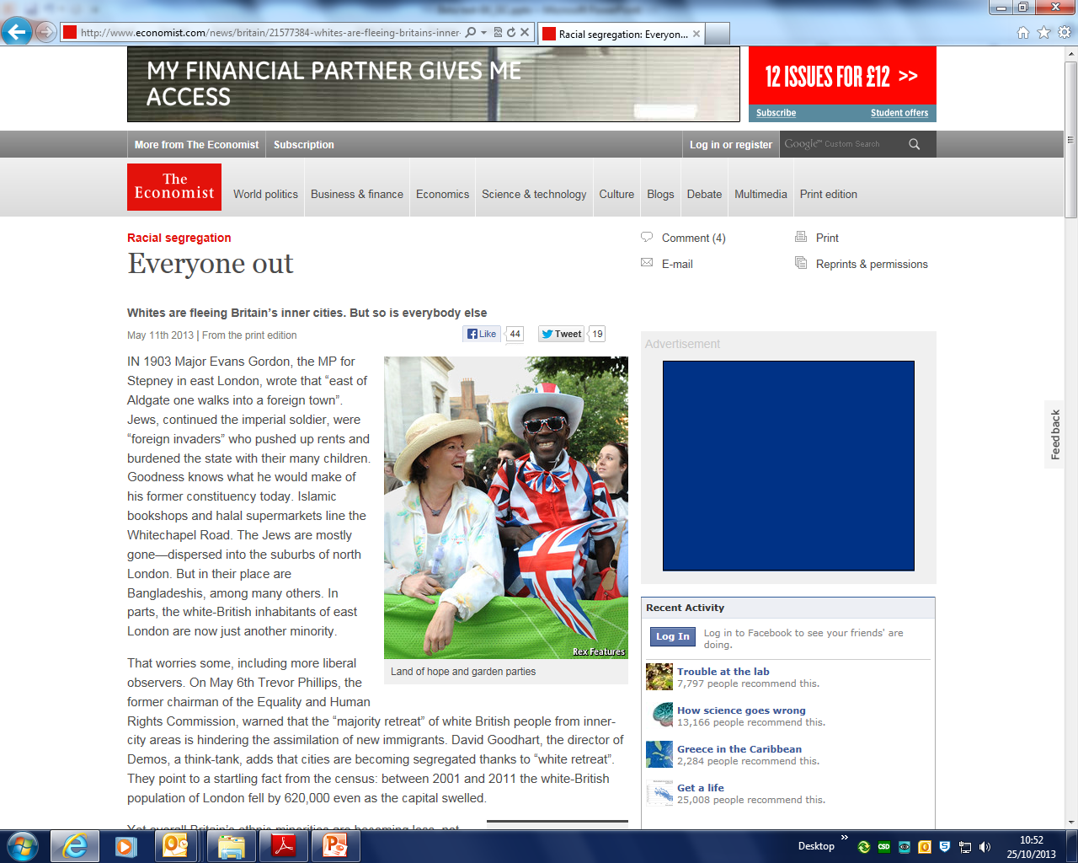
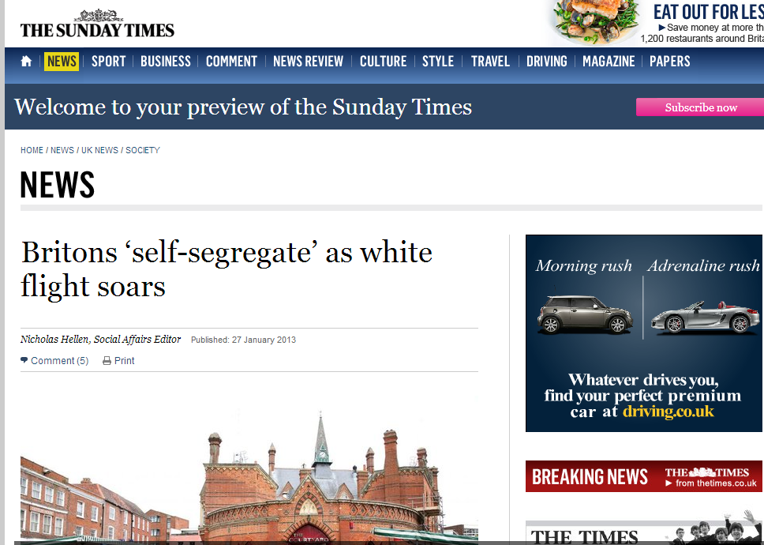
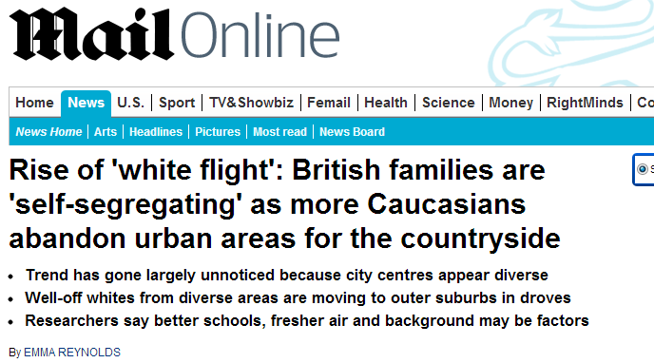
White Flight?

Slide 14
Selection Bias/Endogeneity
No one has properly tested
Test with BHPS-UKHLS and Understanding Society
Large sample, longitudinal, geocoded
Compare white British who enter and leave diverse wards
Compare white British movers (enter/leave) with those who stay
Proxy questions for attitude to immigration

Slide 15
Quintile | Change?: | Same | Less | More | Total
White stayer |  | 119316 | 1596 | 1468 | 122380 | 90.7%
White inter-ward mover |  | 6774 | 1670 | 1421 | 9865 | 7.3%
White intra-ward mover |  | 2565 | 38 | 37 | 2640 | 2.0%
Source: BHPS/ Understanding Society, 1991-2011

Slide 16
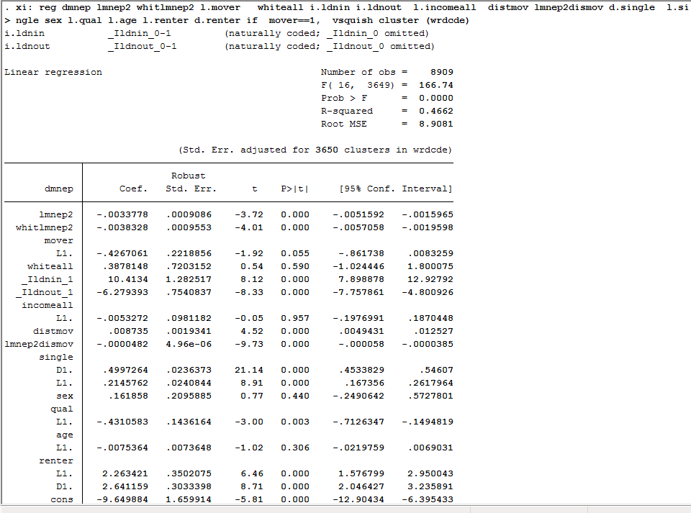

Slide 17
Predicted Ward Minority Change among Inter-ward Movers, 1991-2011 (BHPS/UKHLS)
% Change in Ethnic Minorities in Ward
% Ethnic Minority in Ward a year ago

Slide 18
Those Favouring Reduced Immigration, by class: Role of Transience

Slide 20
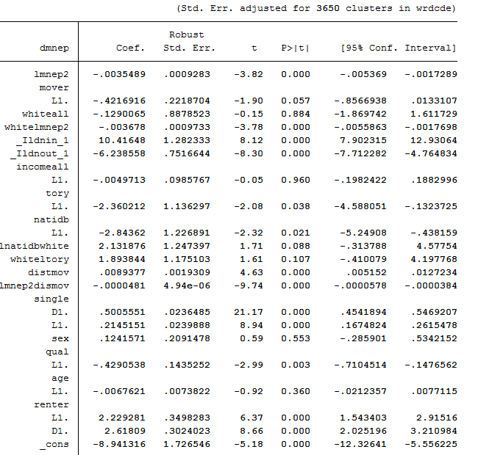

Slide 21
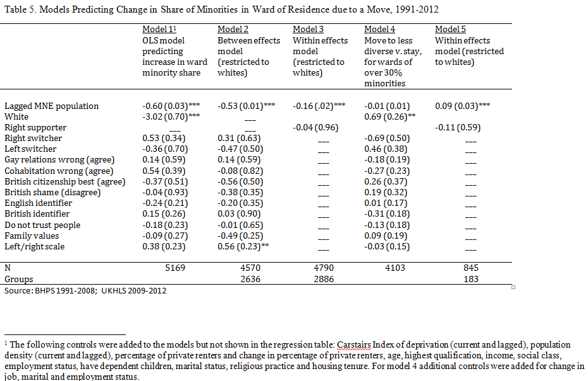

Slide 22
Simpson (2007) Method
 | Wards | % White
Quintile 1 | 7554 | 98
Quintile 2 | 726 | 87
Quintile 3 | 288 | 73
Quintile 4 | 180 | 57
Quintile 5 | 102 | 34
Total | 8850 | 91
White Flight/Avoiders
Diversity Seekers

Slide 23
Simpson (2007) Method
 | Wards | % White
Quintile 1 | 7554 | 98
Quintile 2 | 726 | 87
Quintile 3 | 288 | 73
Quintile 4 | 180 | 57
Quintile 5 | 102 | 34
Total | 8850 | 91
White Flight/Avoiders
24% Tory
18% Working Class
30% Degrees
57% English Identity
56% Tabloid
32% 17-25s
26% renters
35% single
12% anti-homosexual
12% gender traditionalists
Diversity Seekers
24% Tory
18% Working Class
27% Degrees
57% English Identity
46% Tabloid
44% 17-25s
50% renters
49% single
10% anti-homosexual
9% gender traditionalists

Slide 24
Save our Census!
The permission of the Office for National Statistics to use the Longitudinal Study is gratefully acknowledged, as is the help provided by staff of the Centre for Longitudinal Study Information & User Support (CeLSIUS). CeLSIUS is supported by the ESRC Census of Population Programme (Award Ref: ES/K000365/1). The authors alone are responsible for the interpretation of the data.
Census output is Crown copyright and is reproduced with the permission of the Controller of HMSO and the Queen's Printer for Scotland.
The results presented are based on a test version of the LS database incorporating 2011 Census data. Figures may be subject to change when the final version of this database is released in November 2013.

Slide 25
Predicted Probability of Move Away from Diversity,
Inter-ward Movers, 2001-11 (ONS LS)
Probability of move to less diverse ward quintile
Most Diverse Ward
Whitest ward

Slide 26
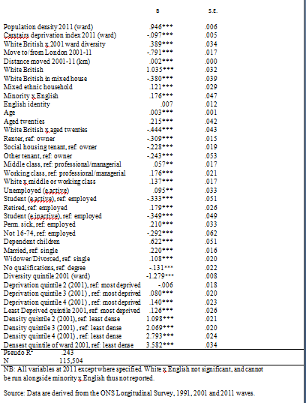
Ordered Logit of Change in White Quintile in the direction of % White, 2001-11. Inter-ward movers only. (ONS Longitudinal Study):

Slide 27
Local Council Wards in the UK have a population of about 10,000 to 30,000 people. Have you moved Local Council Ward to live somewhere new at any time in the past ten years?
  <1> No 66.24% (1085)
  <2> Yes 28.39% (465)
  <3> Don’t know 5.37% (88)
As far as you know, did the last Local Council Ward in which you lived have…?
  <1> More people from an ethnic minority background than the ward I now live in now 37.4% (174)
  <2> Fewer people from an ethnic minority background than the ward I now live in now 22.8% (106)
  <3> About the same number of people from an ethnic minority background than the ward I now live in now
  23.2% (108)
  <4> Don’t know 16.6% (77)

Slide 28
White Flight?:
Yougov-ESRC-BBK Survey, August 2013
 | Moved To Whiter Ward past 10 yrs | Moved To More Diverse Ward past 10 yrs | Sample
Not White British | 53% | 47% | 47
White British | 62% | 38% | 239
Total | 60% | 40% | 286

Slide 29
Comfort with spouse of different race among ward movers, White British only (Yougov/ESRC survey)
 | To Whiter | To Diverse Sample
very comfortable | 61% | 39% | 83
fairly comfortable | 67% | 33% | 33
neither comfortable n | 57% | 43% | 46
fairly uncomfortable | 64% | 36% | 11
very uncomfortable | 76% | 24% | 25
don't know | 58% | 42% | 24
Total | 63% | 37% | 222

Slide 31
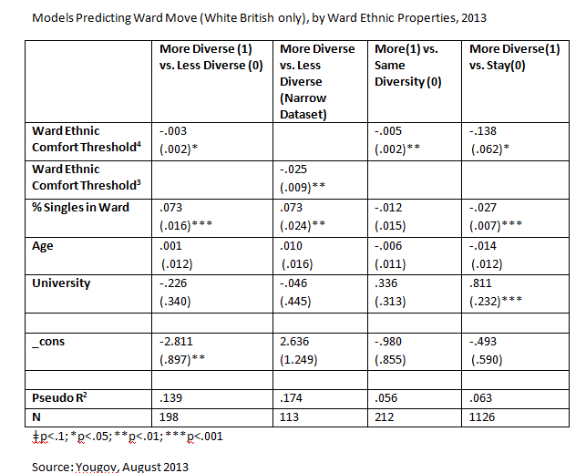

Slide 32
Not Selection
Whites moving to diverse areas and those leaving them are almost identical in voting, family values, English national identity, British patriotism, newspaper readership
Immigration and racism do not predict having moved to a whiter area vs moving to a more diverse area
Comfort threshold for minorities in one’s area has a small effect at the margins

Slide 33
Cultural Amenities not Ethnocentrism
“If the church bulletin board is where people advertise rooms for rent, blacks will rent rooms from blacks and whites from whites because of a communication system…correlated with color” – Thomas Schelling 1978
White British family/friend/association networks and minority networks differ in England, affecting where people relocate once they decide to move
White liberals move to just as white areas as white conservatives. Perhaps minorities are driving findings, but we doubt this.
Yet we find even with controls for friends and social capital, strong ethnicity effect persists
Ethnicity as subliminal or status effect?

Slide 34
Reduce the number of immigrants (a lot and a little) by social class and ward diversity (aggregated dataset) for all white respondents

Slide 35
Conclusion
Local context matters for views on immigration and vice-versa
Whites in diverse English wards more positive about immigration
Not because intolerant whites have self-selected out
But in part because whites in diverse areas are more transient

Slide 36
Some support for contact theory: more in ameliorating strong opposition than in promoting acceptance of current levels
Limited effect on white working class attitudes
3 contextual aspects to white opinion in diverse contexts: a) contact, b) transience, c) habituation

Slide 37
Policy
Reduce segregation by retaining white British in diverse areas and permitting diffusion of minorities to whiter areas
Gentle, gradual diffusion

Slide 38



Is there 'White Flight' in England?
Why Whites in Homogeneous English Wards Are More Opposed to Immigration
Eric Kaufmann and Gareth Harris,
Birkbeck College
e.kaufmann@bbk.ac.uk; g.harris1@bbk.ac.uk
http://www.sneps.net/research-interests/whiteworkingclass twitter: @epkaufm

