Slide 1



UKIP, White Flight and Integration
The White British Response to
Ethnic Change
Eric Kaufmann and Gareth Harris

Slide 3
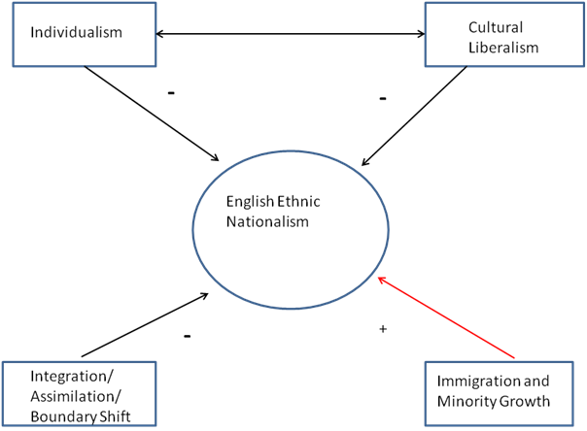
Ethnic Change and Ethnic Nationalism

Slide 4
Individualism
Cultural Liberalism
-
-
English Ethnic Nationalism
-
+
Integration/ Assimilation/
Boundary Shift
Immigration and Minority Growth

Slide 5
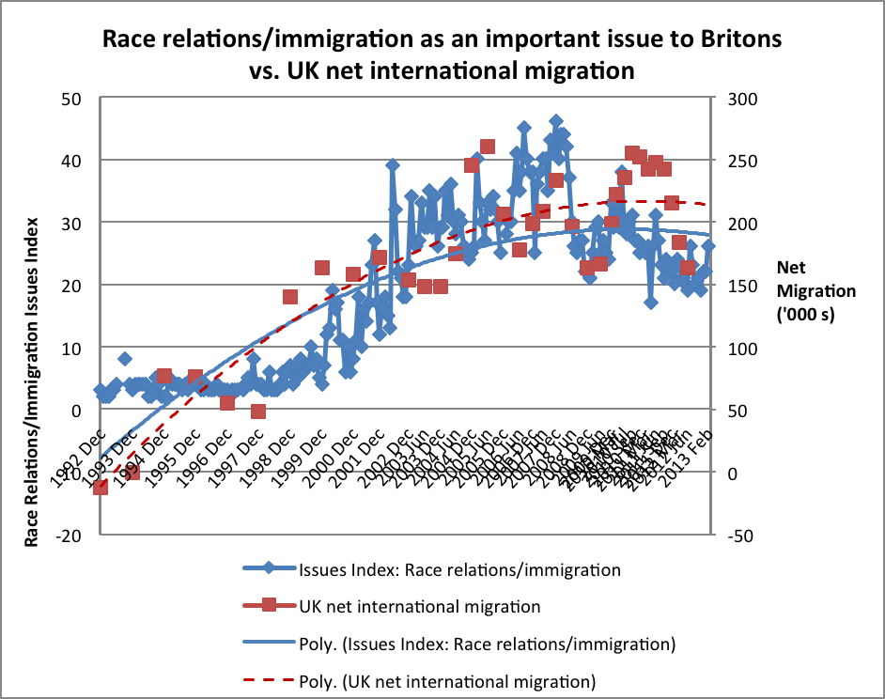
Source: Ipsos MORI, 'Attitudes to Immigration' (forthcoming). Issues Index question: “What do you see as the most/other important issues facing Britain today?”. Issues Index base: representative sample of c.1,000 British adults age 18+ each month, interviewed face-to-face in home. Home Office statistics based on ‘Year ending’.

Slide 7
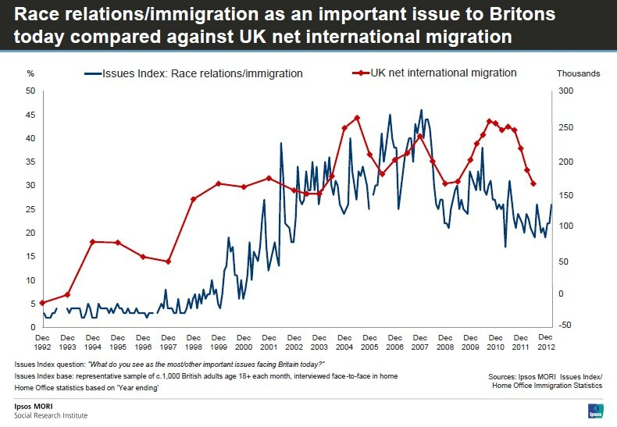

Slide 8
Locality Matters
Nation could be the local writ large (Applegate 1990; Confino 1997; Zimmer 2013)
Local could be a passive space inscribed by national discourses
But then, why do opinions on national issues vary by locale, AND
Why are demographic changes to the nation experienced so differently by locale?

Slide 9
Local Realities Shape Perceptions of the Nation (Kaufmann 2008)
Nation
Local

Slide 10
Source: Home Office Citizenship Survey (Office for National Statistics and Home Office 2011)

Slide 11
Table 2. White British Discomfort Threshold for Minority Share, Ward-level, 2013
Source: Yougov 2013.
Share of minorities beyond which person would become uncomfortable | % of Respondents | Cumulative
Over 75% | 5.6% | 5.6%
75 | 3.4% | 9.0%
66 | 6.8% | 15.8%
50 | 19.0% | 34.8%
25 | 16.5% | 51.3%
17 | 5.7% | 57.0%
10 | 13.9% | 70.9%
5 | 11.3% | 82.2%
2 | 6.3% | 88.6%
1 | 2.2% | 90.7%
Less than 1% | 1.7% | 92.4%
No minorities | 3.1% | 95.5%
Don't know | 4.5% | 100.0%
Number of respondents | 647
'When do you think you would start to feel uncomfortable about the number of people from ethnic minorities…
A) ‘living in your neighbourhood’?
B) ‘living in Britain’?
.60 correlation

Slide 12
Individualism
Mobility: Renter or recent mover v. long-term resident
Living in a transient area
Living in an urban area
Higher Education/Student
Higher social class
Importance of occupation for identity vs. importance of ethnicity/nation
Young

Slide 13
Desire to reduce migration, by class and proportion of renters, among ward residents, white British only
Source: Home Office Citizenship Survey (Office for National Statistics and Home Office 2010, 2011)

Slide 17
Percentage of white respondents who favour a reduction in immigration, by class
Source: Home Office Citizenship Surveys 2009-11

Slide 18
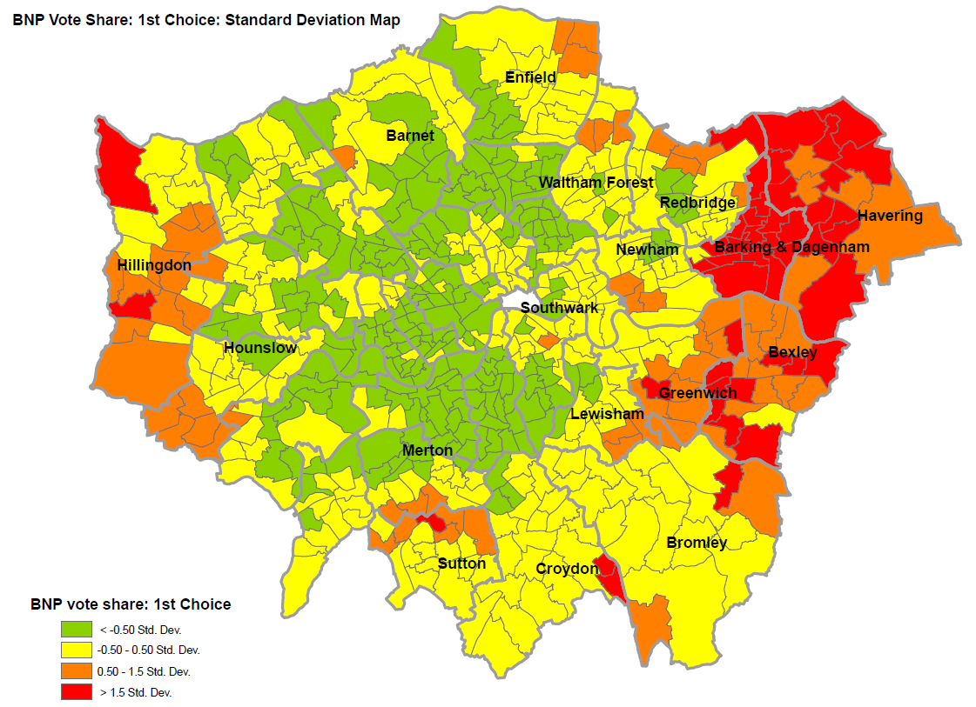
Source: Harris 2012

Slide 19
Source: Harris 2012 (census and election statistics)

Slide 20
Source: Understanding Society survey, waves 1-3, 2009-12

Slide 21
Source: Election data from Plymouth Elections Centre Data; ONS 2013.
http://www1.plymouth.ac.uk/research/ceres/TEC/thecentre/Pages/default.aspx

Slide 22
Source: ONS (Census) 2011

Slide 23
Assimilation? Integration?
White opinion more sensitive to minorities than immigrants. Changes produce opposition
White Other/E European share not associated with opposition to immigration
Minorities: whether UK-born, English-speaking, unsegregated, matters little. Mixed, Muslim, Caribbean – sporadic effects
Habituation of native white population to the local presence of minorities, even if segregated/foreign-born/Muslim, seems key

Slide 24
White Flight in Britain?
 | Moved To Whiter Ward past 10 yrs | Moved To More Diverse Ward past 10 yrs | Sample
Not White British | 53% | 47% | 47
White British | 62% | 38% | 239
Total | 60% | 40% | 286
 | Movers from Diversity | Movers to Diversity | Stayer
Immigration: Increase or same | 23% | 25% | 17%
Immigration: reduce a little | 16% | 21% | 19%
Immigration: reduce a lot | 60% | 54% | 64%
Number of cases | 146 | 89 | 906
English Identity | 43% | 40% | 50%
Conservative Party | 28% | 25% | 28%
Number of cases | 148 | 91 | 927
Discomfort Interracial Marriage | 21% | 14% | 23%
Number of cases | 139 | 83 | 903
Source: Yougov survey, August 2013 (Yougov 2013). N = 1638 white British adults. Note that number of cases is slightly different for different groups of variables depending on response rate

Slide 25
Source: BHPS 1991-2008; UKLHLS 2009-2012

Slide 26
Table A1. Predictors of Inter-Ward Mobility, 1991-2012. Material and Attitudinal Factors
 | Model 1 | Model 2 | Model 3
 | Away v Toward Diversity | Away from Diversity (Quintile Change) | Away from Diversity (change in % minority)
Lagged % minority pop. | .08 (.02)*** | .07 (.01)*** | .43 (.05)***
White (individual) | -.88 (.49) | -.44 (.22)** | -1.01 (.74)
White x minority % pop. | .07 (.02)** | .05 (.01)*** | .21 (.05)***
Religious (non-religious ref.) | -.07 (.16) | .03 (.07) | -.13 (.23)
Labour voter (Conservative ref.) | .36 (.20) | -.17 (.08)* | .38 (.29)
Liberal voter | .09 (.24) | -.03 (.09) | -.13 (.32)
Non-voter | -.23 (.24) | .02 (.09) | .15 (.31)
Gay rights wrong (disagree ref) | -.11 (.18) | -.00 (.07) | -.16 (.24)
Cohabitation wrong (disagree ref.) | .08 (.29) | -.08 (.10) | -.26 (.33)
British citizenship best (agree ref.) | -.06 (.28) | .11 (.08) | .33 (.46)
Britain history shame (agree ref.) | .17 (.27) | .01 (.10) | .48 (.26)
English identifier | .15 (.14) | .04 (.06) | .27 (.20)
British identifier | .17 (.15) | .05 (.07) | .17 (.23)
Low trust (high trust ref.) | .20 (.16) | .17 (.06)** | .67 (.20)***
Traditional family values | .28 (.19) | .06 (.07) | .14 (.24)
Left/right ideology scale | -.06 (.16) | -.07 (.07) | -.26 (.23)
Class is not important to identity | -.19 (.15) | -.09 (.06) | -.34 (.19)
Pseudo R² | .55 | .25 | .60
Adjusted R²
N | 2253 | 7041 | 7041
*p<.05,**p<.01,***p<.001. Source: BHPS 1991-2008; Understanding Society 2009-12. Note: also includes parameters which are not reported for reasons of space.

Slide 27
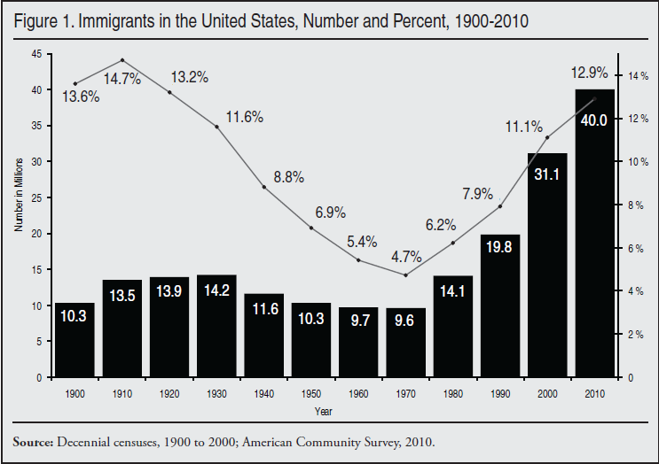
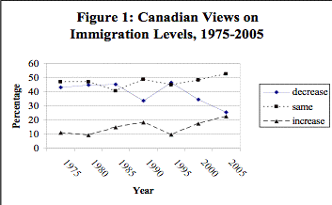
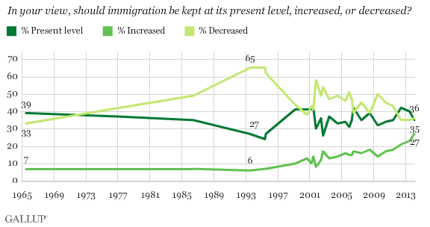
Immigration and Immigration Opinion in the US & Canada since 1965
Source: Wilkes, Guppy & Farris 2007

Slide 28
Conclusion
Ethnic Change associated with English ethnic nationalism
Local ethnic dynamics matter for perceptions of national issues
Assimilation of European immigrants has historically reduced English ethnic nationalism
Local contact with and habituation to minorities, rather than integration, reduces opposition to immigration

