Slide 1



The White British Response to Ethnic Change
Eric Kaufmann,
Birkbeck College, University of London
e.kaufmann@bbk.ac.uk
For RANEPA Political Demography Conference, Moscow,
December 13-14, 2013

Slide 2
Community and Closure
'Neighborhoods can be open only if countries are at least potentially closed...The distinctiveness of cultures and groups depends upon closure and without it cannot be conceived as a stable feature of human life' – Michael Walzer Spheres of Justice (1983)

Slide 3

Demographic Change: differential ethnic population growth through migration and birth rate differences
Ethnic Majority
Exit
Voice
Accommodation?

Slide 4
Demographic Change: differential ethnic population growth through migration and birth rate differences
Ethnic Majority
Anti-immigration attitudes
and voting
White Flight
White Toleration

Slide 5
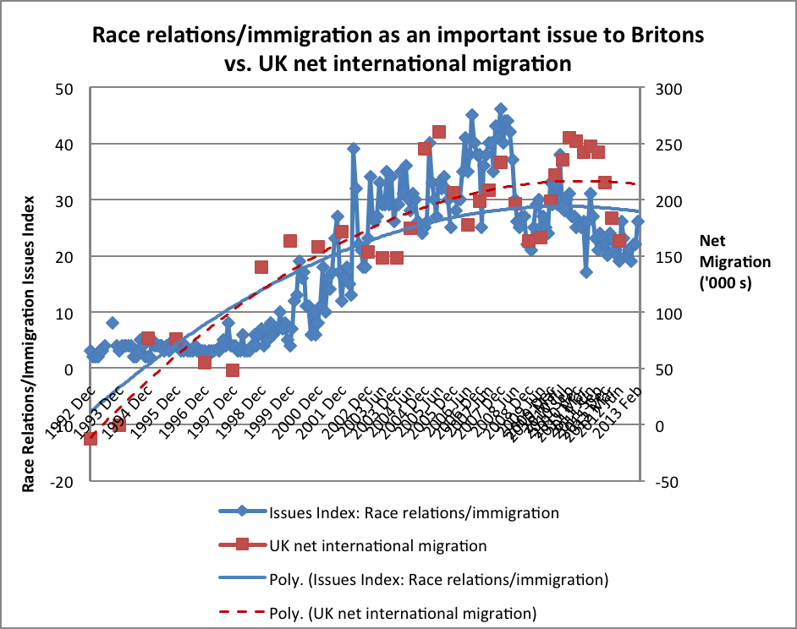
Source: Ipsos MORI, 'Attitudes to Immigration' (forthcoming). Issues Index question: “What do you see as the most/other important issues facing Britain today?”. Issues Index base: representative sample of c.1,000 British adults age 18+ each month, interviewed face-to-face in home. Home Office statistics based on ‘Year ending’.

Slide 6
White Accommodation?:
Favouring Reduced Immigration
Reduce the number of immigrants (a lot and a little) by social class
and ward diversity (aggregated dataset) for all white respondents

Slide 7
Threat or Contact?
Whites – even the white working class – living in diverse wards are more tolerant of immigration
US literature shows that diversity at ward/tract level (10-30k) is associated with less white hostility to immigrants, minorities, immigration
BUT at metro and LA level (100k-1m), more diversity is associated with more white hostility
Feeling of threat at metro level as minorities grow, but positive contact at local level creates accommodation?

Slide 9
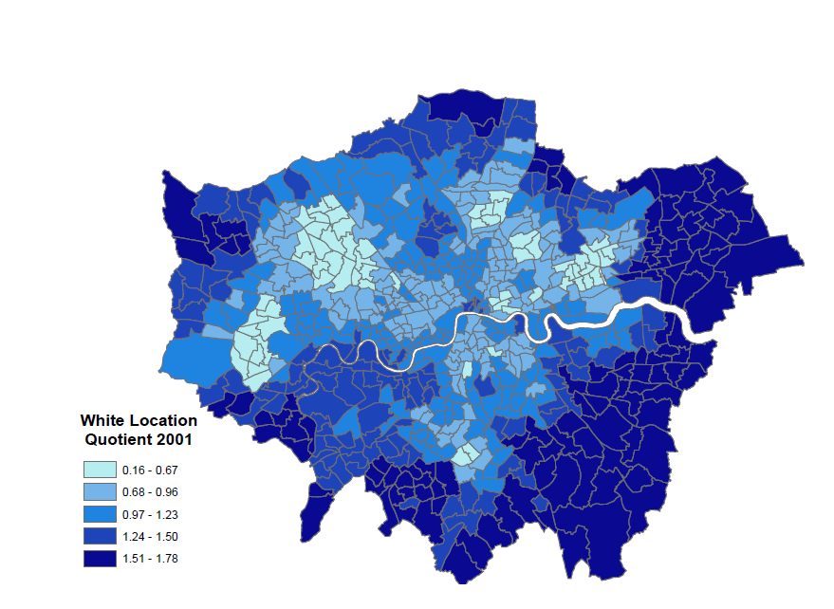
White British

Slide 10
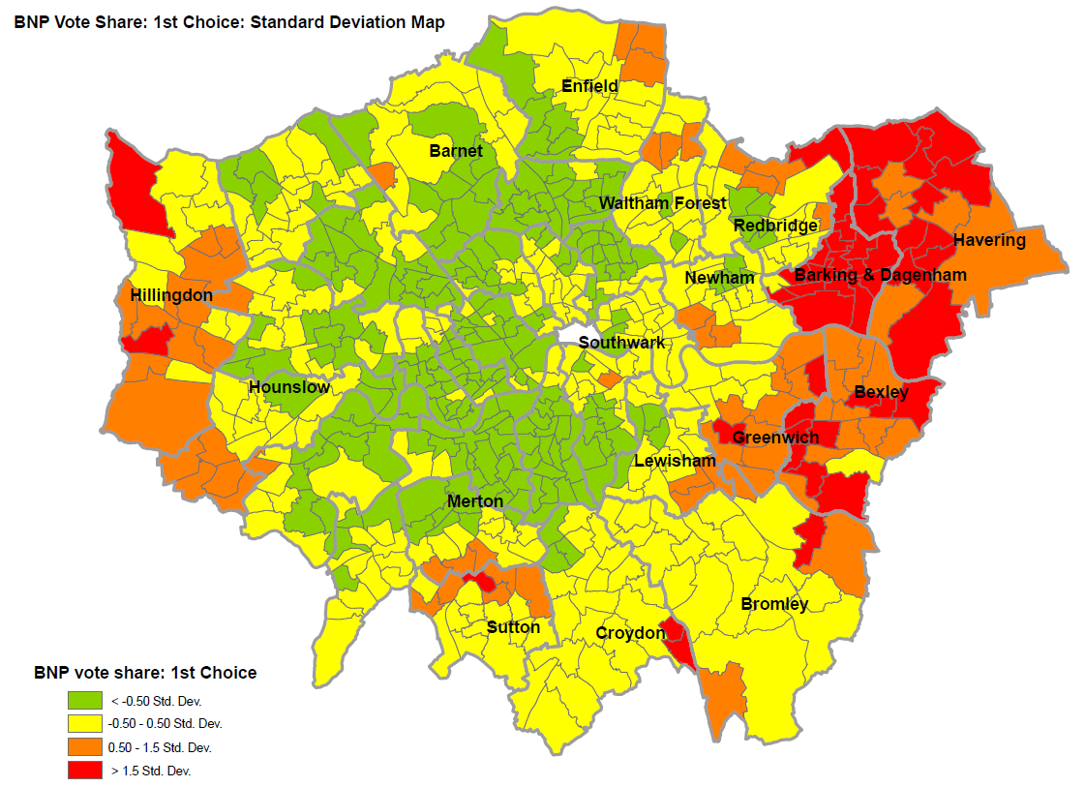
2008 Mayoral Elections

Slide 11
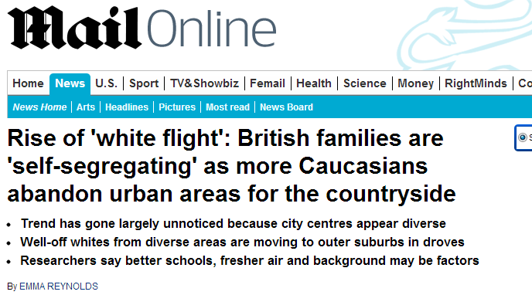
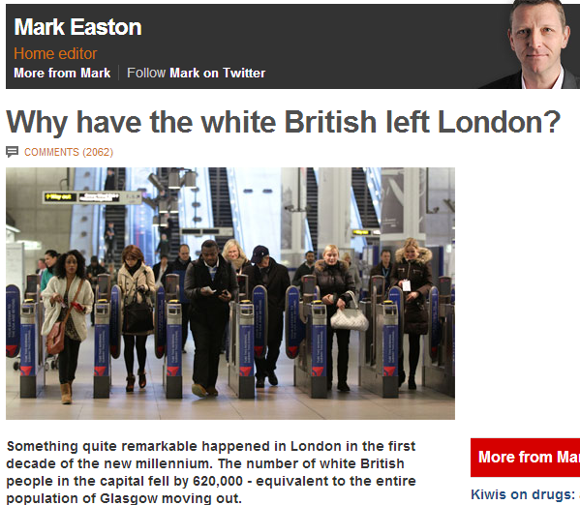
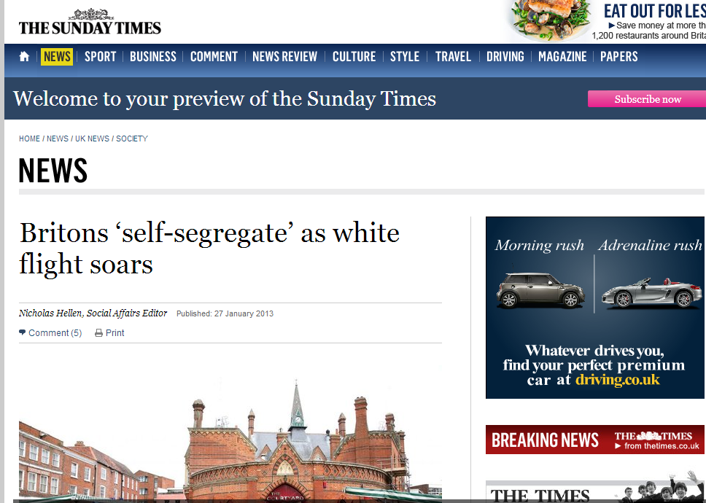
White Flight?

Slide 12
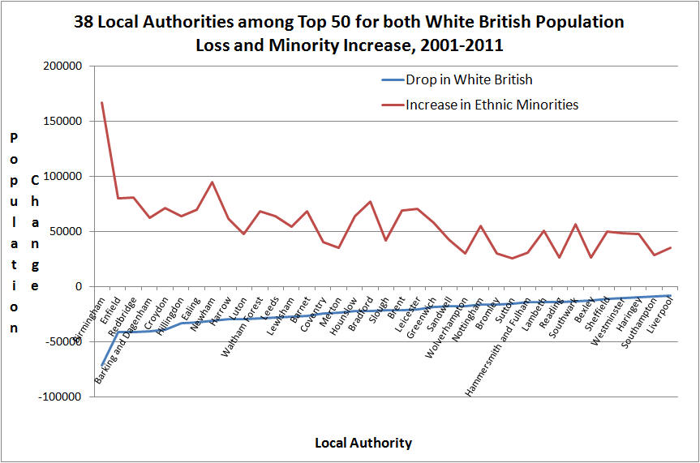

Slide 13
White Flight?

Slide 14
Manchester 1991-2001
London 1991-2001

Slide 16
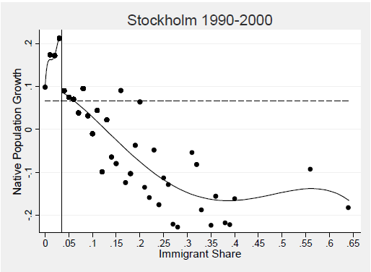
USA 1970-2000
Source: Andersson Hammarstedt Neuman 2012
Source: data from Card Mas & Rothstein 2008

Slide 17
White Flight?:
Yougov-ESRC-BBK Survey, August 2013
 | Moved To Whiter Ward past 10 yrs | Moved To More Diverse Ward past 10 yrs | Sample
Not White British | 53% | 47% | 47
White British | 62% | 38% | 239
Total | 60% | 40% | 286

Slide 18
Comfort with spouse of different race among ward movers, White British only (Yougov/ESRC survey)
 | To Whiter | To Diverse Sample
very comfortable | 61% | 39% | 83
fairly comfortable | 67% | 33% | 33
neither comfortable n | 57% | 43% | 46
fairly uncomfortable | 64% | 36% | 11
very uncomfortable | 76% | 24% | 25
don't know | 58% | 42% | 24
Total | 63% | 37% | 222

Slide 19
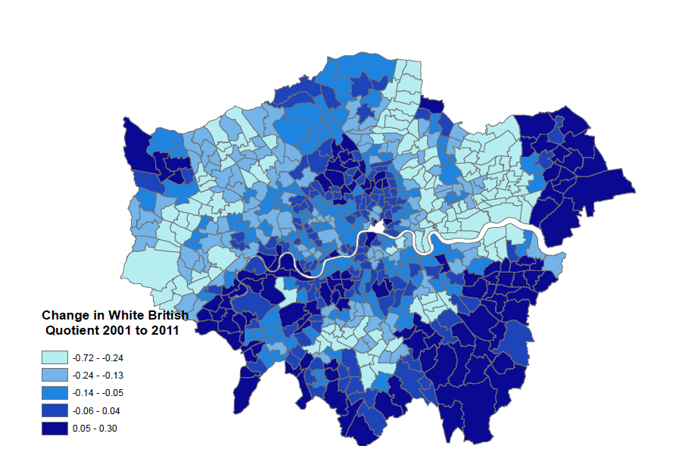

Slide 20
Demography Matters for Politics
Voice: ethnic change does result in anti-immigration sentiment
Exit: white-minority segregation high, due to white self-attraction, not white flight
Voice: threat at higher geography, response at lower geographies to rapid change in white area
Accommodation: at lower levels of geography, through contact
Band of white ‘resistance’ moves out as diversity increases and shifts out from inner cities

Slide 21
…..
Local conditions matter for national issue perceptions and vice-versa
Upper working/lower middle class are somewhat more likely to be both ‘white flighters’ and white nationalists
White attitudes to immigration may be softened by contact in locale;
Or may be hardened by diversity in metro and/or by jumps in minority presence in formerly lily-white areas

