Slide 1



Contact, Threat or 'White Flight'?: Local ethnic change, UKIP and anti-immigration sentiment in Britain
Eric Kaufmann and Gareth Harris, Birkbeck College, University of London
e.kaufmann@bbk.ac.uk

Slide 2
Community and Closure
'Neighborhoods can be open only if countries are at least potentially closed...The distinctiveness of cultures and groups depends upon closure and without it cannot be conceived as a stable feature of human life’
– Michael Walzer Spheres of Justice (1983)

Slide 3

Exit, Voice, Accommodation
Voice = White opposition to immigration and/or Far Right voting (Closure 1)
Exit = ‘White Flight’ or Avoidance (Closure 2)
Accommodation = White acceptance of diversity, immigration,
ethnic change (No closure/transformed closure)
ESRC project: How are exit, voice, acc. related?

Slide 4

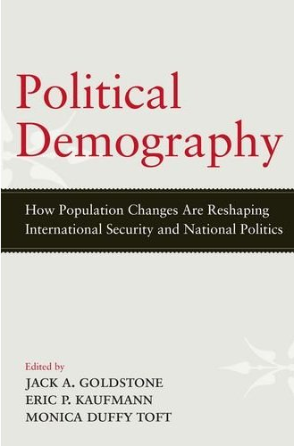

Conceptual Frameworks
Dominant Ethnicity
Political Demography
Ethnic Status

Slide 5
Data and Methods
Methods: Quantitative and Qualitative
Quantitative First, then qual, then back to quant
Today mainly on quantitative findings to date
Sources: ESRC datasets: BHPS, Understanding Society, Citizenship Survey, ONS LS

Slide 6
Save our Census!
The permission of the Office for National Statistics to use the Longitudinal Study is gratefully acknowledged, as is the help provided by staff of the Centre for Longitudinal Study Information & User Support (CeLSIUS). CeLSIUS is supported by the ESRC Census of Population Programme (Award Ref: ES/K000365/1). The authors alone are responsible for the interpretation of the data.
Census output is Crown copyright and is reproduced with the permission of the Controller of HMSO and the Queen's Printer for Scotland.
The results presented are based on a test version of the LS database incorporating 2011 Census data. Figures may be subject to change when the final version of this database is released in November 2013.

Slide 7
Voice: Opposition to immigration
The Citizenship Survey has asked the question:
  “Do you think the number of immigrants coming to Britain nowadays should be increased a lot, increased a little, remain the same as it is, reduced a little, or reduced a lot?”
Majority view, consistently over 80% since 2005 amongst white UK-born population
Data, pooled dataset of four Citizenship Surveys 2007-08, 2008-09, 2009-10, 2010-11
What about non-white views of immigration?
Does local diversity increase or reduce white hostility to immigration?

Slide 8
Not just white British….
Source: Home Office/DCLG Citizenship Surveys, 2007-11 (Cumulative)

Slide 11
Reduce the number of immigrants (a lot and a little) by social class and ward diversity (aggregated dataset) for all white respondents

Slide 12
All Politics is Local
Puzzle: Why are whites (and even white working-class British) people living in diverse wards more tolerant of immigration?

Slide 13
Threat or Contact?
Whites – even the white working class – living in diverse wards are more tolerant of immigration
US literature shows that diversity at ward/tract level (10-30k) is associated with less white hostility to immigrants, minorities, immigration
BUT at metro/county/LA level (100k-1m), more diversity is associated with more white hostility
Feeling of threat at metro level as minorities grow, but positive contact at local level creates accommodation?

Slide 14
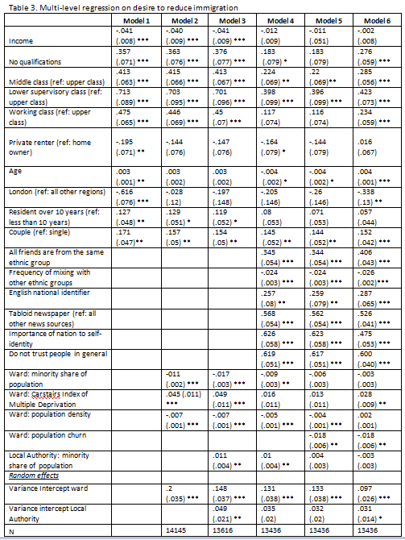

Slide 15
Desire to reduce immigration by Local Authority & highest quartile of % minority population (selected in black)
Desire to reduce immigration by Local Authority & highest quartile of % white British population (selected in black)
http://www.smartcensus.org.uk/index.php?option=com_wrapper&view=wrapper&Itemid=611

Slide 16
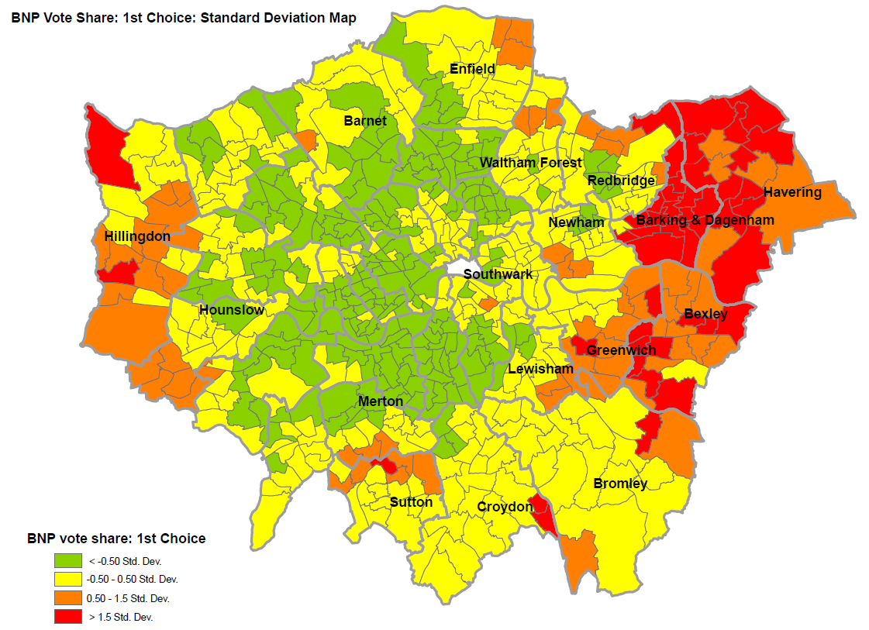

Slide 17
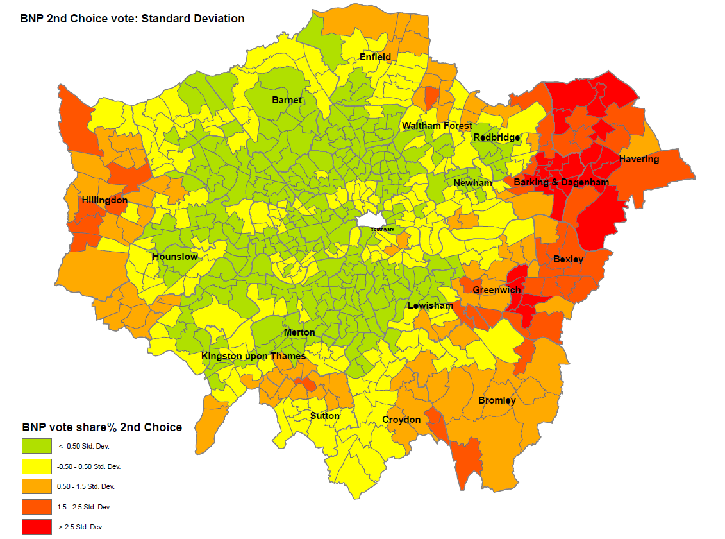

Slide 22
Why are diverse neighbourhoods in whiter metros most tolerant?
Contact or Threat is the usual framework
But other explanations:
  Theory #1) not diversity of neighbourhood per se, but something about the white population in diverse areas that is different

Slide 23
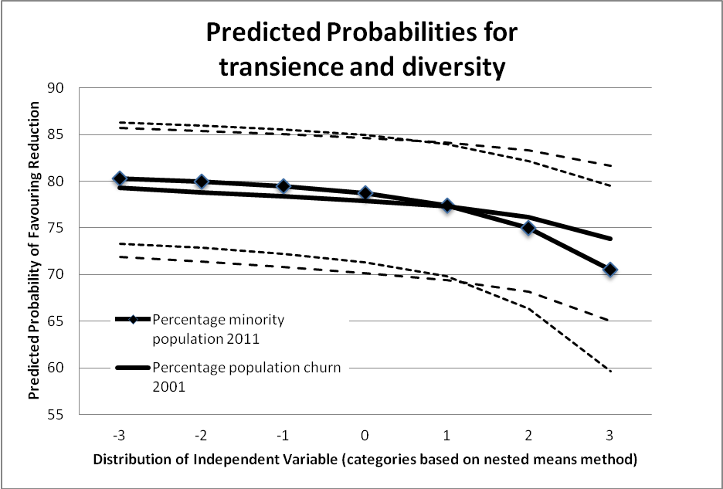
Note: Dotted lines represent 95% confidence intervals for predicted variable.

Slide 24
Theory # 2 - Selection Bias
No one has properly tested
Have tested with BHPS/Understanding Society
Compare those who enter and leave diverse wards
Compare movers (enter/leave) with those who stay
But let’s explore ‘white flight’

Slide 25
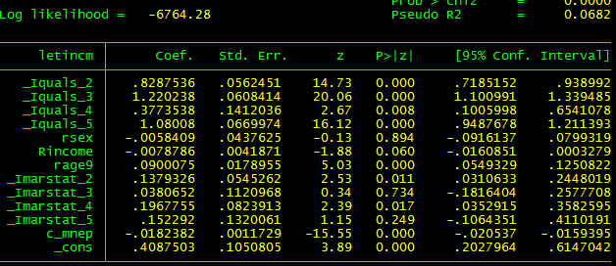
% Minorities Softens Views on Immigration
Source: Home Office Citizenship Surveys, 2006-11

Slide 26
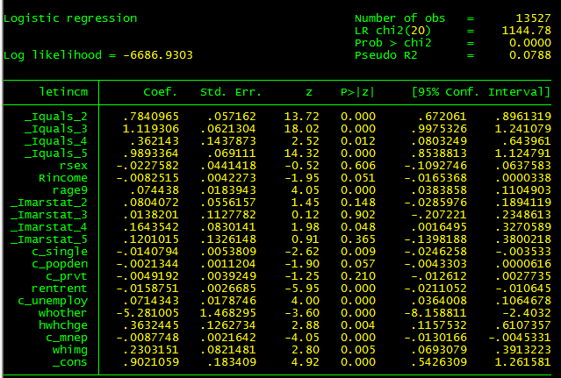
…Adding Mobility & Contextuals

Slide 27
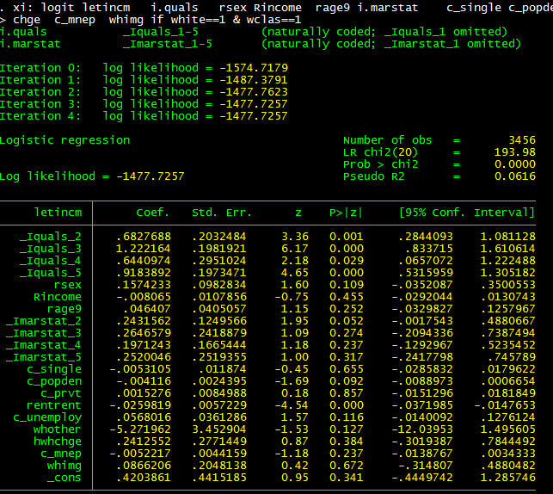
Focusing on Working Class

Slide 28
Drivers of opposition to immigration

Slide 29
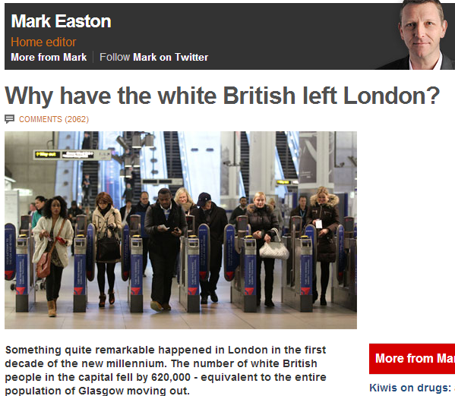
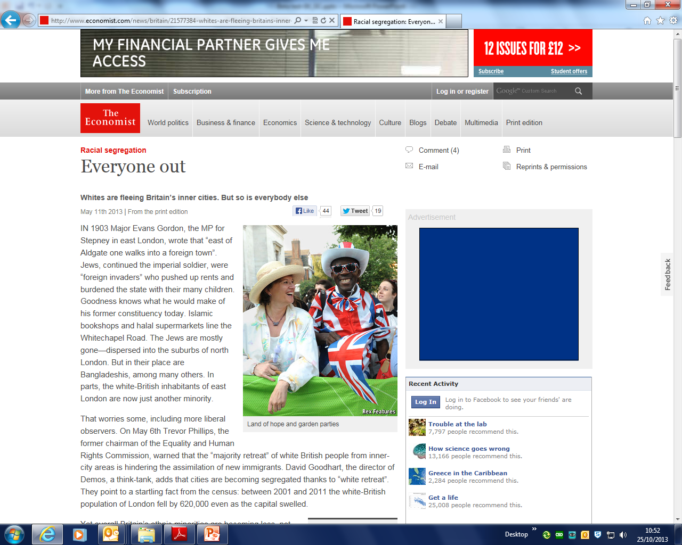
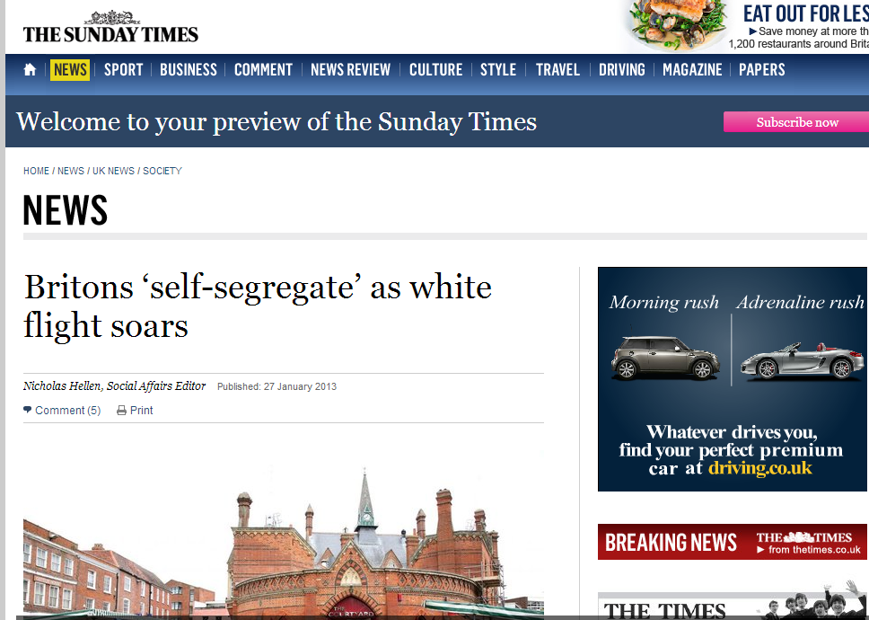
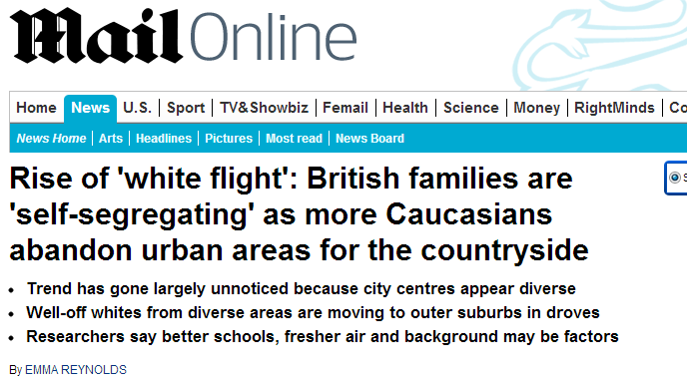
White Flight?

Slide 30
Net Migration from London by Ethnicity: with rest of England & Wales,
1971-2011
 | White British | Net Migration to London from Rest of England and Wales
 | In | Out | Net | % Change
1971-1981 | 3,030 | 7,495 | -4,465 | -14.7%
1981-1991 | 3,724 | 7,208 | -3,484 | -11.0%
1991-2001 | 3,566 | 7,402 | -3,836 | -11.0%
2001-11 | 2,953 | 6,962 | -4,009 | -13.4%
 | White British | WB Working/ Middle Class | WB Professional | WB with Children | WB Twenties
1971-1981 | -14.7% | -14.0% | -11.2% | -21.9% | -2.1%
1981-1991 | -11.0% | -12.0% | -10.0% | -13.1% | 11.7%
1991-2001 | -11.0% | -12.7% | -6.4% | -15.1% | 27.7%
2001-11 | -13.4% | -15.3% | -12.4% | -19.6% | 24.0%
 | Minority | Minority Working/ Middle Class | Minority Professional | Minority with Children | Minority Twenties
1971-1981 | 1.0% | 2.1% | 1.9% | 0.7% | 9.6%
1981-1991 | 2.7% | 2.3% | 3.1% | 3.3% | 11.0%
1991-2001 | -1.9% | -1.5% | -1.3% | -3.6% | 2.3%
2001-11 | -4.1% | -4.1% | -3.8% | -6.9% | 0.5%

Slide 31
Quintiles (ONS LS 2011)
 | Diverse fifth of Wards | Homogeneous four-fifths of Wards
2011 | 40.7% Minority | 4.9% Minority
2001 | 27.8% Minority | 2.4% Minority
1991 | 19.8% Minority | 1.5% Minority
White British net outflow
Minority net outflow

Slide 32
Smart Census Data Plotter
file:///C:/1-Data/1-1-work/1-Research/1-1-Projects/1-white%20flight/Models/UK/Ridgway/dependent%20children/5dplot_fromtxt_quick%20start.swf [Class; Dependent Children v 20s; Mixed Ethnicity House; English; Tenure]
http://www.smartcensus.org.uk/index.php?option=com_wrapper&view=wrapper&Itemid=611 [time permitting, to show deprivation-density-diversity link]

Slide 33
Manchester 1991-2001
London 1991-2001

Slide 35
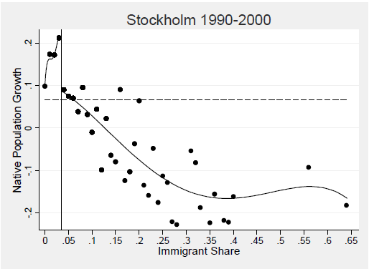
USA 1970-2000
Source: Andersson Hammarstedt Neuman 2012
Source: data from Card Mas & Rothstein 2008

Slide 36
How did Ethnic Groups Move?: by Ethnic Neighbourhood Type, 2001-11
Source: R. Johnston, M. Poulsen, J. Forrest, Multiethnic residential areas in a multiethnic country? A decade of major change in England and Wales,’ Environment and Planning A 2013, volume 45, pages 753 – 759

Slide 37
Change in Segregation (ID), 1991-2011, England and Wales
Changes in Mutual Segregation (index of dissimilarity),
for Combinations of Groups, 1991-2001 and 2001-2011
White British-Minority little change
White British-individual minorities modest decline
Minority-minority largest decline

Slide 38
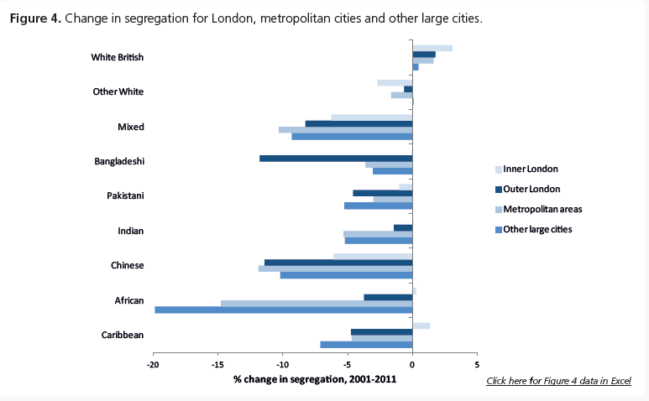
Source: Catney, G. 2013. ‘Has neighbourhood ethnic segregation decreased,’ Dynamics of Diversity: Evidence from the 2011 census (JRF/Manchester: February), ethnicity.ac.uk

Slide 39
Simpson (2007) Method
 | Wards | % White
Quintile 1 | 7554 | 98
Quintile 2 | 726 | 87
Quintile 3 | 288 | 73
Quintile 4 | 180 | 57
Quintile 5 | 102 | 34
Total | 8850 | 91
White Flight/Avoiders
Diversity Seekers

Slide 40
BHPS & Understanding Society: Attitudes of Movers. Mover Intentions.
 | Want to Move from White Minority Area (Quintiles 4 & 5)
 | All | Nonwhite | White | White Working |  | Minority Working
 | 47.3% | 45.5% | 49.5% | 59.7% |  | 38.2%
N | 3772 | 805 | 1840 | 466 |  | 222
 | Want to Move from 98% White Area (Quintile 1)
 | All | Nonwhite | White | White Working |  | Minority Working
 | 32.4% | 46.4% | 32.4% | 37.7% |  | 50%
N | 67151 | 491 | 49670 | 13458 |  | 144
Source: British Household Panel Survey & UKHLS 1991-2012

Slide 41
 |  | Moved Out of Ward in 2000-2001:
 | Wards | Wh British | Minorities | WH Other | White Irish
98% White | 7554 | 1.1% | 4.7% | 3.2% | 1.5%
87% White | 726 | 5.4% | 6.4% | 7.7% | 4.1%
73% White | 288 | 6.8% | 6.0% | 8.1% | 5.6%
57% White | 180 | 7.0% | 4.6% | 7.8% | 3.8%
33% White | 102 | 6.1% | 2.9% | 13.1% | 3.2%
Total | 8850
Source: Office for National Statistics. 2001. ONS Longitudinal Study.

Slide 42
What Items are on the Menu?
Option A
Deprived
Urban
Diverse
Rental Stock
London
Option B
Low Deprivation
Rural
Homogeneous White British
Homeowner Stock
Non-London
Option C?
Deprived
Urban
Homogeneous White British
Rental Stock
London
Option D?
Low Deprivation
Rural
Diverse
Homeowner Stock
Non-London

Slide 43
Which is the more important slice?
A
B

Slide 44
Net Migration from Diverse Wards (quintile 1) by Ethnicity,
1991-2011
White British Interward Movers | Net Migration to Diverse Wards as Share of White British Mover Population:
 | In White Ward '01 | In Diverse Ward '01 | Total Inter-Ward Movers '01
Move to Whiter Ward '01-11 |  | 14330 | 14330
Move to Same Diversity Ward '01-11 | 67065 | 7303 | 74368
Move to More Diverse Ward '01-11 | 9180 |  | 9180
 | 76,245 | 21,633 | 97,878
 | 12.0% | 66.2% | -54.2%
Minority Interward Movers 2001-2011 | Net Migration to Diverse Wards as Share of Minority Mover Population:
 | In White Ward '01 | In Diverse Ward '01 | Total Inter-Ward Movers '01
Move to Whiter Ward '01-11 |  | 1,889 | 1,889
Move to Same Diversity Ward '01-11 | 1,527 | 6,206 | 7,733
Move to More Diverse Ward '01-11 | 1,017 |  | 1,017
 | 2,544 | 8,095 | 10,639
 | 40.0% | 23.3% | 16.6%
White British Inter-Ward Movers | Net Migration to Diverse Wards as Share of White British Mover Population |  |  |  | % Change
 | In | Out | Net
1991-2001 | 10,165 | 14,858 | -4,693 |  | -4.4%
2001-11 | 9,180 | 14,330 | -5,150 |  | -5.3%
Minority Inter-Ward Movers | Net Migration to Diverse Wards as Share of Minority Mover Population |  |  |  | % Change
 | In | Out | Net
1991-2001 | 689 | 1,104 | -415 |  | -5.8%
2001-11 | 1,017 | 1,889 | -872 |  | -8.2%

Slide 45
66% out , 12% into diversity:
Net ‘Segregation’
23% out, 40% into diversity:
Net ‘Integration’
White British
- 12%
Minorities
- 40%
- 66%
-23%

Slide 46
Toward v Away from Diversity – Statistical Models
Ethnicity matters: Groups move from themselves except white British; white British move from diversity, others to diversity
Higher education/occupation move to diverse wards rather than away*, young, students as well.
White British leave diversity when: in more diverse ward, with children, working/middle class more than Professionals; Toward diversity: in mixed-ethnicity house, renter, 20s. English v. British/Celtic not significant (no white flight?)
Minorities leave diversity when: in mixed-race house, English; toward diversity: in whiter ward.

Slide 47
Into or out of London –
Statistical Models
English, UK-born predicts move out
White in mixed ethnic house, degree, young, foreign-born: predicts stayer. Inner London
Higher education/occupation, foreign-born predicts move to London from elsewhere in UK

Slide 48
White Flight?:
Yougov-ESRC-BBK Survey, August 2013
 | Moved To Whiter Ward past 10 yrs | Moved To More Diverse Ward past 10 yrs | Sample
Not White British | 53% | 47% | 47
White British | 62% | 38% | 239
Total | 60% | 40% | 286

Slide 49
Comfort with spouse of different race among ward movers, White British only (Yougov/ESRC survey)
 | To Whiter | To Diverse Sample
very comfortable | 61% | 39% | 83
fairly comfortable | 67% | 33% | 33
neither comfortable n | 57% | 43% | 46
fairly uncomfortable | 64% | 36% | 11
very uncomfortable | 76% | 24% | 25
don't know | 58% | 42% | 24
Total | 63% | 37% | 222

Slide 50
Conclusion
White British prefer 90+% white areas, except in their 20s
Not ‘white flight’: white cultural attraction/status, not white anxiety over boundaries
Anti-immigration, political or racist attitudes not strongly linked to moving to whiter area, esp when compared to stayers
No selection bias

Slide 51
…..
Local ethnic geography and demography matter for national issue perceptions and vice-versa
Anti-immigration and far right vote (closure 1) not linked to white flight/avoidance (closure 2)
But upper working/lower middle class are more likely to be both ‘white flighters’ and white nationalists
Some support for contact theory but much of the positive effect of diversity is due to other aspects of diverse areas (transient, urban).
White attitudes to immigration may be softened by contact in locale;
or may be hardened by diversity in metro OR by jumps in minority presence in formerly lily-white areas

Slide 52
Future Research
Focus Group Work required to tease out meanings that white working class people hold
4 focus groups, 2 in white minority areas, 2 in adjacent mainly white areas. 2 in London, 2 in North or Midlands
2011 data updates (ONS LS, Census)

Slide 53
Potential Policy Implications
Immigration: not principally about white working class
Housing: retain white British population (social housing, housebuilding, benefits)
Housing: aim for dispersed building, slow demographic change. Not to disperse minorities to homogeneous areas
Schooling: yes to mixed catchment, but sensitivity to white tipping

