Slide 1
Clash of Civilizations or Narcissism of Minor Differences?: Huntington Revisited
Eric Kaufmann
Department of Politics
Birkbeck College
e.kaufmann@bbk.ac.uk

Slide 2
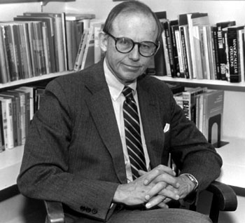
Huntington & Clash of Civilizations
Realism and Liberalism consider only interests and interdependency
Identity: not that of constructivists, but of ethnicity, nationalism, religion, civilization

Slide 3
Two Huntingtons
Huntington I: not ideology, economics or realism, but culture
‘Ancestry, religion, language, history, values, customs’
Huntington II: system builder, grand theorist of Civilizations
Huntington I more important than II

Slide 4
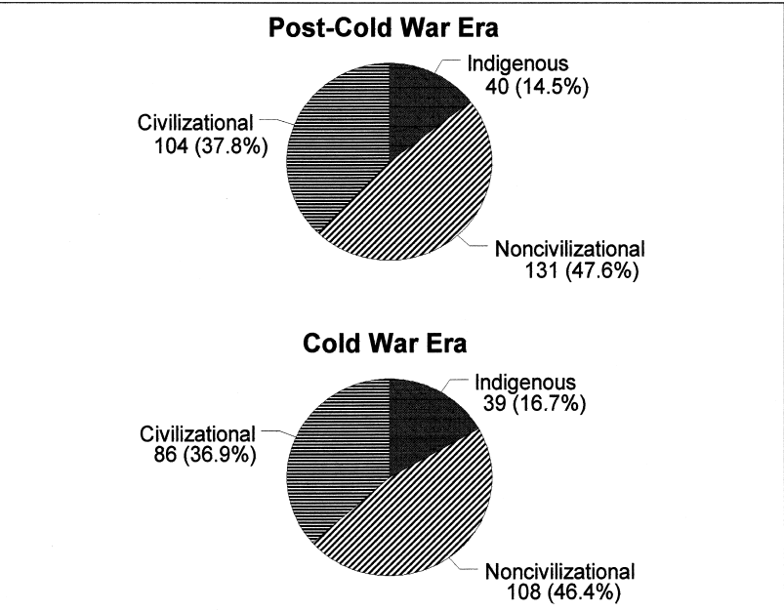
Ethnic Conflicts and the Huntington Thesis

Slide 5
Measuring Interstate Conflict
Unit is the Dyad: i.e. France-Malawi 1991, France-Malawi 1992, France-Iraq 1992…
Militarized Interstate Disputes (MID) – 2690 events of 512,000 during 1945-2001
Alliance Behaviour – 34,266 events of 512,000
Using Gartzke and Gleditsch 2006 data

Slide 6
Militarized Interstate Disputes, 1992
State1 | State2
Albania | Serbia
Armenia | Azerbaijan
Burma (Myanmar) | Thailand
Croatia | Serbia
France | Serbia
France | Iraq
Germany | Serbia
Guinea-Bissau | Senegal
India | Sri Lanka
India | Papua New Guinea
Iran | Iraq
Iran | United Arab Emirates
Iraq | Kuwait
Italy | Serbia
Korea, Democratic Pe | Korea, Republic of
Malaysia | Singapore
Moldova | Russia
Russia | Estonia
Russia | Ukraine
Russia | Georgia
Russia | Sweden
Serbia | Greece
Serbia | Turkey
Spain | Serbia
United Kingdom | Serbia
United Kingdom | Iraq
United States | Peru
United States | Serbia
United States | Iraq

Slide 7
Debate: Is Interstate War More Likely Between Civilisations?
Huntington is wrong because countries from similar civilizations go to war against each other more often than those from different civilizations (Chiozza 2002; Gartzke & Gleditsch 2006)
Huntington is correct because countries on a civilizational faultline ARE more likely to go to war (Charron 2010)
I examine both MID and KOSIMO measures

Slide 10
Is Huntington right? No.
‘Realist’ factors (distance, power balance, contiguity) most important
‘Liberal’ factors (regime type, trade) very important
Cultural Factors also important, but somewhat less so
Civilization per se unimportant for war

Slide 11
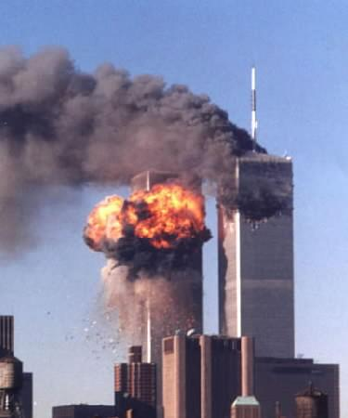
Is Huntington right? Yes.
Ethnic and religious culture more important than ideology
Civilizational faultlines are important for war
Civilization matters for alliance behaviour, especially Israel’s relations with Muslim countries, West with Latin America

Slide 12
Clash of Civilizations or Narcissism of Minor Differences?
What explains the anomaly: nationalism.
Religion is a marker of ethnicity and nationalism
Ethnic groups historically formed on faultlines, esp. Christian-Islam (ie. Armstrong 1982; Hastings 1997)
Faultlines are picking up ethnic differences that are marked by religion
Missing those that are not religious: i.e. Iran-Iraq, Russia-Georgia
But, nationalism unimportant for alliance behaviour

Slide 13
Conclusion
Nationalism, not civilization, is the key cultural principle for war
Civilization rather than nationalism is a somewhat important cultural principle for alliance behaviour
Culture matters in IR, but less so than the basics of distance, trade, regime type
No major shift to culture post-Cold War
Huntington I more support than Huntington II

