Slide 1
Demography and Group Conflict
Political demography studies unevenness between demographic populations, which correspond – however imperfectly - to political groups
Ethnic groups, regions, nations, civilizations - are distinct populations, though not clear where boundaries lie
National or ethnic populations are almost never totally separate: assimilation and dissimilation can muddy the waters of identity. Ethnic people can change their identity and immigrants can assimilate into a new ethnic identity over generations

Slide 2
Groups: Primordial or Constructed?
Theories of nationalism
How quickly can group boundaries be constructed, invented?
Rigidity or flexibility of ethnic boundaries.

Slide 3
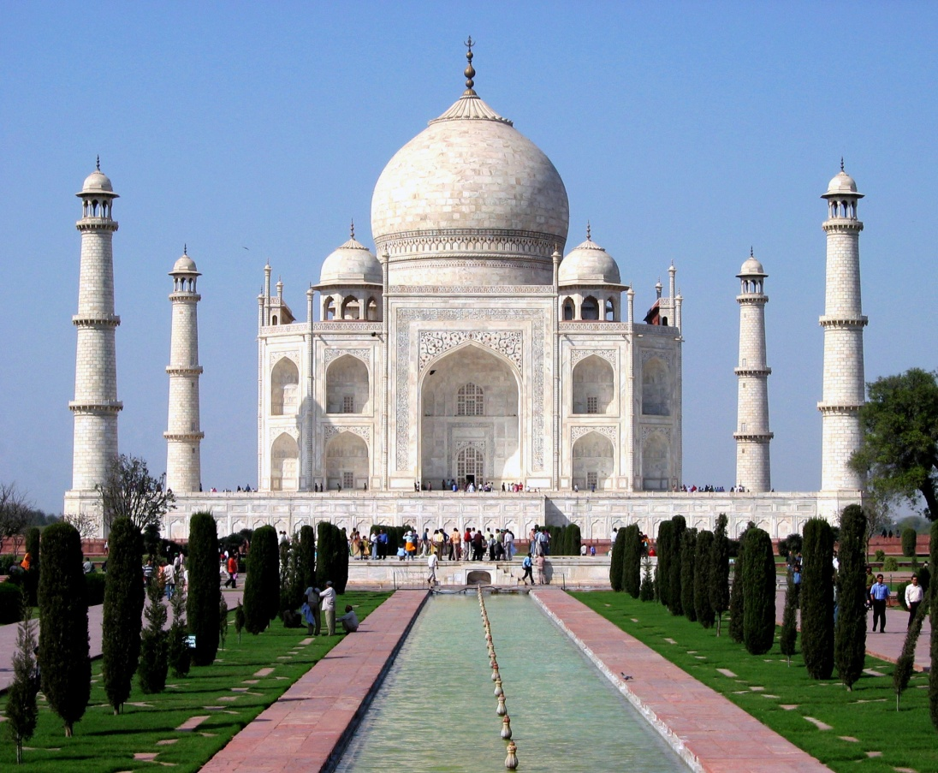
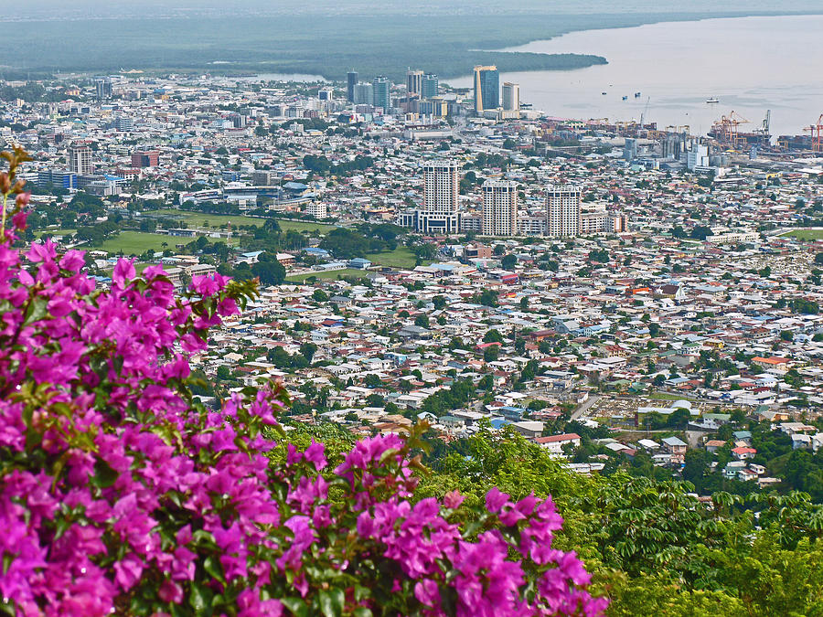
Tight or Loose Ethnic Boundaries?

Slide 4
Ethnic Boundaries
  Varies by type of group: state v ethnic group
  Varies by location: North India v Caribbean, Americas & Africa
  May be rooted in specific traditions concerning boundary maintenance of patrilineal v matrilineal descent rules (Wimmer)

Slide 5
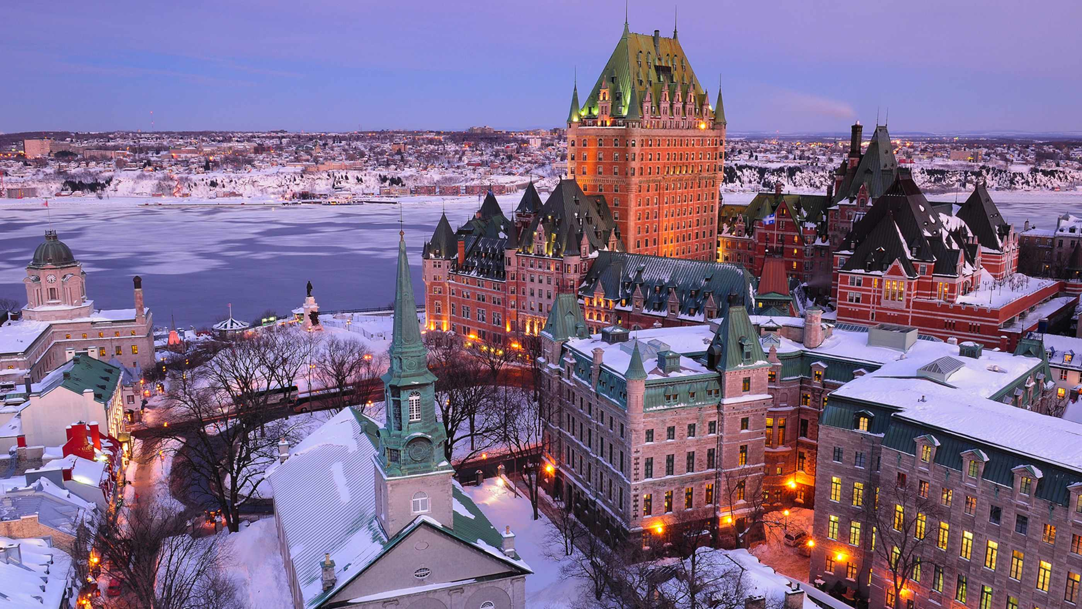
Issues of Demographic Ethnic Conflict
In Canada, French-Canadians already had much higher birthrates than British in 19th c. One of the highest growth rates in history
French expanded west into four Ontario border counties and into N Ontario
Priests and Quebec nationalists used 'La revanche du berceau' (revenge of the cradle) to hold the demographic line against massive British immigration from late 19th c
Both French growth and British immigration were causes of British-French conflict, in both established and frontier areas

Slide 6

Demography and Ethnic Conflict: Northern Ireland
"The basic fear of Protestants in Northern Ireland is that they will be outbred by the Roman Catholics. It is as simple as that." - Terence O’ Neill, Unionist PM of Northern Ireland after resigning, 1969

Slide 7
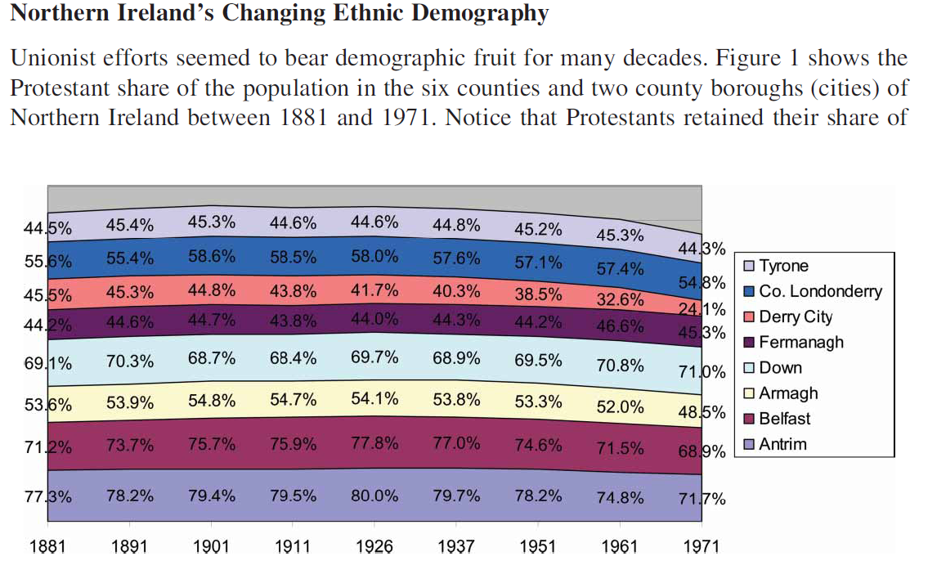

Slide 8
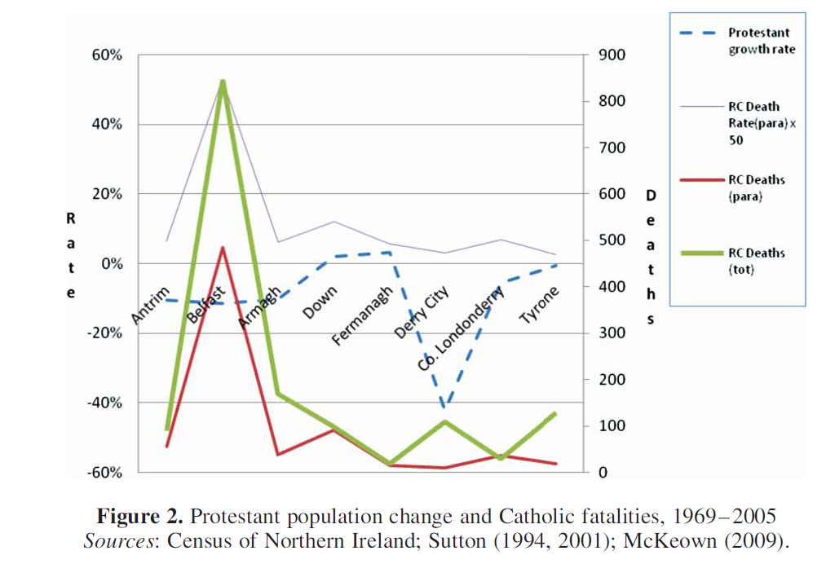

Slide 9
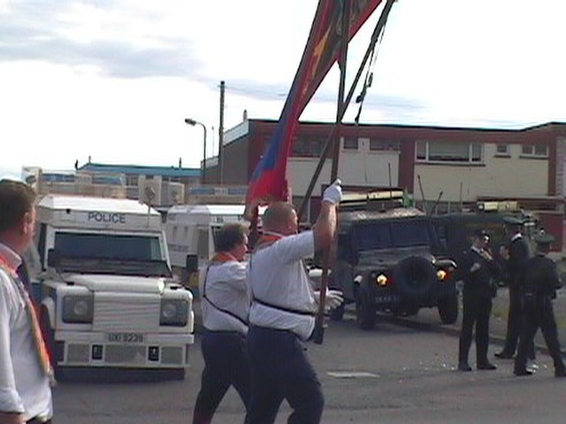

Slide 10
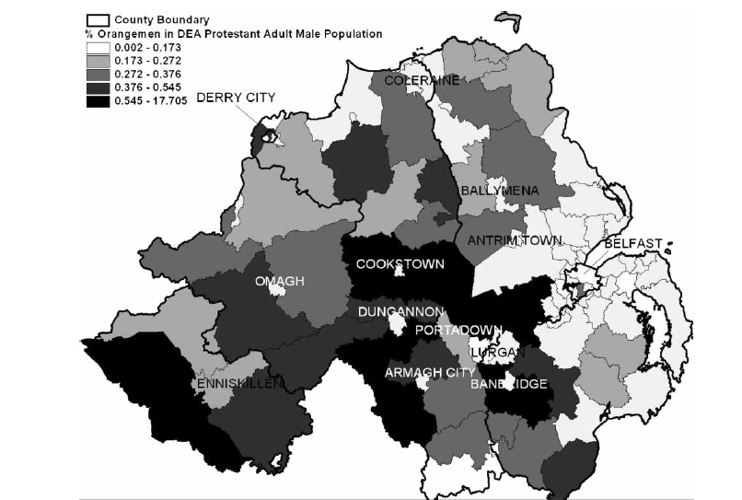

Slide 11
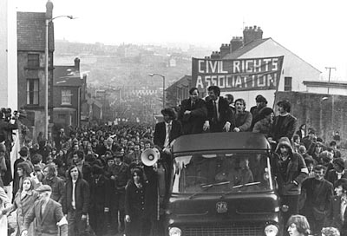
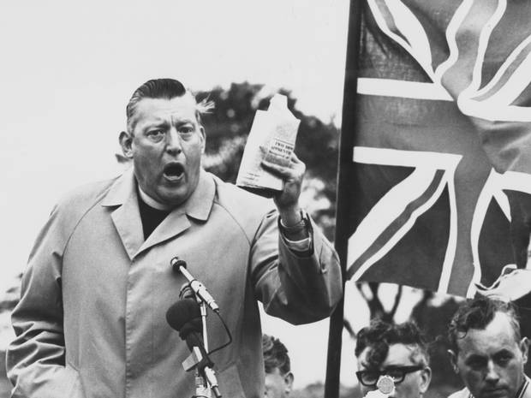
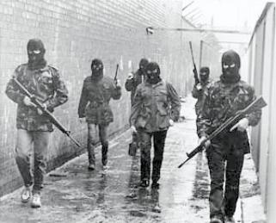
Protest, Intransigence, and Reaction

Slide 12
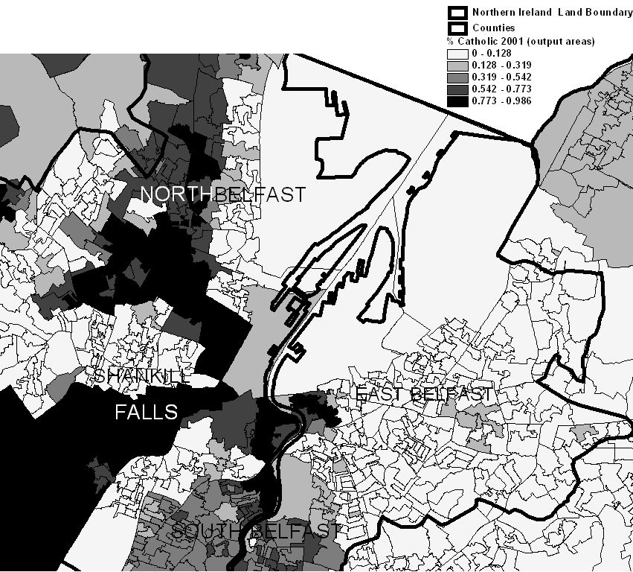

Slide 13
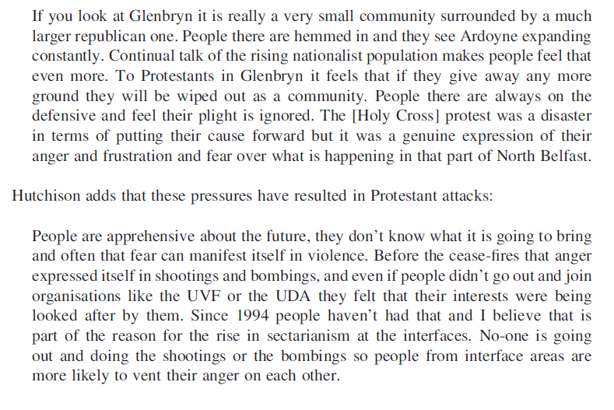

Slide 14
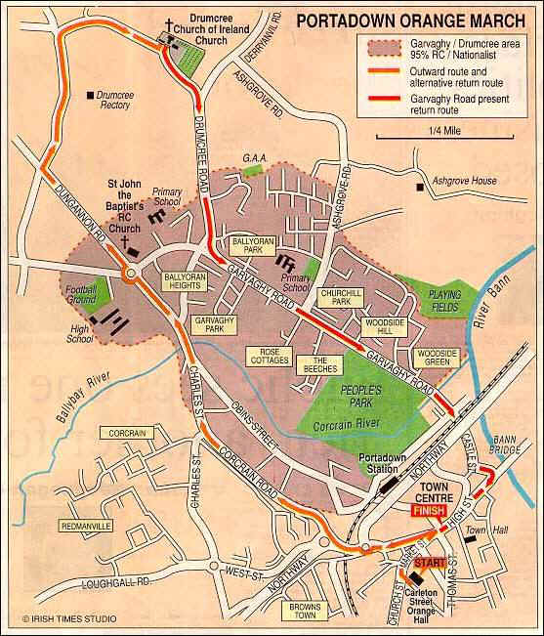
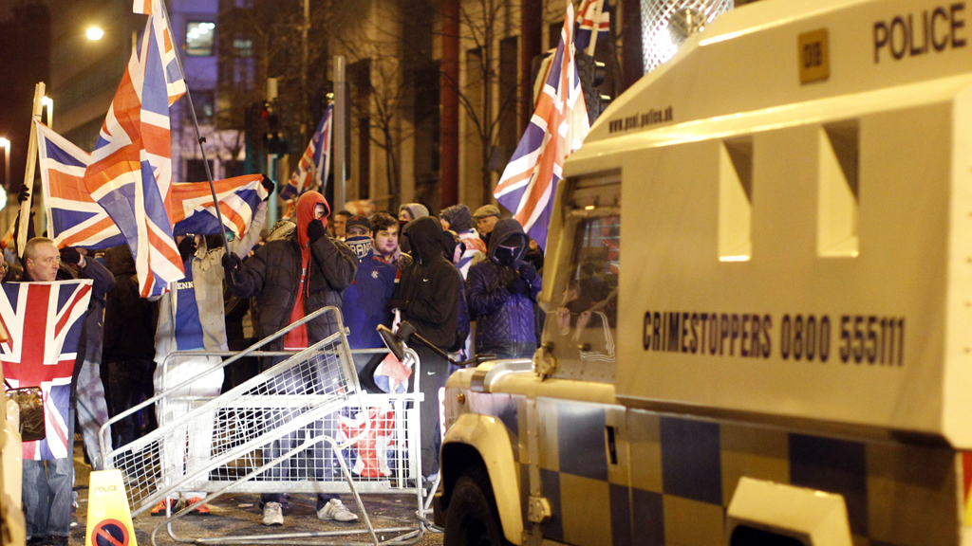
Demography and Ethnic Conflict: Northern Ireland
IRA invests its hope in demography as a substitute for violence

Slide 15
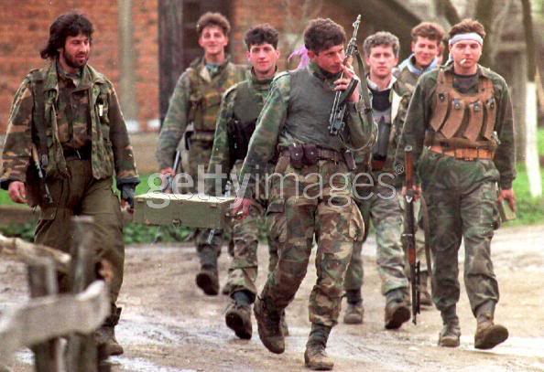
Ex-Yugoslavia, E Europe
Kosovo: once 1/3 Serbian, declined. Causes tensions
Bosnia: areas where Muslim/Serb fertility differences were high were more conflict prone
Macedonia: strict limits on number of Albanian refugees accepted – and then only temporary

Slide 16
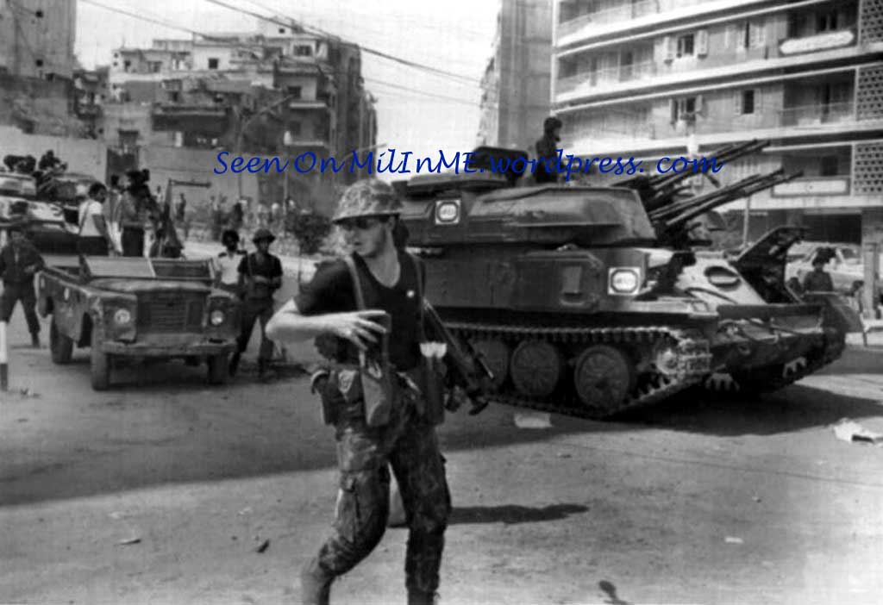
Middle East
Lebanon: Muslim fertility and immigration helped spark civil war
Israel: worries about Jewish-Muslim and secular-orthodox fertility differentials

Slide 17
Sons of the Soil Conflicts
Residence and Rebellion: Mean Maximum Rebellion Scores by Category of Residence
 | YES | NO
Has the Group Been in the Country Since 1800? | 2.9 (n=248) | 1 (n=50)
Does the Group have a Regional Base? | 2.9 (n=276) | 1.1 (n=123)
N.B. A score of 1 indicates no rebellion.
N refers to number of such groups in the MAR dataset. Source: Fearon and Laitin 2011

Slide 18
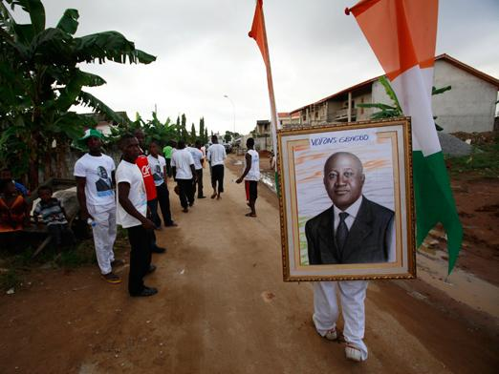
Sons of the Soil Conflicts
‘Our’ land. Concern with migrants
Indigenousness (Eriksen 1993)
Dominant ethnicity; dominant ethno-nationalism (Kaufmann 2004)

Slide 19
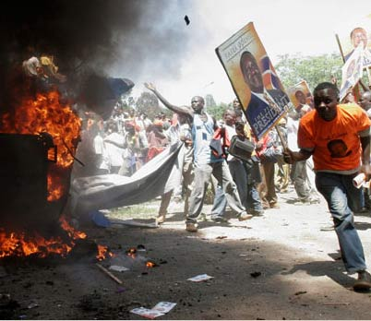
Ethno-nationalism includes a concern with individual migration/change
Autochthony: internal migration across ethnic boundaries, into ‘our’ land

Slide 20
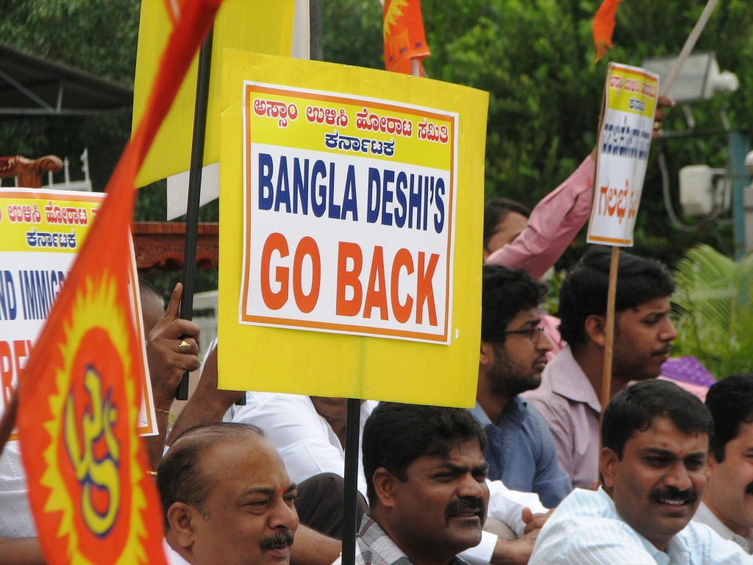
Migration and minority growth
Assam, India: native Assamese, outnumbered 15:1, instigate violence against Bengalis
Hungary, Slovakia, Romania, Czech: Roma growth
Immigration in the West?

Slide 21
Nationalism Theory and Demography
Instrumentalists believe that host societies can absorb newcomers and redefine identities (US WASPs redefined themselves; some societies became peaceably multiethnic). Ethnicity is malleable and transcends demographic ‘populations’
Ethnosymbolists would argue that boundaries are permeable, but not porous. Primordialists would argue that ethnic populations are genetically distinct and hence all immigration causes zero-sum conflict

