Slide 1
Population Aging,
World Population Shifts and the
Global Balance of Power

Slide 2
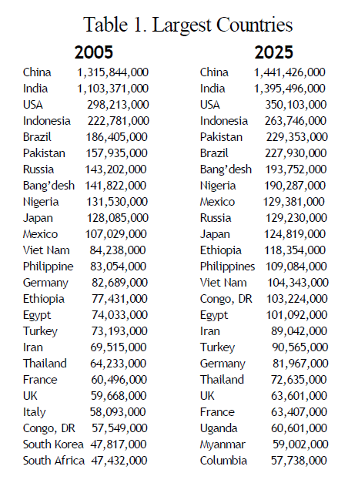

Slide 3
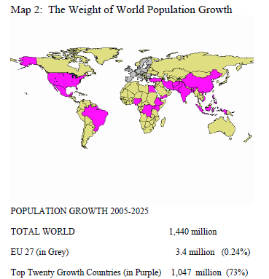
Source: Goldstone, ‘Flash Points and Tipping Points’, 2007

Slide 4
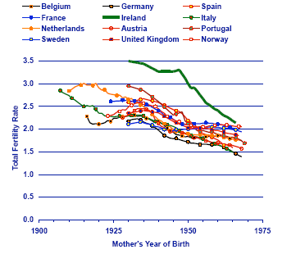

Slide 5
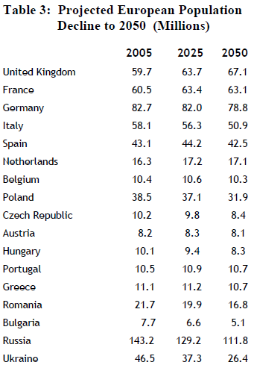
Source: Goldstone, ‘Flash Points and Tipping Points’, 2007

Slide 6

At a TFR of 1.3, a country is only ¼ its present size in 100 years. Many countries in Southern and Eastern Europe not far off this

Slide 7
Population and GDP, 1950-2001
Source: Demeny & McNicoll 2007

Slide 8
Aging

Slide 9
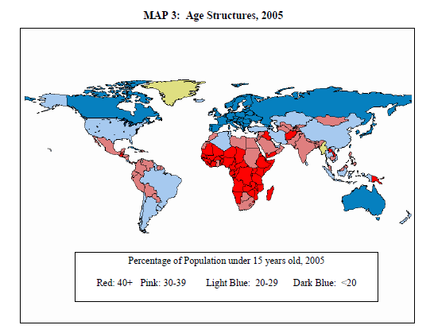
Source: Goldstone, ‘Flash Points and Tipping Points’, 2007

Slide 10
World's Oldest Countries, 2000 and 2050
in 2000 in 2050
Country
15-59
60+
15-59
60+
Italy
61.7
24.1
46.2
42.3
Greece
61.5
23.4
46.2
40.7
Germany
61.2
23.2
49.5
38.1
Japan
62.1
23.2
45.2
42.3
Sweden
59.4
22.4
48.3
37.7
Belgium
60.6
22.1
50.3
35.5
Spain
63.5
21.8
44.5
44.1
Bulgaria
62.6
21.7
47.6
38.6
Switzerland
62.1
21.3
48.6
38.9
Latvia
61.7
20.9
47.5
37.5
Portugal
62.5
20.8
49.9
35.7
Austria
62.6
20.7
47.4
41.0
United Kingdom
60.4
20.6
51.1
34.0
Ukraine
61.6
20.5
49.0
38.1
France
60.7
20.5
51.3
32.7
Estonia
62.1
20.2
48.5
35.9
Croatia
61.8
20.2
53.0
30.8
Denmark
61.8
20.0
53.0
31.8
Finland
62.0
19.9
50.6
34.4
Hungary
63.3
19.7
49.4
36.2
Norway
60.7
19.6
51.7
32.3
Luxembourg
62.0
19.4
57.1
25.2
Slovenia
65.0
19.2
45.1
42.4
Belarus
62.4
18.9
49.6
35.8
Romania
62.9
18.8
50.0
34.2
Source: Goldstone 2007

Slide 11
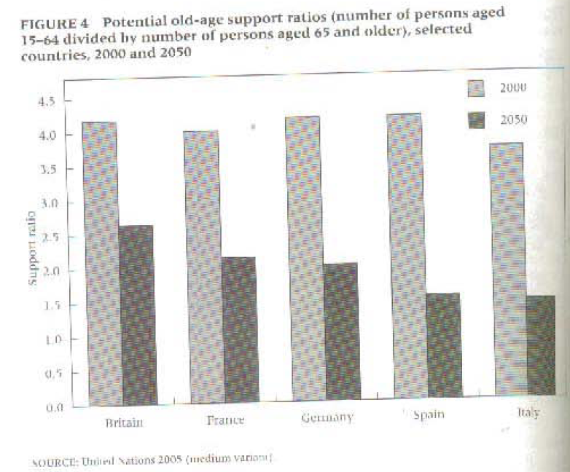

Slide 12
Population Aging
Future aging built into population age structure. Demographic momentum
Immigration would have to be ‘orders of magnitude higher’ (Haas) to compensate
Fertility unlikely to radically change. Decades-long pattern
Fewer workers per dependant
Older people vote more, will vote for spending for elderly and healthcare

Slide 13
Big drop in working age population to 2050: Russia -27, Germany -25, China -19, Japan -32
*China as old as W Europe by 2035
But rise of 17 in USA, 5 in France, 2 in UK
US in best position, but with powerful old-age lobby (AARP)

Slide 14

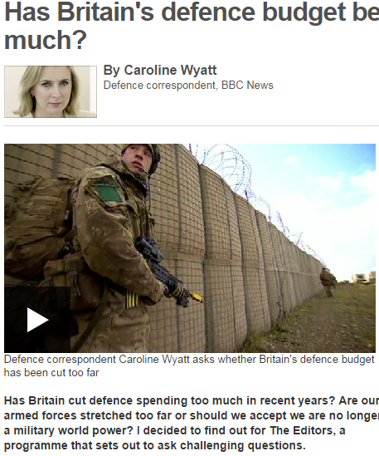
Guns vs. Canes

Slide 15
Aging and the Military
Decrease in tax revenue as fewer workers
Increase in spending on elderly
Decrease in savings as elderly spend lifetime savings
Less money for military expenditures

Slide 16
Elderly Care
Japan increase in elderly spend will be 15 x more than current military spend
Germany: 7x, France 5 x
Cuts to military already sometimes justified in terms of more for elderly, ie Japan
Exceptions?: China – limited elderly care; Russia – low life expectancy
China has relied on families to care for elderly, yet smaller families will make that harder. Rising discontent

Slide 17
Weapons v Military Pensions
Not just balance of spending between military and welfare
Military budgets themselves shifting to cover personnel and obligations to military retirees
France/Ger: 60 pc of military budgets to personnel costs
Personnel v weapons: Germany – 4x, France, Japan, Russia – 2.5x, USA- only 1.3x

Slide 18
Geriatric Peace?
Older countries:
  smaller militaries
  fewer weapons
  less risk-taking?
  publics less willing to risk lives of their children?

Slide 19

Sons and war
Surplus sons, as well as youth bulge, contribute to warlike behaviour
Iraq, Afghanistan
Lebanon 1975 v 2006
In aging societies like China, little appetite for sacrificing ‘little emperors’

Slide 20
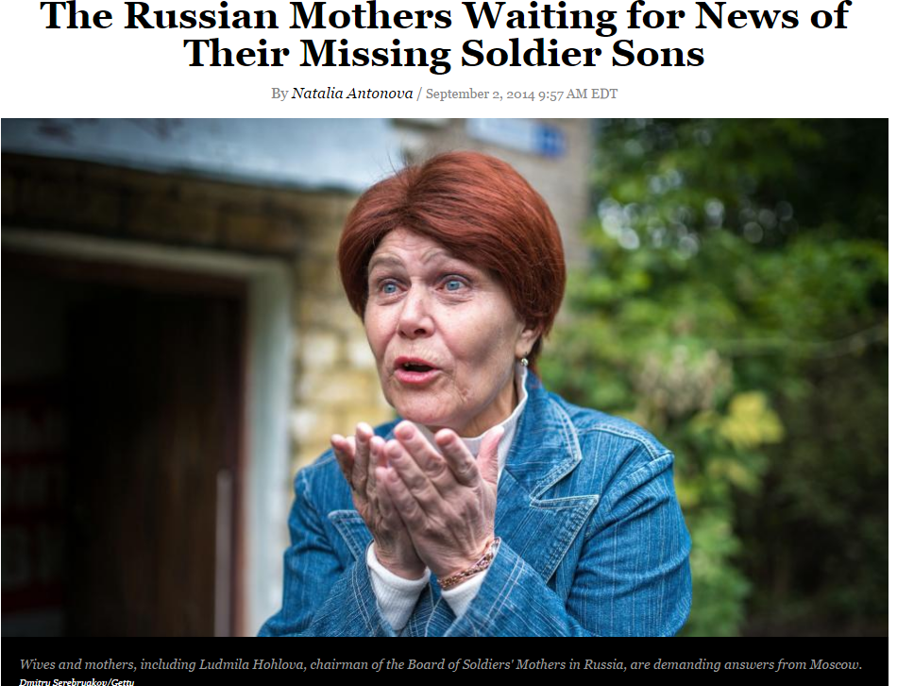

Slide 21
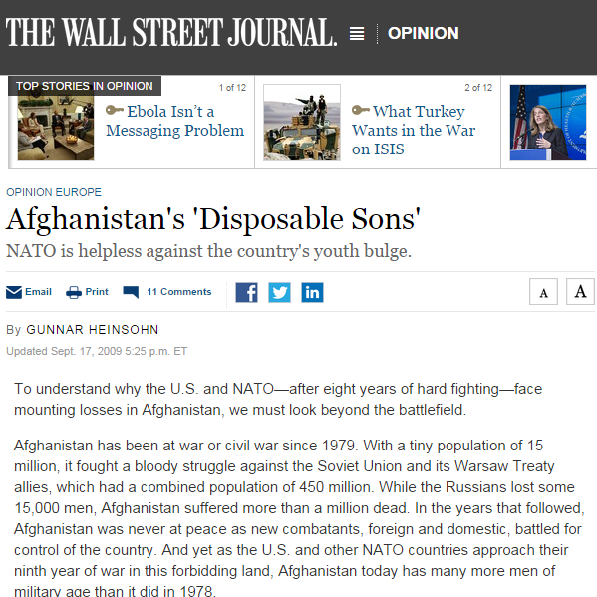
Bring our boys home
Will aging sharpen divide between growing and aging societies?
Less 1st world intervention in the developing world?

Slide 22
Figure 5: Youth population 2030
UN Department of Economic and Social Affairs (2011) appearing in EUISS ESPAS Report, p.51

Slide 23
Power Shift to Developing World?
Europe, Japan and Russia in decline
China not far behind
US more stable
Mideast, S Asia, Africa rising?
Yet no obvious mideast or African power on the horizon

Slide 24
IR Theory
Hedley Bull: 100 million population needed for Great Power. Necessary, not sufficient
Power transition theory (Organski and others): rising powers (population, GDP, hard power) cause instability in world system

Slide 25
Historic Population Explosions and Power Shifts
Britain rises 19th c, worrying France
Germany late 19th - early 20th c, worrying Britain and France
Russia early/mid 20th c, worrying the West
Who now?: China? Muslim world?
Note: Link between industrialisation and population growth as well

Slide 26
Jackson & Howe on Social Mood
Alfred Sauvy: ‘society of old people, living in old houses, ruminating about old ideas’
Fluid intelligence and mental agility decline with age. Nobel Prize winners’ work peaks in 30s, declines sharply in 40s
Less incentive to challenge status quo ideas
Of study of ‘new entrepreneurs’: 40% under 35, 69% under 45, only 9% over 55
Stock portfolios shift to safer investments with age
Rising populations create climate of optimism which power investment, new ideas, new techniques, new products

Slide 27
A Skeptical View: Sciubba
Aged unlikely to lobby for themselves against younger generations
States can use policies to raise fertility
Can raise retirement age and employ more women and elderly
Innovation still mainly centred in the aging developed world (few Chinese patents, for instance)
Fewer young people may just mean they specialise more in ‘young’ functions like entrepreneurship

Slide 28
Maybe Europe not doomed?
Higher human capital high among elderly
European elderly can function effectively at older ages than in ‘competitor’ nations
Many jobs do not require physical labour
Population aging will not affect dependency ratio much

Slide 29
Cognitive age-variation in Europe, North America, Mexico and China
Ageing, defined as a given cognitive functioning level, differs by more than 25 years across countries

Slide 30
Population shares with at least completed lower secondary education, 2005
age-groups
(IIASA education projections 2010)

Slide 31
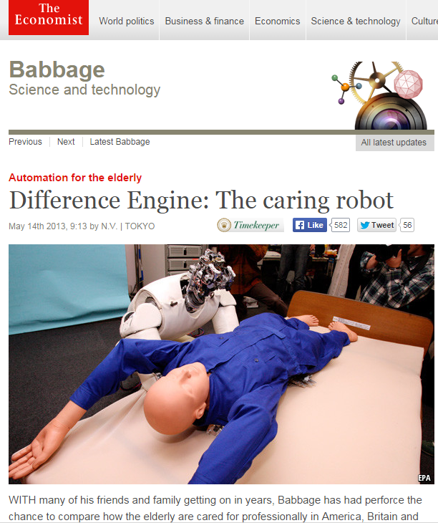
Productivity increases and technological substitution can address some labour shortages
Or is productivity growth and innovation hampered in older societies?

Slide 32
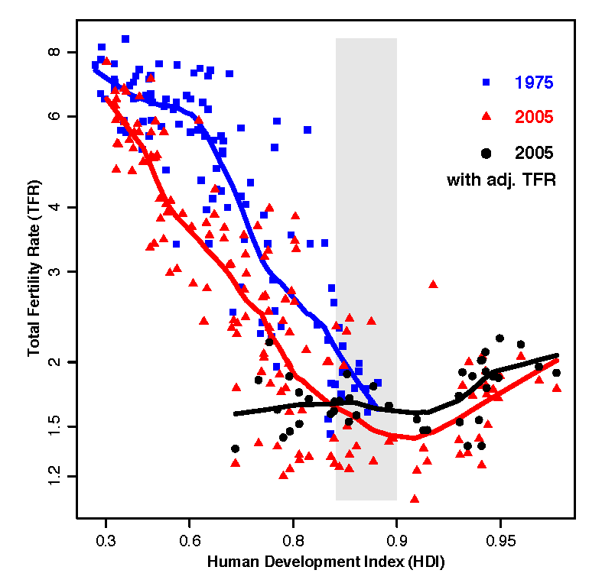
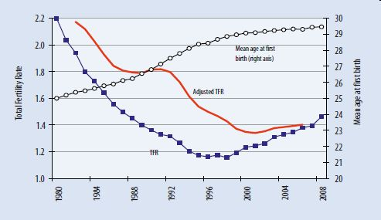
Rebound in European Fertility?

