Slide 1
Environment, Climate Change and Conflict

Slide 2

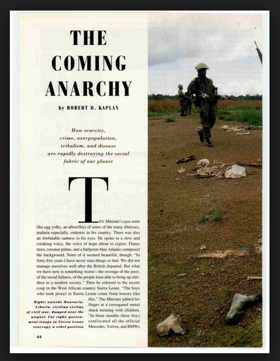
Population, Environment, Resources
Struggle for survival has connotations of fighting for limited resources
Books like Diamond’s Collapse point to importance of environmental factors
Kaplan to resource depletion and anarchy

Slide 3
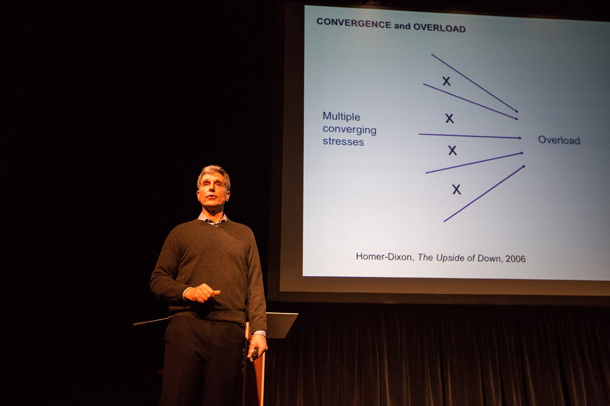
Population, Environment, Resources
We are ‘on the threshold’ of an era in which armed conflicts and security concerns will come frequently and primarily from environmental change –
Thomas Homer-Dixon 1991, 1994

Slide 4
Mechanisms (Homer-Dixon)
Decrease in supply of renewable resources due to climate change or exploitation
Increase in demand for renewables due to population growth or other factors
Inequalities in distribution of resource access due to political institutions

Slide 5
Local Environmental Pressure
Deforestation, overgrazing, pesticides, intensive fish farming, draining water table: erosion, silting, bacterial blooms
Damming, diverting water supply: flood communities, drought
nuclear, mining, industrial: toxic waste and pollution, acid rain, crop poisoning, well poisoning

Slide 6
Global Climate Change
Global warming
23 scenarios IPCC: between 1 and 6.5 degrees C increase to 2100
Number and intensity of severe weather events
Heat waves, droughts, pests, loss of agricultural productivity
Nonlinear ‘tipping’: gas release, temperature hike, microbial explosion
Pandemic, mass migration, famine

Slide 7
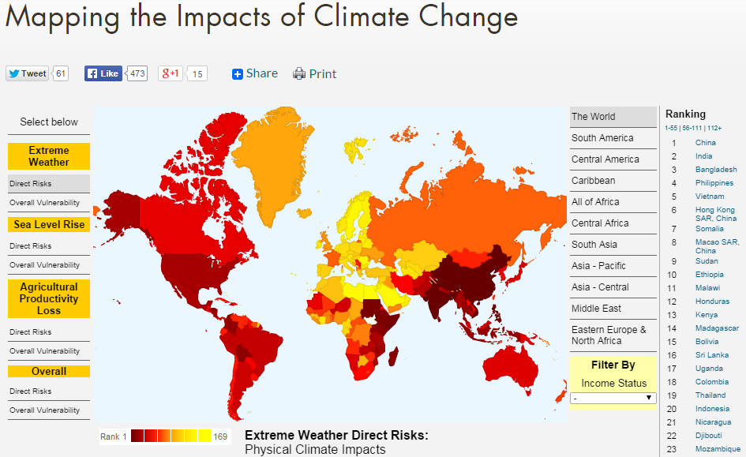

Slide 8
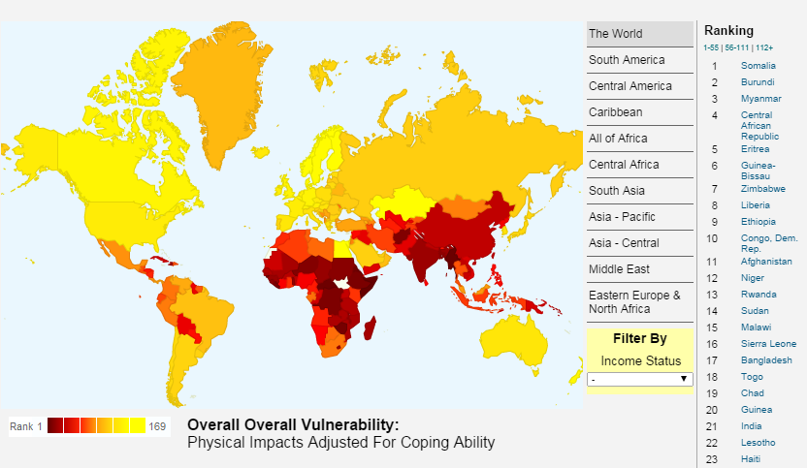

Slide 9
Interplay of Population Growth, Poverty, Climate
Sub-Saharan Africa (Sahel and South), parts of S and SE Asia, least able to cope, esp. water scarcity
Hot spots: degradation of fresh water, decline in food, storm and flood disaster, rising sea levels, environmentally-induced migration
Migration: Stern claims ‘200 million or more’ may be permanently displaced
Make poverty reduction and development more difficult

Slide 10
Skeptics
Historical record does not show much connection between environmental problems and large-scale conflict
Current models of conflict find only limited links between population growth, density, intensity of resource use, and civil war
Climate change: often gradual, warmer weather may aid agriculture and life chances in some places

Slide 11
Case Study: Water Wars?
Imagine you share a lake with a neighbour. Either side can poison the lake, use it up
Too much at stake, too little to be gained by war
Dabelko: No nations have gone to war specifically over water resources for thousands of years.
Others largely concur, but suggest this somewhat of an overstatement

Slide 12
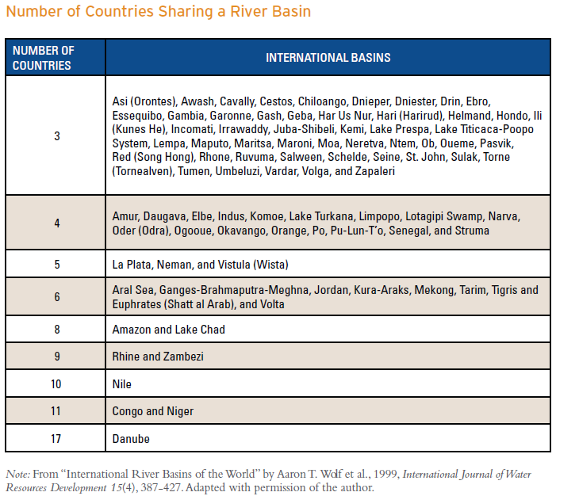

Slide 13
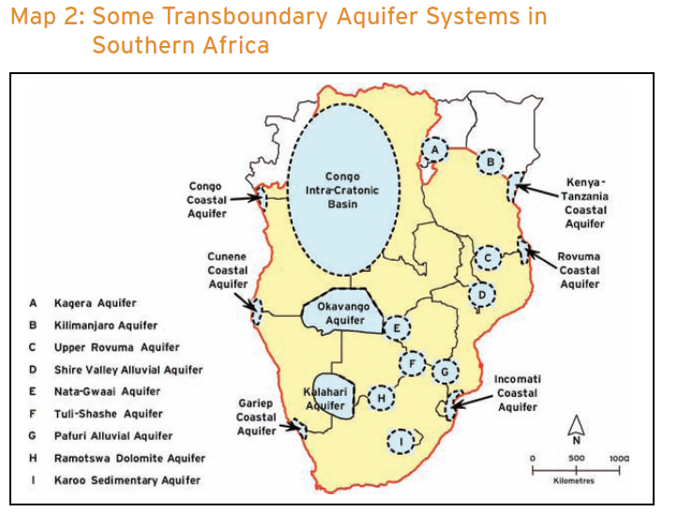

Slide 14
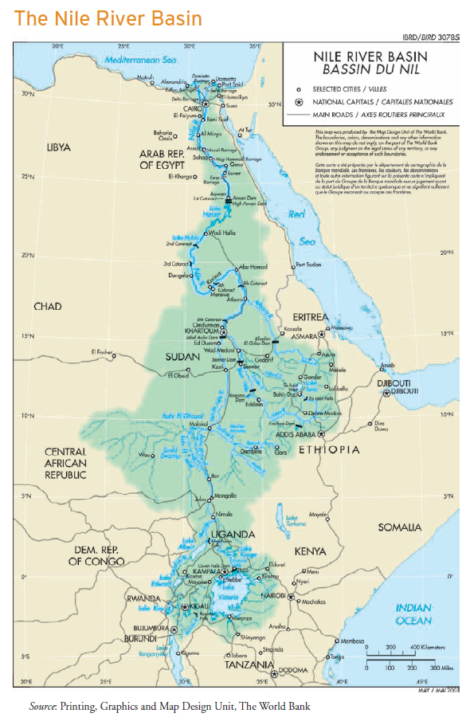
Why no War?
Egypt and Sudan hold absolute rights to use 100 percent of the river’s water under agreements reached in 1929 between Egypt and Britain ..and in 1959 between Egypt and Sudan

Slide 15
…
Other Nile basin countries do not develop on Nile as require Egyptian consent
Demand for renegotiation, but no war
Jordan River (Israel-Jordan); Indus (India-Pakistan); Mekong (Vietnam, Laos, Cambodia) River Commissions, all functioned while countries at war
Dabelko: Rivers and water bodies actually a source of trust-building between warring parties
Interdependence offers incentive to share resource

Slide 16
Resource Depletion, Pollution or Degradation
Goldstone: 'long term environmental degradation…has little or no significant role’ in fomenting conflict
Locals can alter patterns of resource use (ie less water-intensive crops)
Urbanization may relieve pressure; state can step in
People adjust to long-term changes
Rural areas may not be politicised or organised for rebellion against the state and centre
Goldstone: Must engage the state, or a faction within it, to instigate large-scale conflict

Slide 17
But Population-Environment Can Matter
Conflicts within states more than between
Small-scale more than large-scale conflicts
Sudden climate events rather than gradual shifts
Conditioning factor rather than driver
Interactions with weak states, cultural cleavages
Threshold effects in the future? (climate change?, sudden events?)

Slide 18
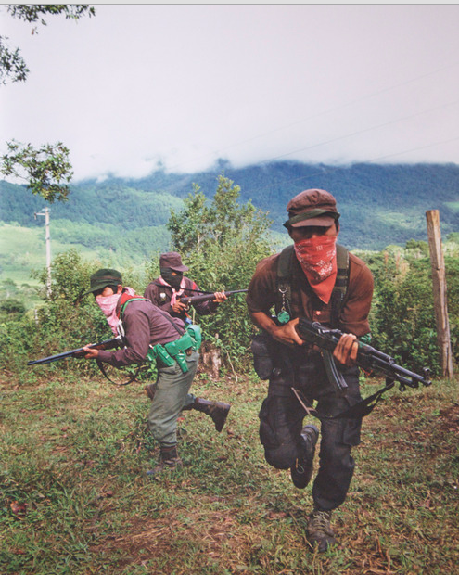
Rural Land Conflict
Most civil wars in countryside
Long history of rural rebellions and peasant wars caused by peasant population pressure for land against landlords
From 1789, 1848, 1917, 1949…anti-landlordism feeds conditions for revolution
Urdal finds link between land scarcity and rural population growth in India, as well as growth x density

Slide 19
Landlords often industrial, commercial. Connected to government
Insurgent groups can harness rural discontent over land. Population pressure fuels this
Urbanisation may relieve pressure
Rural masses must link to existing faction or to state against another state. Else suppressed or small scale discontent

Slide 20
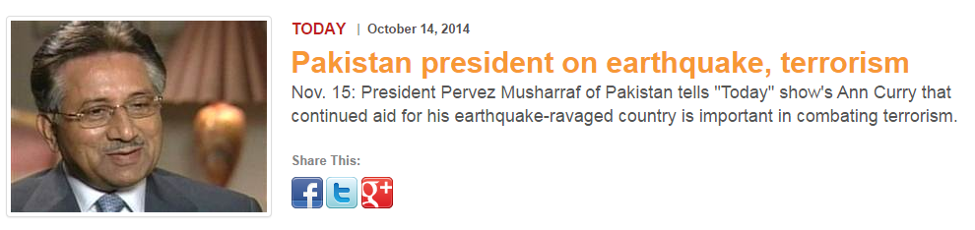
Sudden Events
Hurricane Hazel 1954 in Haiti, 1972 Nicaragua earthquake, Chernobyl 1986, 1988 Armenia earthquake, Pakistan earthquake 2014
Depends on how population evaluates performance of govt

Slide 21
Non-renewable resources
‘Resource curse’ of oil (Niger delta); diamonds (Liberia; Angola; Congo)
‘Greed’ hypothesis in civil war
Lootable resources and oil/mineral exports linked to higher incidence of civil war
Valuable to state or insurgents, whereas renewable resources harder to exploit for cash. Opium and other high-end crops an exception

Slide 22
Ethnicity
Migration across tribal or ethnic homelands within a country
Migration across borders
‘Sons of the Soil’ wars (Fearon & Laitin)
Transmigration (i.e. Han in Xinjiang or Tibet; Sinhala in Jaffna; Javanese in W. Papua)
Migration and refugees: Palestine-Lebanon? Syria-Turkey? Zimbabwe-S Africa?

Slide 23
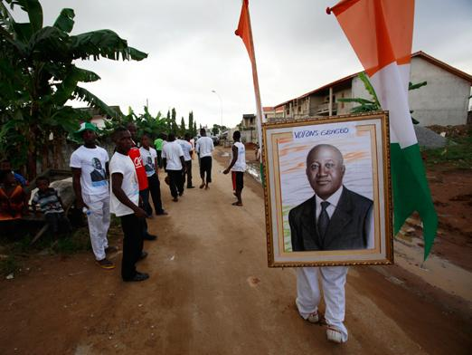
Sons of the Soil wars
Impetus given to members of dominant or trader groups to move to sparsely populated areas
Helps political control by dominant ethnic group
Xinjiang, Kirghizstan, Jaffna, USSR, W. Irian…
Ecological element: role of dams in flooding out natives; locals driven off prime land

Slide 24

Some 50,000 Egyptian Nubians were forced to move from 45 villages and relocated to Aswan, which has become a New Nubia… a charmless development of small concrete housing which, unlike the lush Nubia they left behind, lay in the desert.

Slide 25

Migration sometimes voluntary (Kenya?, Ivory Coast, Uganda…)
Interaction of landless ‘authochthons’ and ‘aliens’
State can also mobilise autochthons against migrants (Ivory Coast, Assam)

