Slide 1
Youth Bulges and Violent Conflict

Slide 2
Huntington on the youth bulge
I don’t think Islam is any more violent than other religions . . . But the key … is the demographic factor. Generally speaking, the people who go out and kill other people are males between the ages of 16 and 30. During the 1960s, 1970s, and 1980s, there were high birthrates in the Muslim world, and this has given rise to a huge youth bulge – Samuel Huntington, after the 9/11 attacks

Slide 3
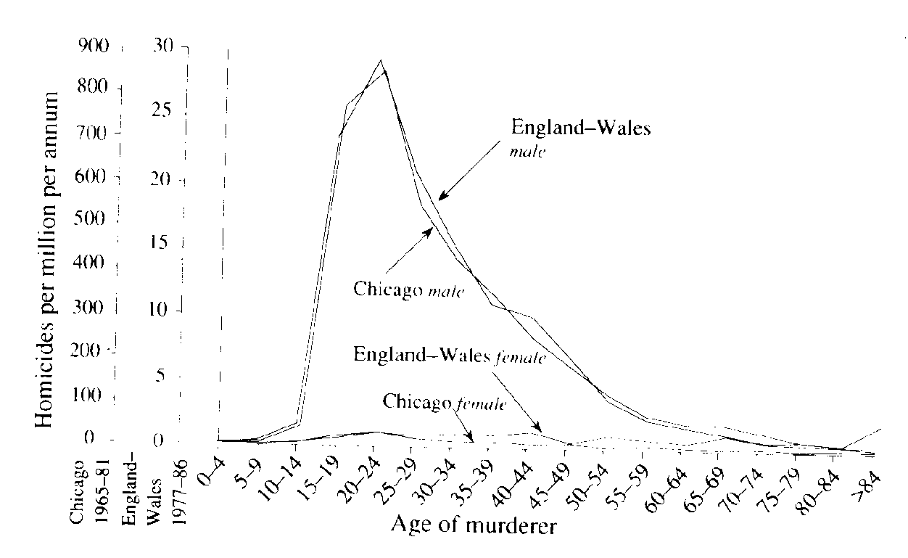
Young Men and Violence?
Figure 1. Age-specific rates of killing nonrelatives for each sex in the United Kingdom and Chicago. Although murder rates are 30 times higher in Chicago, shapes of the curves are nearly identical in both places. Murders are almost invariably committed by young men, not by females or by older males. [Adapted from Daly and Wilson (1990).]

Slide 4

Young Men and Violence?
“Young men who loved the ruins, loved the destruction, loved the power that came from the barrels of their guns," - Michael Ignatieff, Blood & Belonging (1995)
Freudian, sociobiological argument about 18-25 males

Slide 5
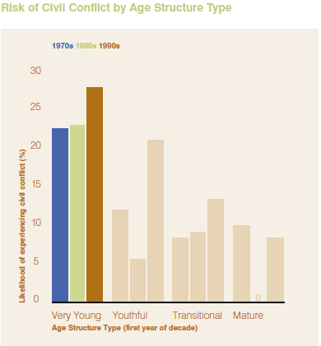
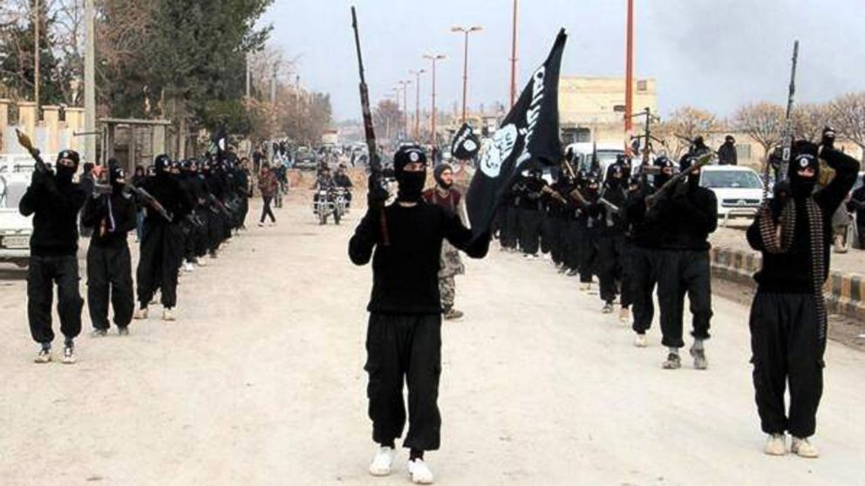
Younger Countries More Violent

Slide 6
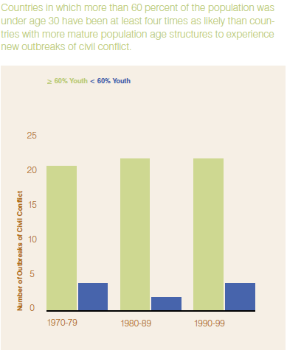
Is it really the youth bulge that is to blame?
There is a strong correlation between youth bulges and violence, but is this spurious?

Slide 7
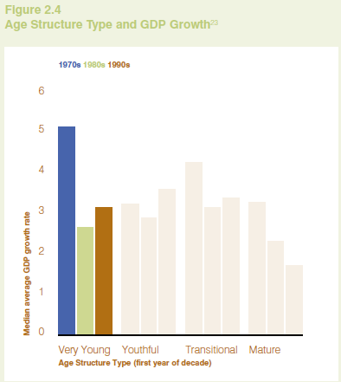
.....
Poverty is also correlated with a young age structure; so is religiosity, non-western location, non-democracy, weak states

Slide 8
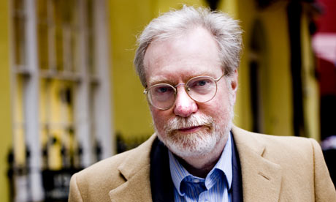
Skeptics
Collier & Hoeffler 2004 and Fearon & Laitin 2003
Controlling for weak state, GDP/capita, democracy and other factors, no youth bulge effect

Slide 9
Urdal’s Argument
Other authors have miscalculated age structure by taking share of young adults/total population, ie. (18-25 yr olds)/ (0+ population)
If you instead take 18-25/18+ population you get a different result
Screens out the large number of very young societies where 18-25/0+ is small because of so many 0-18s

Slide 10
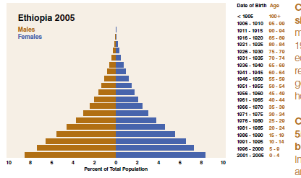
…..
Though a small share relative to the under-15s, the 15-24s could still be a big group relative to the 25+s
So there is still a youth bulge
And the difference in measures matters most in underdeveloped countries, where there is most conflict

Slide 11
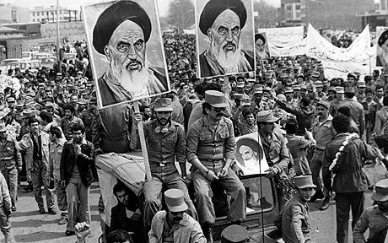
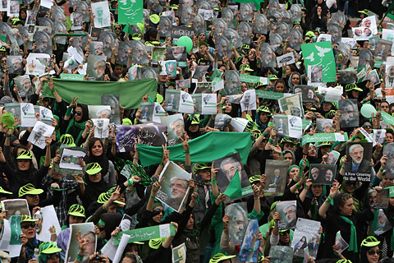

Slide 12
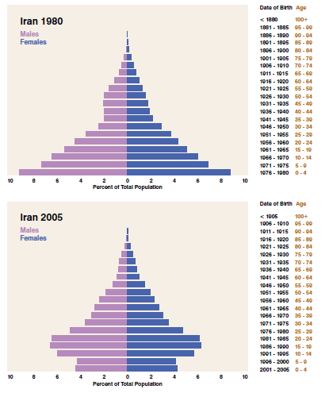

Slide 13
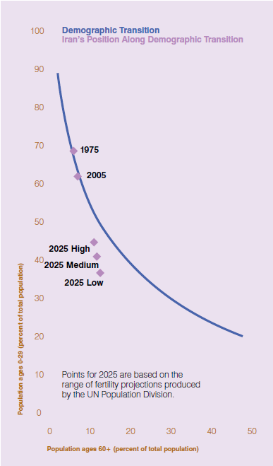
Iran has moved along its demographic transition since 1975
But 18-25 (or 18-30) as share of adult population has not changed
Big change will come in next 20 years

Slide 14
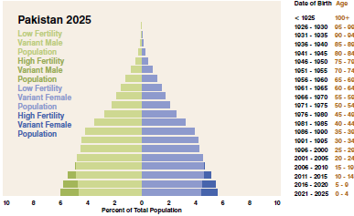
No Changes Forecast for Youngest..

Slide 15
Direct v Indirect Effects
No direct effect in that generations don’t usually have power struggles/conflicts with each other
But demography usually mediated by other factors such as weak state, democratization, economic crisis
  Youth bulge reaches adulthood unemployed people at violent ages insurrection OR
  Youth bulge reaches adulthood in developing, peaceful society with state education and inward investment: more energetic workers of productive age = ‘demographic dividend’

Slide 16
Mechanisms
More young, unemployed men on the streets lowers cost of recruitment into insurgencies (rational choice ‘greed’ view, akin to instrumentalism)
Blocked upward mobility causes resentment (‘grievance’ view, also part of instrumentalist theory except if states repress, creating memories)
Education can be a problem: N Africa

Slide 17
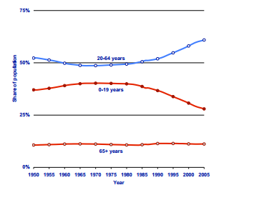
Ireland’s Demographic Dividend

Slide 18
Level of Violence
Demographics associated with low-level violence (i.e. Fearon-Laitin’s ‘sons of soil’ wars)
Less so with large civil wars, which require other factors
Urbanization tends to involve young people moving to cities. ‘Youth bulge’ in cities
Civil wars in countryside, riots in cities (except revolutions/coups)
Perhaps link between demography and riot/revolution, but not with large scale civil war

Slide 19
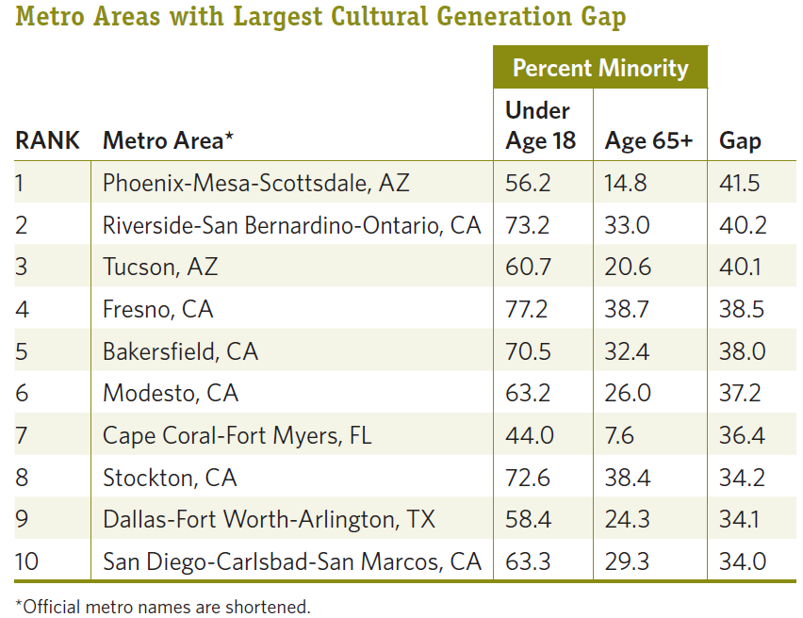
Ethnicity and Age Interaction
Source: Frey, W. 2010. Baby Boomers and the
New Demographics of America’s Seniors

Slide 20
Leuprecht argument
N Ireland: young Catholics v older Protestants
  Lowers cost of Catholic recruitment to IRA
  Increases fear of Protestants, hence intransigence for reform
Falling Catholic birthrate:
  Increases urgency of SF/IRA
  Decreases fear of Protestants

Slide 21
Conclusion
Debate over whether youth bulge causes more conflict, or whether something else associated with young populations
Debate over whether greed or grievance drives conflict
Debate over which kinds of violence are affected
Interactions and second-order effects are at work

