Slide 1
Demography, Migration and Power
Concepts and Trends

Slide 2
Demography: Main Factors
Endogenous (Internal) aspects: fertility, mortality level (infant mortality, life span) = natural increase
Exogenous (External) aspect: net migration = immigration - emigration.
Age structure
Mathematical formulas link age structure, fertility, mortality, migration, and population growth
TFR – total fertility rate
Demography is the mechanism behind the natural selection process in the evolution of populations

Slide 3
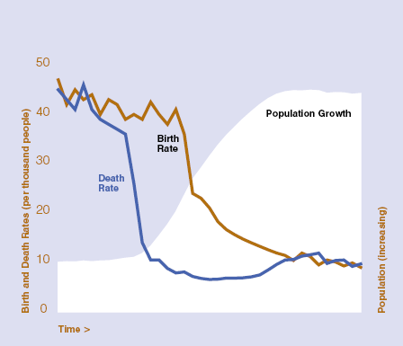
Demographic Transition
Begins in Europe in late 18th c.
Spreads to much of the rest of the world in 20th c
TFR below 2.1 in most of East Asia, Brazil, Kerala, Tunisia, Iran…
World TFR is just 2.55. UN predicts World TFR falling below replacement (2.33) during 2020-2050

Slide 4
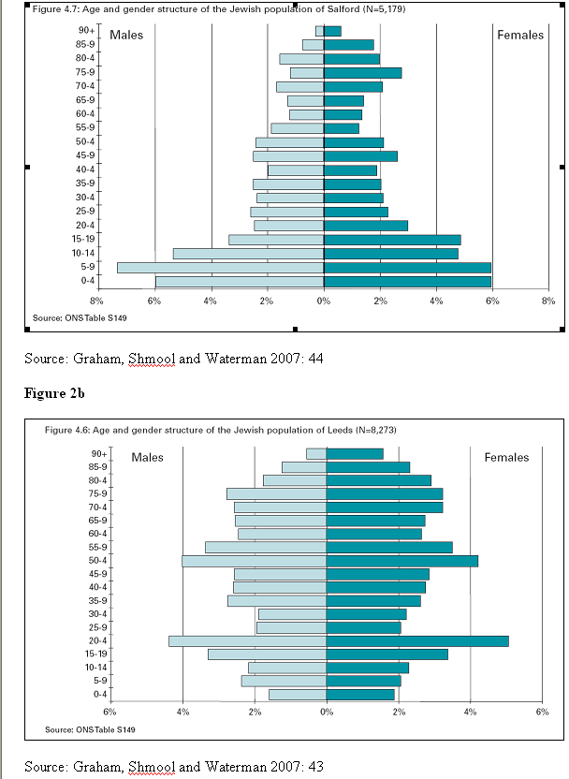
A Tale of Two Cities’ Jews: Salford v Leeds

Slide 5
Groups: Primordial or Constructed?
Theories of nationalism
How quickly can group boundaries be constructed, invented?
Rigidity or flexibility of ethnic boundaries.
  Varies by type of group: state v ethnic group
  Varies by location: North India v Caribbean
  May be rooted in specific traditions concerning boundary maintenance of patrilineal v matrilineal descent rules (Wimmer)

Slide 6
Demography and Group Conflict
Political demography studies unevenness between demographic populations, which correspond – however imperfectly - to political groups
Ethnic groups, regions, nations, civilizations - are distinct populations, though not clear where boundaries lie
National or ethnic populations are almost never totally separate: assimilation and dissimilation can muddy the waters of identity. Ethnic people can change their identity and immigrants can assimilate into a new ethnic identity over generations

Slide 7
Which Groups?
City, region, ethnic group, nation, religion, civilization
Ages, Sexes - still constructed (gender, generation)

Slide 8
Pathways from demography to politics
Politics affects, and is affected by, all demographic variables
Conflict leads to ‘wombfare’, i.e. Arafat “the womb of the Arab woman” as ultimate weapon OR Jewish celebration of high Orthodox birthrates; or differential birthrates lead to conflict
Often demography works in tandem with other factors, i.e. economic problems, political instability, painful ethnic memories, state fragility

Slide 9
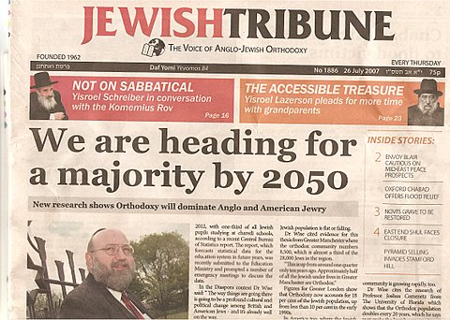
Direct Political Demography
Direct (1st order): Demographic differences change social composition
i.e. Upsurge of Evangelical Protestants in USA; Catholics in N. Ireland; ultra-Orthodox in Israel

Slide 10
Second Order Change
Second order: Demographic changes change age composition and that directly affects outcomes
i.e. 1-lower mortality and lower fertility=2-more elderly dependents per working age adult = Pension burden increases
i.e. Unemployment increases with bulge in 18-25 population

Slide 11
Third Order
Third order: Demographic changes change age composition and that indirectly affects outcomes
1-Higher fertility or lower mortality for 20 years=2-more young adults needing work = 3-unemployment, grievance and idleness = rise in protest or insurrection

Slide 12

Demography and Ethnic Conflict: Northern Ireland
"The basic fear of Protestants in Northern Ireland is that they will be outbred by the Roman Catholics. It is as simple as that." - Terence O’ Neill, Unionist PM of Northern Ireland after resigning, 1969

Slide 13
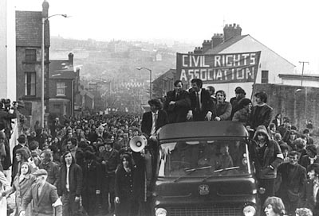
Four steps upstream?
Catholic fertility & growth
Protestant fear
Stalled reform
Catholic violence
Protestant retaliation

Slide 14
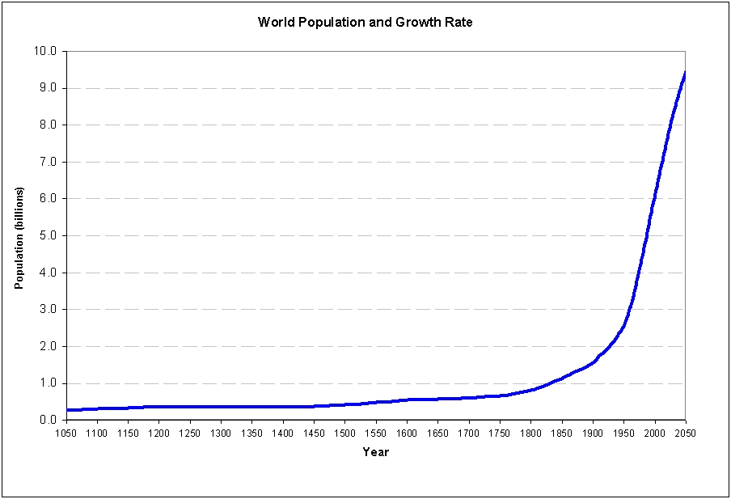
Why Now?

Slide 15
Why Now?
Speed of Change (Transition, Urbanization, Migration)
Unevenness of change
Globalisation
Democratisation**

Slide 16
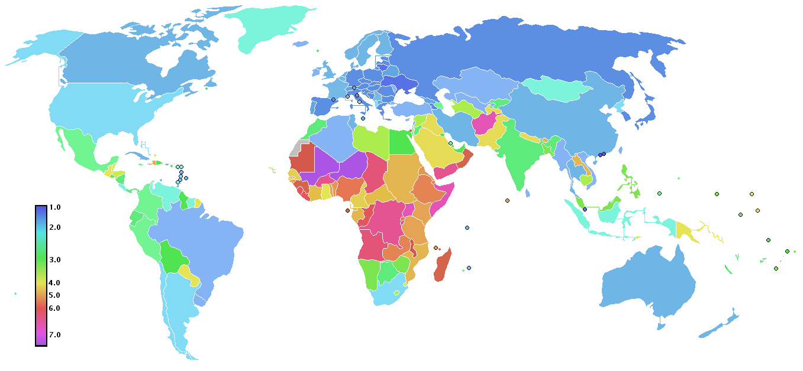
Total Fertility Rates by Country, 2008
Source: CIA World Fact Book 2008

Slide 17
Megatrends
Rise of non-West
Aging of developed world
Youth bulge
Mass urbanization
Common disease pool?
Mass migration across political/ethnic boundaries?

