Slide 1
The World Population Revolution

Slide 2
Demography: Main Factors
Endogenous (Internal) aspects: fertility, mortality level (infant mortality, life span) = natural increase
Exogenous (External) aspect: net migration = immigration - emigration.
Age structure
Mathematical formulas link age structure, fertility, mortality, migration, and population growth
TFR – total fertility rate
Demography is the mechanism behind the natural selection process in the evolution of populations

Slide 3
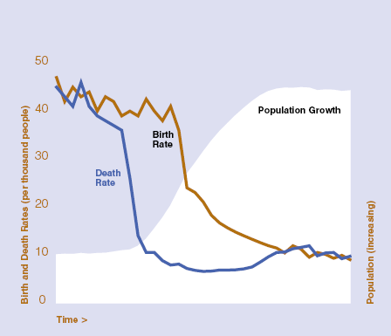
Demographic Transition
Begins in Europe in late 18th c.
Spreads to much of the rest of the world in 20th c
TFR below 2.1 in most of East Asia, Brazil, Kerala, Tunisia, Iran…
World TFR is just 2.55. UN predicts World TFR falling below replacement (2.33) during 2020-2050

Slide 4
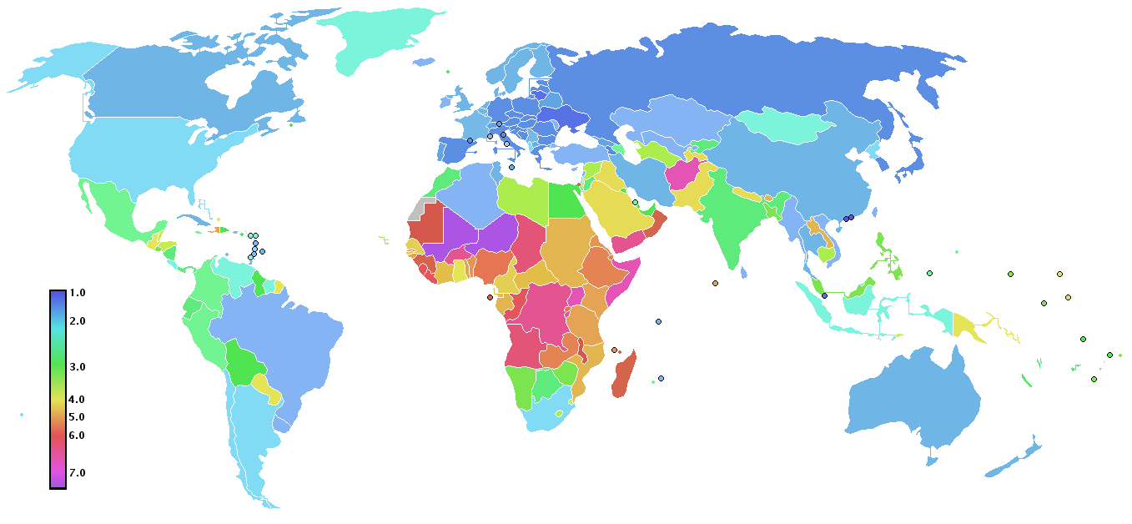
Total Fertility Rates by Country, 2008
Source: CIA World Fact Book 2008

Slide 5
Megatrends
Youth bulge
Rise of non-West
Aging of developed world
Mass migration across political/ethnic boundaries?
Mass urbanization
Common disease pool?

Slide 6
Huntington on the youth bulge
I don’t think Islam is any more violent than other religions . . . But the key … is the demographic factor. Generally speaking, the people who go out and kill other people are males between the ages of 16 and 30. During the 1960s, 1970s, and 1980s, there were high birthrates in the Muslim world, and this has given rise to a huge youth bulge – Samuel Huntington, after the 9/11 attacks

Slide 7
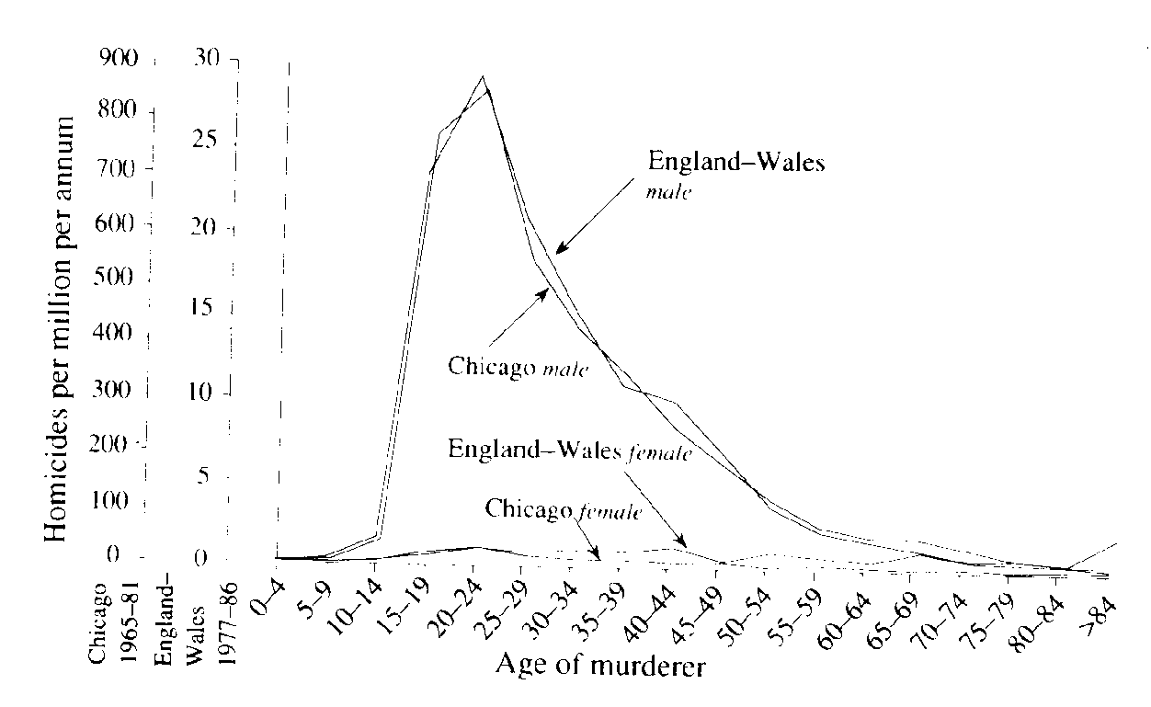
Young Men and Violence?
Figure 1. Age-specific rates of killing nonrelatives for each sex in the United Kingdom and Chicago. Although murder rates are 30 times higher in Chicago, shapes of the curves are nearly identical in both places. Murders are almost invariably committed by young men, not by females or by older males. [Adapted from Daly and Wilson (1990).]

Slide 8

Young Men and Violence?
“Young men who loved the ruins, loved the destruction, loved the power that came from the barrels of their guns," - Michael Ignatieff, Blood & Belonging (1995)
Freudian, sociobiological argument about 18-25 males

Slide 9
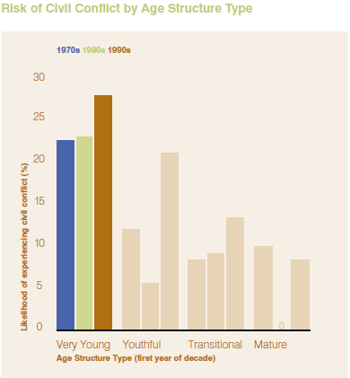
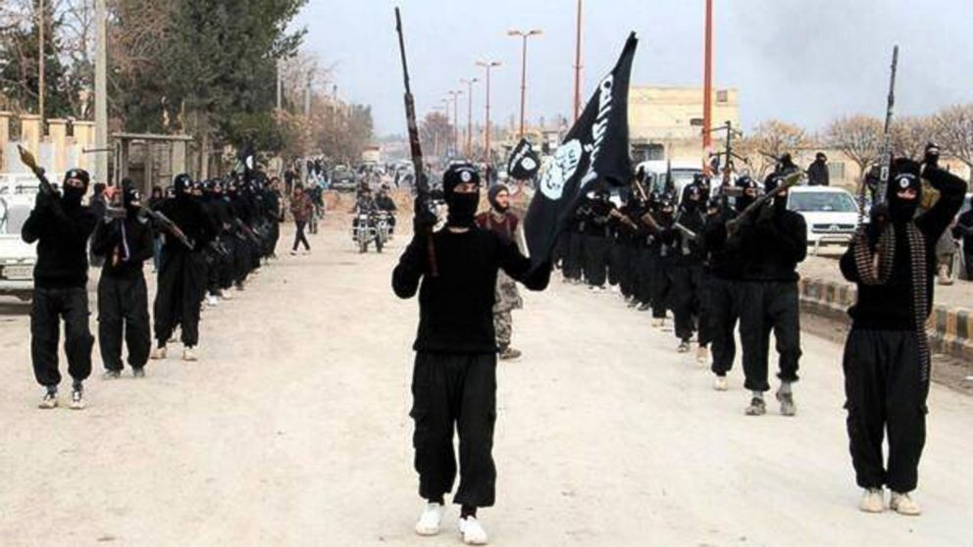
Younger Countries More Violent

Slide 10
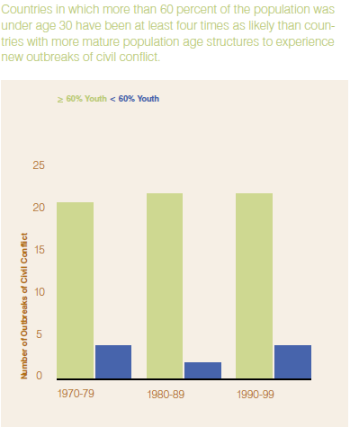
Is it really the youth bulge that is to blame?
There is a strong correlation between youth bulges and violence, but is this spurious?

Slide 11
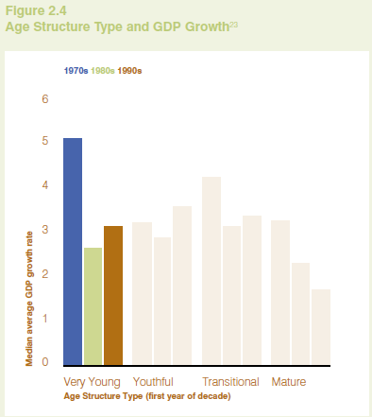
.....
Poverty is also correlated with a young age structure; so is religiosity, non-western location, non-democracy, weak states

Slide 12
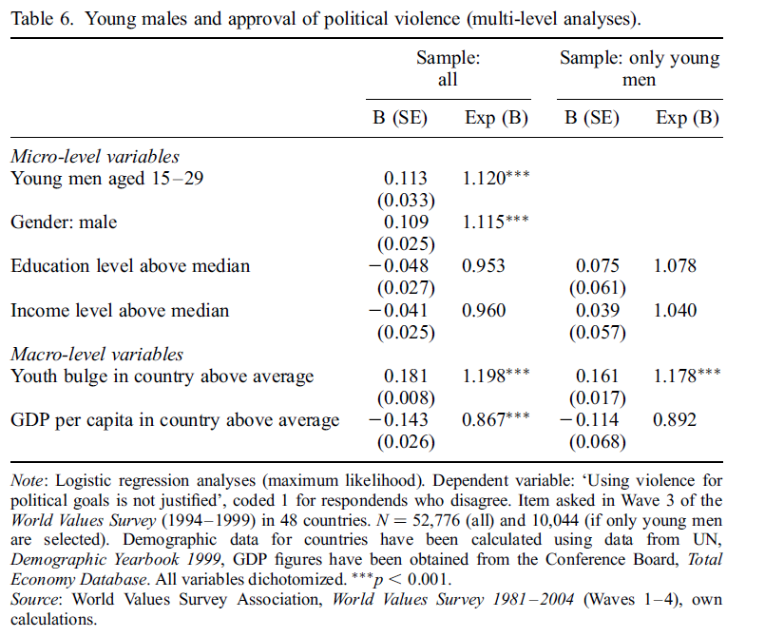
Young Men Sanction Violence?
Young men more likely to express extremist attitudes and approve of violence

Slide 13
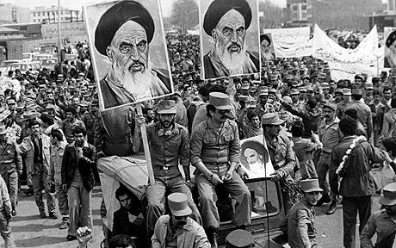
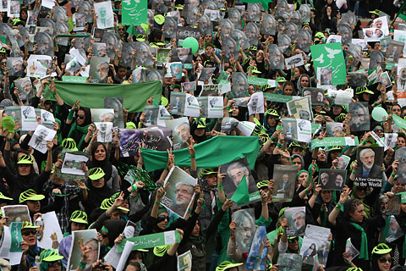

Slide 14
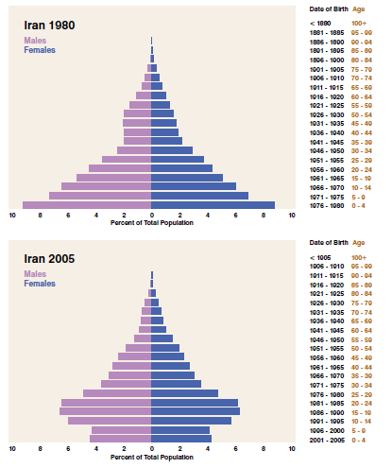

Slide 15
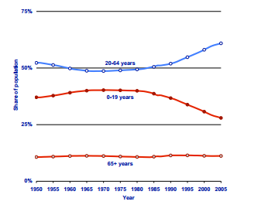
Ireland’s Demographic Dividend

Slide 16
Aging and international relations

Slide 17
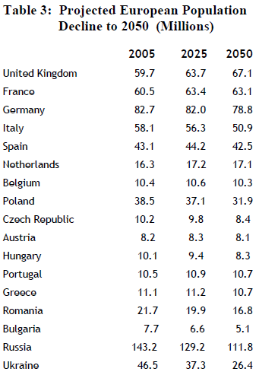
Source: Goldstone, ‘Flash Points and Tipping Points’, 2007

Slide 18
World's Oldest Countries, 2000 and 2050
in 2000 in 2050
Country
15-59
60+
15-59
60+
Italy
61.7
24.1
46.2
42.3
Greece
61.5
23.4
46.2
40.7
Germany
61.2
23.2
49.5
38.1
Japan
62.1
23.2
45.2
42.3
Sweden
59.4
22.4
48.3
37.7
Belgium
60.6
22.1
50.3
35.5
Spain
63.5
21.8
44.5
44.1
Bulgaria
62.6
21.7
47.6
38.6
Switzerland
62.1
21.3
48.6
38.9
Latvia
61.7
20.9
47.5
37.5
Portugal
62.5
20.8
49.9
35.7
Austria
62.6
20.7
47.4
41.0
United Kingdom
60.4
20.6
51.1
34.0
Ukraine
61.6
20.5
49.0
38.1
France
60.7
20.5
51.3
32.7
Estonia
62.1
20.2
48.5
35.9
Croatia
61.8
20.2
53.0
30.8
Denmark
61.8
20.0
53.0
31.8
Finland
62.0
19.9
50.6
34.4
Hungary
63.3
19.7
49.4
36.2
Norway
60.7
19.6
51.7
32.3
Luxembourg
62.0
19.4
57.1
25.2
Slovenia
65.0
19.2
45.1
42.4
Belarus
62.4
18.9
49.6
35.8
Romania
62.9
18.8
50.0
34.2
Source: Goldstone 2007

Slide 19
Population Aging
Future aging built into population age structure. Demographic momentum
Immigration would have to be ‘orders of magnitude higher’ (Haas) to compensate
Fertility unlikely to radically change. Decades-long pattern
Fewer workers per dependant
Older people vote more, will vote for spending for elderly and healthcare

Slide 20
Big drop in working age population to 2050: Russia -27, Germany -25, China -19, Japan -32
*China as old as W Europe by 2035
But rise of 17 in USA, 5 in France, 2 in UK
US in best position, but with powerful old-age lobby (AARP)

Slide 21

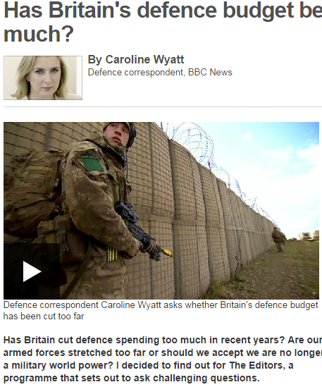
Guns vs. Canes

Slide 22
Aging and the Military
Decrease in tax revenue as fewer workers
Increase in spending on elderly
Decrease in savings as elderly spend lifetime savings
Less money for military expenditures

Slide 23

Sons and war
Surplus sons, as well as youth bulge, contribute to warlike behaviour
Iraq, Afghanistan
Lebanon 1975 v 2006
In aging societies like China, little appetite for sacrificing ‘little emperors’

Slide 24
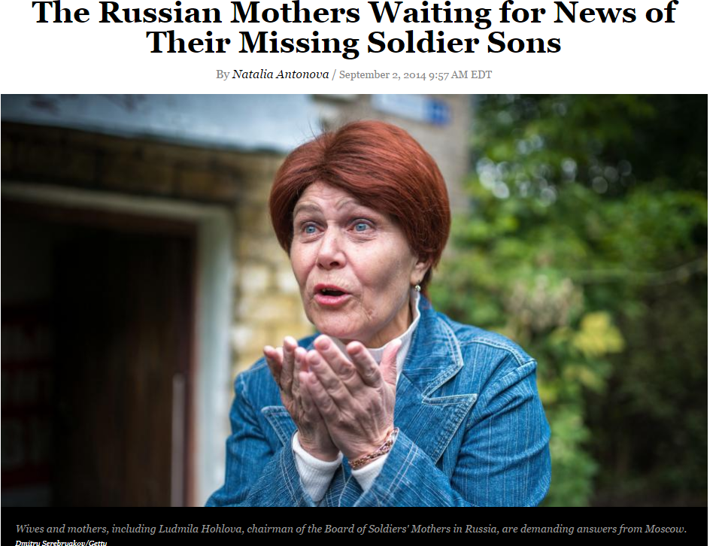

Slide 25
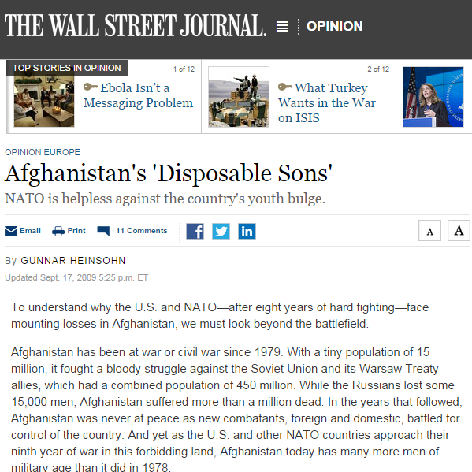
Bring our boys home
Will aging sharpen divide between growing and aging societies?
Less 1st world intervention in the developing world?

Slide 26
Figure 5: Youth population 2030
UN Department of Economic and Social Affairs (2011) appearing in EUISS ESPAS Report, p.51

Slide 27
Power Shift to Developing World?
Europe, Japan and Russia in decline
China not far behind
US more stable
Mideast, S Asia, Africa rising?
Yet no obvious mideast or African power on the horizon

Slide 28

Demography and Ethnic Conflict: Northern Ireland
"The basic fear of Protestants in Northern Ireland is that they will be outbred by the Roman Catholics. It is as simple as that." - Terence O’ Neill, Unionist PM of Northern Ireland after resigning, 1969

Slide 29
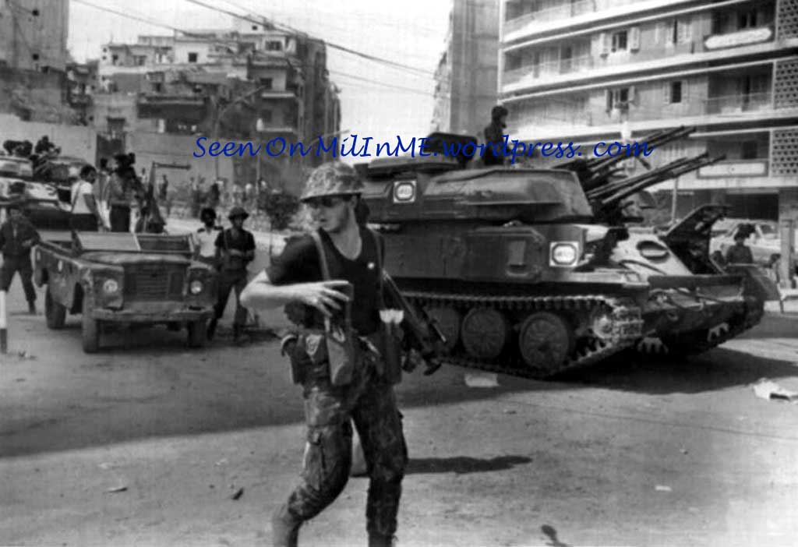
Middle East
Lebanon: Muslim fertility and immigration helped spark civil war
Israel: worries about Jewish-Muslim and secular-orthodox fertility differentials

Slide 30
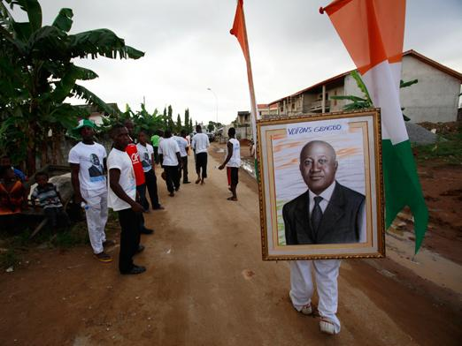

Sons of the Soil Conflicts
‘Our’ land. Concern with migrants
Indigenousness (Eriksen 1993)
Dominant ethnicity; dominant ethno-nationalism (Kaufmann 2004)

Slide 31
Groups: Primordial or Constructed?
Theories of nationalism
How quickly can group boundaries be constructed, invented?
Rigidity or flexibility of ethnic boundaries.
  Varies by type of group: state v ethnic group
  Varies by location: North India v Caribbean
  May be rooted in specific traditions concerning boundary maintenance of patrilineal v matrilineal descent rules (Wimmer)

Slide 32
Which Groups?
City, region, ethnic group, nation, religion, civilization
Ages, Sexes - still constructed (gender, generation)

Slide 33
Conclusion
Population change can affect politics, or politics can affect population change
Often works indirectly or in interaction with other factors
Megatrends: youth bulge, aging North, mass immigration to West, migration to cities
Instability in global South, reconfiguration of international power, pressure on national identity in the West via ethnic transformation, urban reform and unrest

