Slide 1
The Decline of Violence in Human History?

Slide 3
Pinker’s past work
Pinker, an evolutionary psychologist, makes his name for being on the ‘nature’ side of the nature-nurture debate. Critical of the ‘blank slate’ view of human psychology

Slide 4
Decline of Violence in Human History
Importance of dividing by total population
Hunter Gatherer societies: 15 pc violent death rate
Europe: rate of violent death is 2 pc in 17th c. and 1 pc in ‘bloody’ 20th c
US 2005: .0004 pc violent war death, up to .008 if include homicides

Slide 5
5 neurological causes of violence
1-Practical or instrumental (dorsolateral prefontal cortex, toward a goal set up by the Seeking system)
2-Dominance (testosterone-fuled)
3-Revenge (rage system, part of Seeking System)
4- Sadism (esp. Seeking System)
5-Ideology (whole brain)

Slide 6
Innate Violence
Men’s sexual rapacity and proprietary sentiments toward women
Manifestation of parent-child conflict such as infanticide and corporal punishment
Normalization of sexual disgust in homophobia
Meat hunger, thrill of the hunt (for attacks)
Demonisation, dehumanisation of outgroups
Boundaries of empathy based on kinship, reciprocity, and charisma

Slide 7
5 Transitions
Hunter-Gatherer to Agricultural States
Civilising Process in Premodern States
Humanitarian Revolution, 18th c. to 1939
Post-1945 near-end to interstate war and post-1950s rights revolutions
Post-1989 reduction in civil war

Slide 8
5 Main Forces
Leviathan (most consistent, strongest)
Commerce
Feminisation
Cosmopolitanism
Reason

Slide 9
Hunter Gatherer Societies
Chimps - raiding, rape females, attack and eat children. Gang up and murder and tear apart other foragers
Average violent death rates for hunter gather societies past and present. 15 pc. 14 pc for contemporary hunter gatherers
Montenegrins, Europe’s last hunter gatherer society: 24.5 pc death rate
Paleontological and anthropological evidence

Slide 10
Peaceful Primitives?

Slide 11
Leviathan
Monopoly of violence
Stamping out cycle of vendettas
Pinker argues secure environment interacts with our brain regions to reduce likelihood of violence
“Dominance an adaptation to anarchy” - once Leviathan in, anarchy out

Slide 12
State leads to drastic cuts in rate of violence
Less chance of random violence
Pre emptive violence less necessary
Pockets of anarchy in wild regions or down social scale
Still, does not address state cruelty and violence

Slide 13
Civilising Process
Norbert Elias’ term
Conquerors in dark ages lacked reading, manners
Knights mosly marauders. raided each others’ peasants and livestock
Warlords in sea of anarchy
Bloodsports
Cruel punishments
Casual violence in Greek Myths, Old Testament, bit less in bible

Slide 14
Civilising Process
Violence to some degree caused by weakness of self-control
Introduction of manners into European courts. Self-control of personal violence
Hazy line between legitimate and illegitimate use of force in premodernity
16th-17th c professionalisation of military. Drill, discipline
Less use of mercenary, vagabonds, plunder
Rule of Law

Slide 15
Commerce
Lay behind Kantian cosmopolitanism and Enlightenment views of Smith and others
More to be gained by cooperation than conflict
Peace rather than war is in elites’ self-interest
Free trade rather than mercantilism
Rational rather than intellectual or emotional driver of reduced violence
Golden arches theory - no two countries with a McDonalds have gone to war, bar Serbia

Slide 16
Norms Reflected in Casual Violence in early 19th c Popular Culture
Grimm’s Fairy Tales:
A particularly horrific incident occurs in “The Robber Bridegroom,” when some bandits drag a maiden into their underground hideout, force her to drink wine until her heart bursts, rip off her clothes and then hack her body into pieces. …In “Cinderella” the evil stepsisters cut off their toes and heels trying to make the slipper fit and later have their eyes pecked out by doves; in “The Six Swans” an evil mother-in-law is burned at the stake; in “The Goose Maid” a false bride is stripped naked, thrown into a barrel filled with nails and dragged through the streets; and in “Snow White” the wicked queen dies after being forced to dance in red-hot iron shoes.

Slide 17
Enlightenment/Humanitarianism
“Line from” Erasmus, Bacon, Hobbes, Spinoza to Locke, Kant, Bentham, Mill, Jefferson
Ideas expose inconsistencies, spread consciousness
Enlarges circle of empathy to those of other families, classes, religions, nations
19th c horse protections extend to cats and dogs. Humanitarianism and romanticism
Novel/fiction spreads empathy

Slide 18
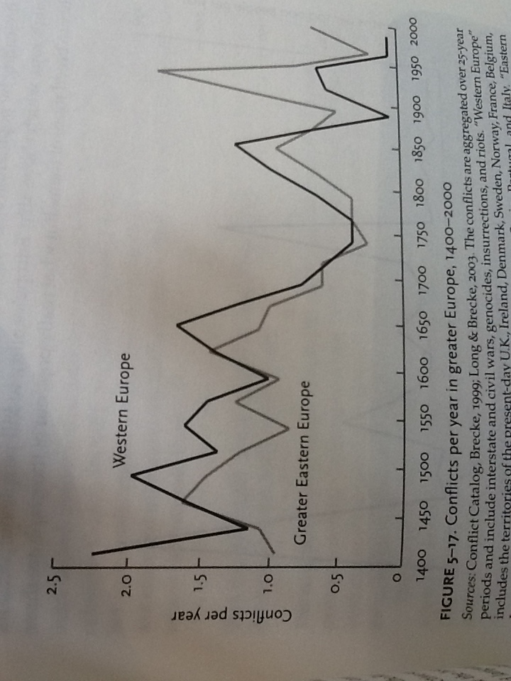

Slide 19
Post-1945
International state system able to seemingly contain interstate war after 1945
Over 90% of wars are internal wars
Decline in interstate, but rise in intra-state, war
Postcolonialism and Cold War accentuate civil war

Slide 20
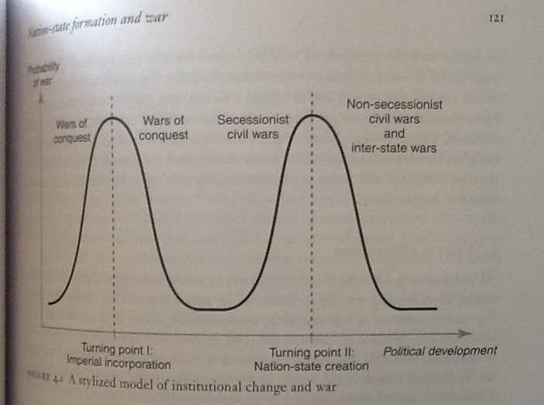
Political Uncertainty tied to War

Slide 21
Democratic Peace?
Idea that two democracies have not gone to war against each other (not quite accurate)
Democracies require more deliberation before going to war, greater public support and consideration of cost
Some contend that illiberal democracies (anocracies) are actually MORE conducive to war

Slide 22
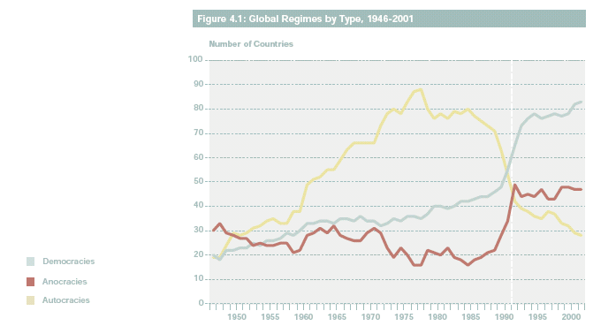
Uncertainties around the end of the Cold War

Slide 23
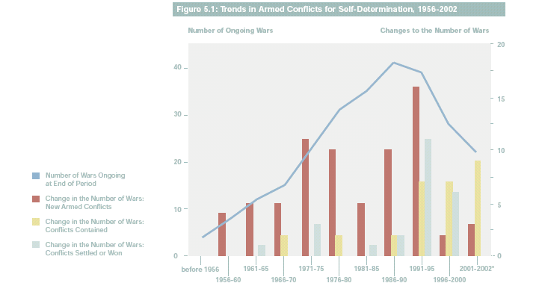
Uncertainties around the end of the Cold War

Slide 25
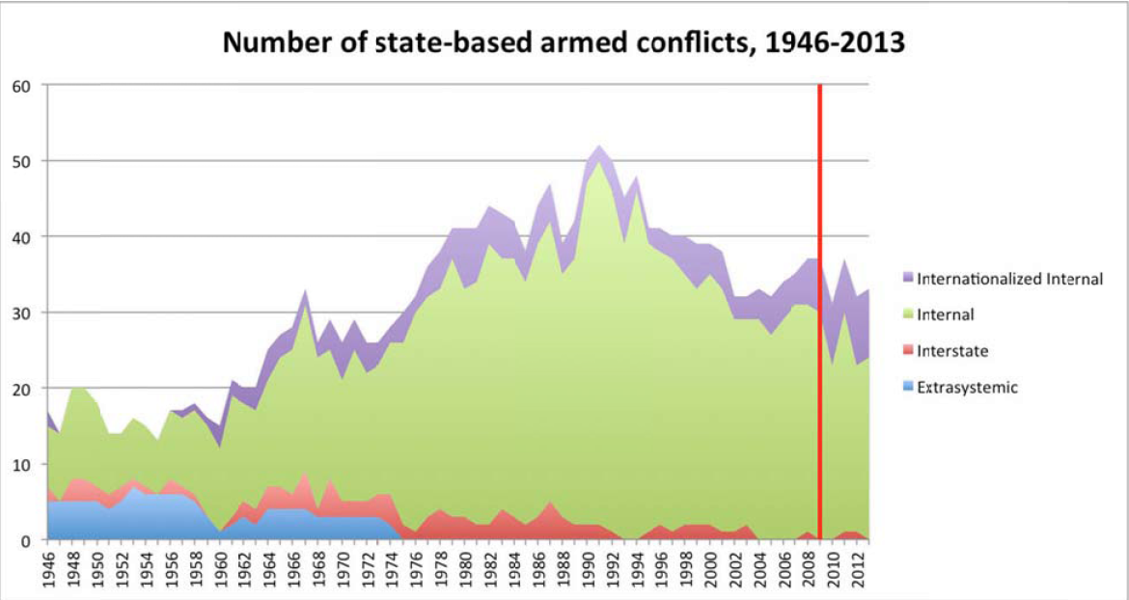
Post-Cold Decline I

Slide 27
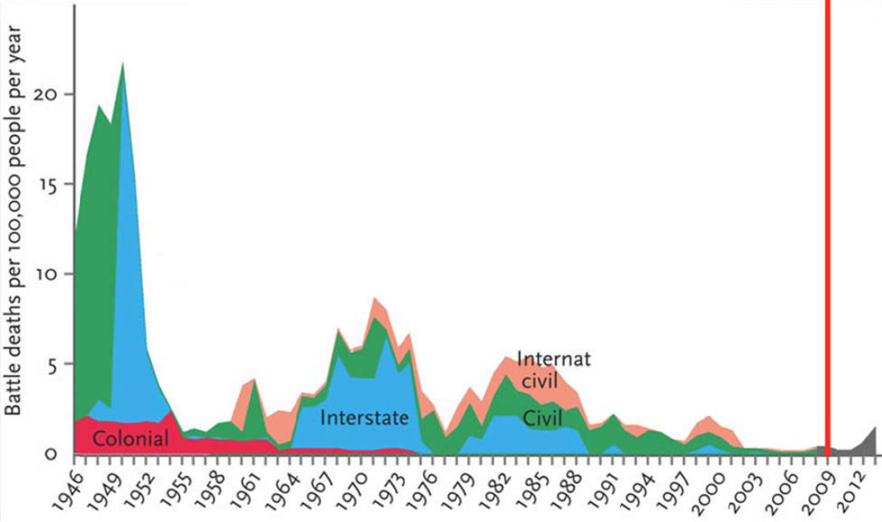
Post-Cold War Decline II

Slide 28
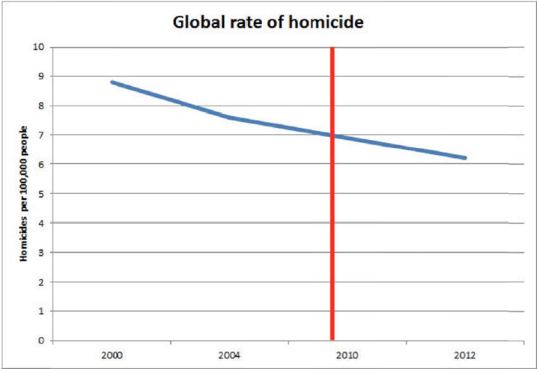
Private Violence Down – connected?

Slide 29
Ads as barometer of toleration for violence
Advertisements no longer advocate physical violence or domestic violence as was the case as recently as 1940s and 1950s
Even executions in US have been declining

Slide 30
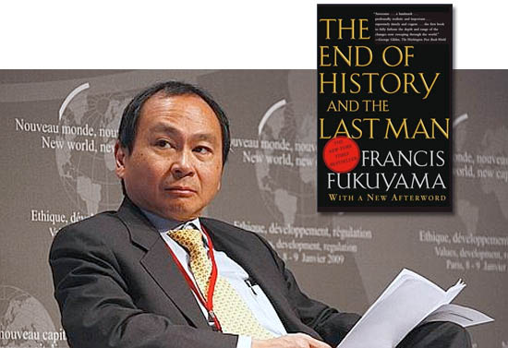
The Optimistic View of the World

Slide 31
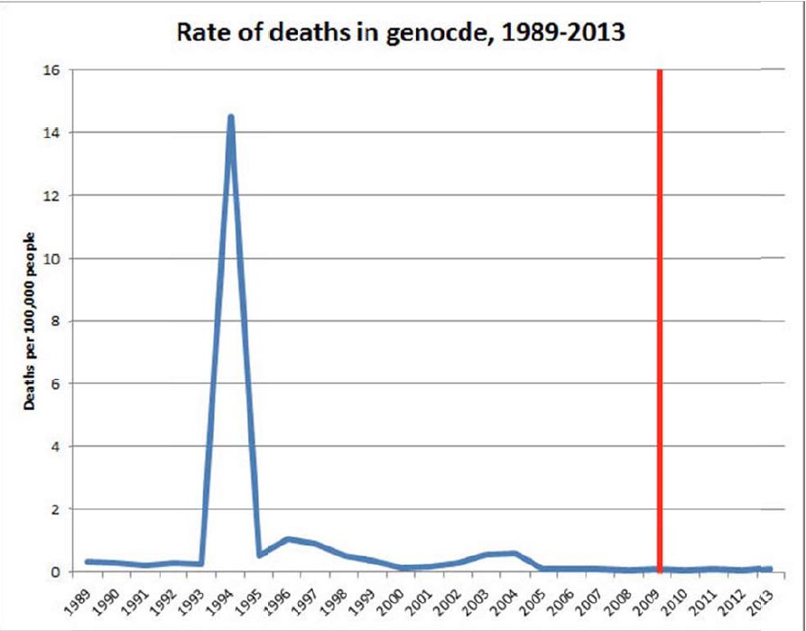
An Age of Genocide?
Not so, argues Pinker:

Slide 32
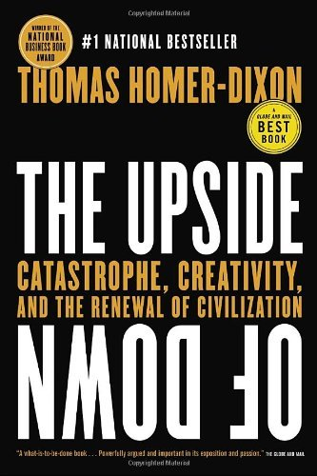
A More Dangerous World?

Slide 33
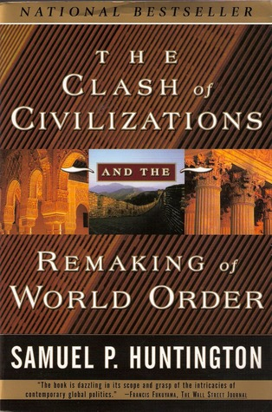
Clash of Civilizations?

Slide 34
John Gray and the Futility of Progress

Slide 35
Nationalism and Religious Fundamentalism?

Slide 36
Conclusion
Pinker sees a decline of violence in human history - even since 1989
Does not preclude ‘blips’ - temporary reversals
Key is environmental stability provided by state monopoly of violence
Commerce and value change have also contributed since the 18th c
An enduring trend or are we merely at a favourable point in a longer cycle?

